Slide 1
Meet the Teacher
Wednesday 28th September
U.K. Class

Slide 2
U.K. Timetable
Forest School will be on a Wednesday.
Miss Dunstall will take U.K. class every Thursday (alternate morning/afternoon).
Rhymes will be taken home weekly this term.
Purple books (Phonics) will be taken home weekly, we will start these soon.

Slide 3

Phase 1
In order for children to be able to read and write well, they must be able to listen very carefully and discriminate between sounds. They should be taught to do this in a fun, exciting and active way with both planned and self-chosen activities.

Slide 4

Phase 1 – The 7 Aspects
Environmental Sounds
Instrumental Sounds
Body Percussion
Rhythm and Rhyme
Alliteration
Voice Sounds
Oral blending and Segmenting (short sounds)

Slide 5
Phase 2
Teach 19 letter graphemes (shapes) and phonemes (sounds) (GPCs) all lower case
Move from oral blending and segmenting to doing the same with letters
Learn to read and spell VC and CVC words using magnetic letters, whiteboards, phoneme fans
Introduced to reading two syllable words and simple captions.
Learn to read the tricky words – I, no, go, the, to

Slide 6
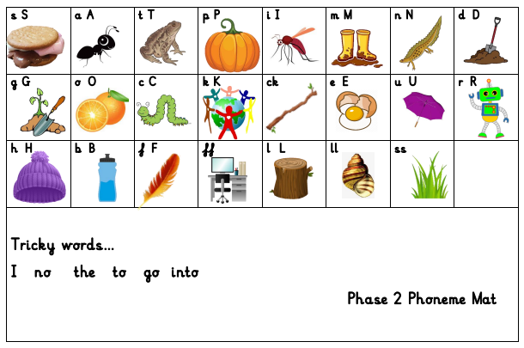
New phonics scheme….

Slide 7
Phase 2 - Writing
Until this point, the children have not been taught to form letters correctly.
We have been doing lots of work in Physical Development to get ourselves ready for writing.
They start by writing these in the air, in the salt, flour, in paint, on each others’ backs and, if appropriate, with a pencil.

Slide 8
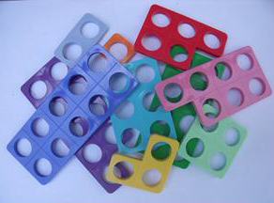
Maths Resources
Recommend;
Number line
2 x dice
Numicon pack
Counters
Number fan
Ideas pack (please ask for a copy if needed)
These basic resources are available online.

Slide 9
Encouraging Independence.
Please involve your child in packing their bag at home. That way they are more aware of what they have brought to school each day.
Shoes – if your child has laces, please ensure they can do these themselves.
Clothing – please support your child in learning how to dress/undress independently.

Slide 10
Reading Books
The children will be bringing home a reading book from school.
Please read with your children as often as possible and write in their reading log.
They should also be encouraged to read ‘real’ books from home or the library. We will be visiting the village library in November. Please try and take your child down and have a look at the lovely children's section.

Slide 11
Reading Books
Reading books need to be sent back in in the book bag.
We read every day with the children in all subjects and will write in their reading logs once a week after whole class, individual or guided group reading. If you feel your child needs to change reading levels please email us.
At this early stage when sharing picture books the focus is on talking through the pictures and developing the use of ‘story book’ language, as their phonic skills develop they will bring home books linked to the sounds we have taught.
When reading the Phonic Reading Scheme Books it is important that phonics is the first and main strategy used to decode the words. Books will be carefully matched to the phonemes they have been taught.

Slide 12
Book Bags
Please use these for books only.
Last year we lost several books because of water bottles leaking on them or fruit going rotten.
Please send these bags in everyday.

Slide 13

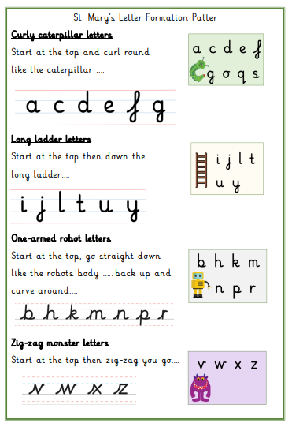

Slide 14
In EYFS and Key Stage 1:
Our priority is meeting the needs of our children – whichever class they are in.
Your child will get the required ‘diet’ for their year group – but also a diet that is tailored to their need – this may look different for children in different classes.
Classes may work completely independently… sometimes.
Classes may work with the class next door… sometimes.
Children may do things with other children in their year group – thus mixing with other classes or doing similar activities… sometimes.
For example: at Christmas, UK will work with Thailand on a performance and India will work with Italy on a different performance – each child will be included.
You may hear that children who are in another class, but are in the same year group as your child, are doing something different from your child – don’t worry! Refer to point 1!
We will try our best to communicate clearly with you.
Notes:
Teachers – please delete (for your notes) – EYFS trip to Two Woods coming up will be ONLY EYFS – because they’ve never been before! Dress up days may be different for different classes or groups – all children will get equal opps. Year 1 in BOTH Christmas performances will be the chorus/choir for example.
Ask parents to EMAIL as a general rule rather than using Dojo (because of GDPR)

Slide 15
School Uniform
Please ensure that all of your children’s school uniform, including PE kits (after Christmas) and coats, is clearly labelled with their name.
If you notice the name is starting to wear off, please could you re-write it so we know to whom items belong.
At the end of the day we try to collect all jumpers and cardigans, etc, from the cloakroom to give out, but please check your children’s jumpers when they get home to ensure they are not wearing somebody else’s.

Slide 16
Learning Journals
One of the ways in which your child is assessed in Reception is through collecting evidence of things they have said or done. These are put into a ‘Learning Journal’, which is simply a scrapbook of your child’s achievements.
Throughout Reception this is used to work out your child’s learning and their next steps.

Slide 17
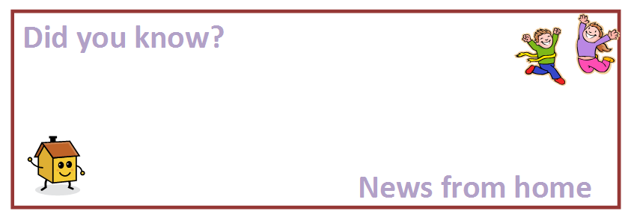
Learning Journals
One of the ways we ask you to help with this is through completing ‘Did you know?’ slips telling us of their achievements and providing evidence of things they have said or done outside of school.
Alternatively you can email photos to illustrate these achievements; ehuntleyhart@stmarysprimarypulborough.co.uk

Slide 18
Behaviour
We follow the school Golden Rules at all times in U.K. class, we have linked these to Mr Potato!
We also follow the school behaviour code in lessons and have high expectations of how we should behave in order to learn.
Good behaviour is reinforced through our PSHE lessons and class assemblies.
We like to focus on positive behaviour and may send your child to share their work with Mrs Copus or Mrs Hatcher; they might also get a special Headteacher sticker!

Slide 19

Helpers
All help much appreciated!
Reading
Craft Activities
Forest Schools
Weeding the garden!
Walks around the village.

Slide 20

Water bottles and Fruit
All children should have a water bottle to keep in class should they be thirsty during our Busy Bee sessions. We keep water bottles over by the sink. Children are also provided with a drink with their hot lunches.
At morning break, the children are encouraged to take a piece of fruit
for a snack. Children may bring fruit from home or have a piece of school fruit. We discourage fruit winders, fruit flakes, etc at break times in preference for a piece of fresh fruit. Please bring an extra piece of fruit or a wholemeal biscuit for the afternoons.

Slide 21

Free School Milk
Milk is completely free for all children aged under 5.
Milk is subsidised for children aged 5 or over.
Please visit www.coolmilk.com for more information

Slide 22
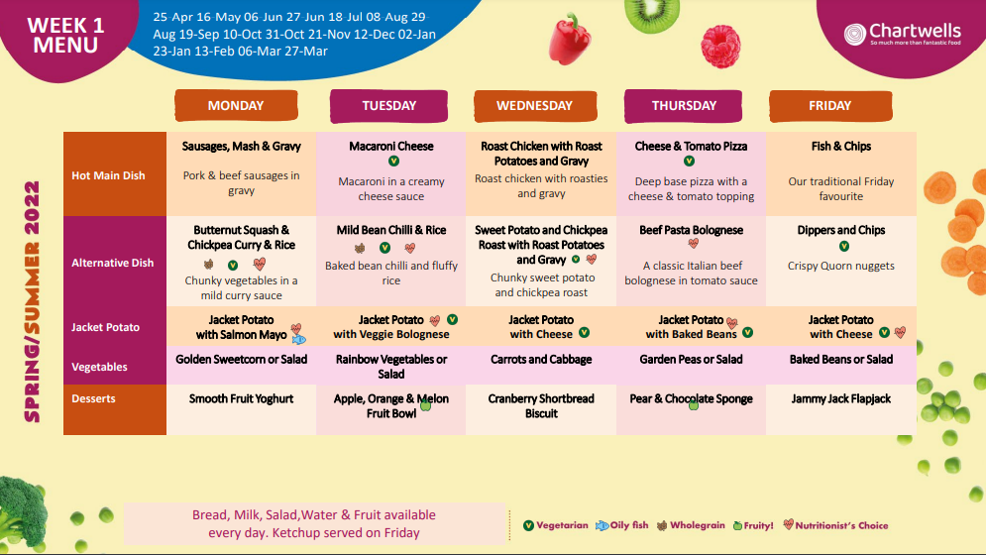
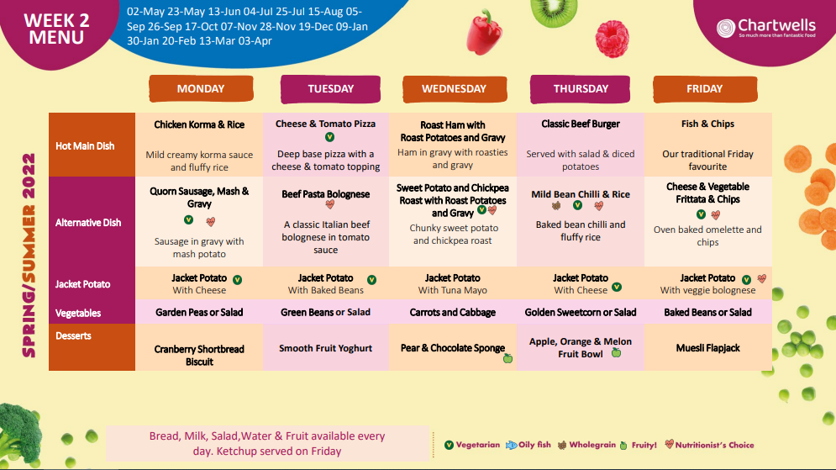
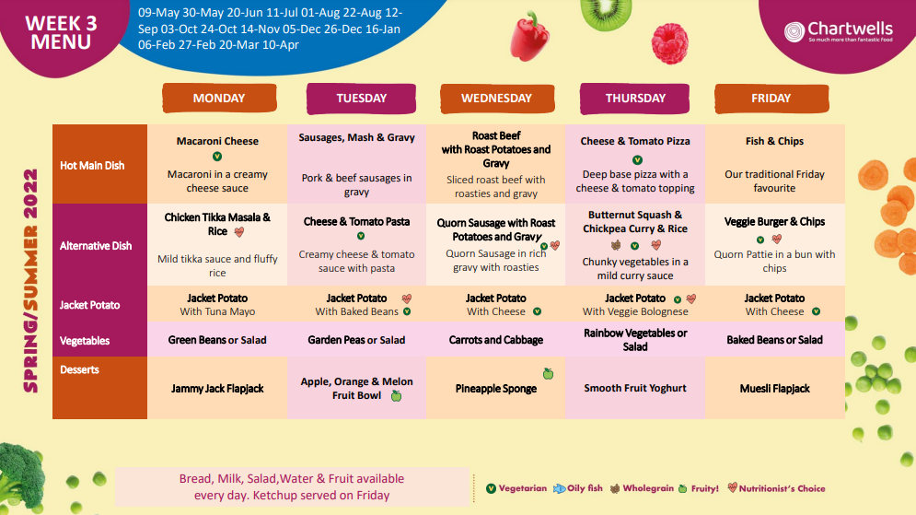
School Lunches
https://westsussex.mealselector.co.uk

Slide 23
Other bits……
Learning Journals from Nursery
Pupil Premium
Boxes, tubes, etc for making trolley
DBS checks
WhatsApp, Class Dojo, Google Classroom
Early Birds and Roosters

Slide 24
Dates;
Six Weeks in Meeting - 9th October
INSET - Friday 21st October
Flu Nasal Spray - 5th October– FORMs asap
Parents’ Evenings - 8th and 10th November
Library Visit - Wednesday 9th November

Slide 25
Things to look forward to;
Walks to the library and to St. Mary’s Church.
Trip to Two Woods for Forest School.

Slide 26
Thank you for coming.
Car parking
Website – dates, Newsletters, etc

