Slide 1
Easter in Spain

Slide 2
Learning Objective
To understand how Easter is celebrated in Spain.
Success Criteria
I can identify the meaning of the key words.
I can repeat the key words with correct pronunciation.

Slide 3
La Semana Santa
‘La Semana Santa’ (‘Holy Week’ or ‘Easter’) is one of the most important religious celebrations in Spain.
This is the calendar of the main dates during Easter:
L | M | X | J | V | S | D
 |  |  |  |  |  | Domingo de Ramos
 |  |  | Jueves Santo | Viernes Santo |  | Domingo de Pascua

Slide 4
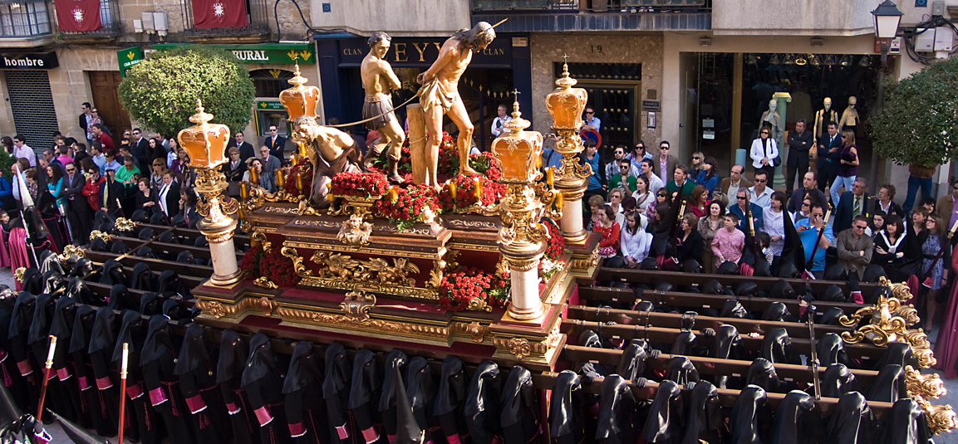
Las procesiones y los costaleros
In Spain in Easter, there are religious processions (‘procesiones’) where the large floats (called ‘pasos’) go through the street representing different scenes of the Bible. They are heavy and usually decorated with candles. People who carry the ‘pasos’ are called ‘costaleros’.
Photo courtesy of Guijarro Fotografía (@flickr.com) - granted under creative commons licence - attribution

Slide 5
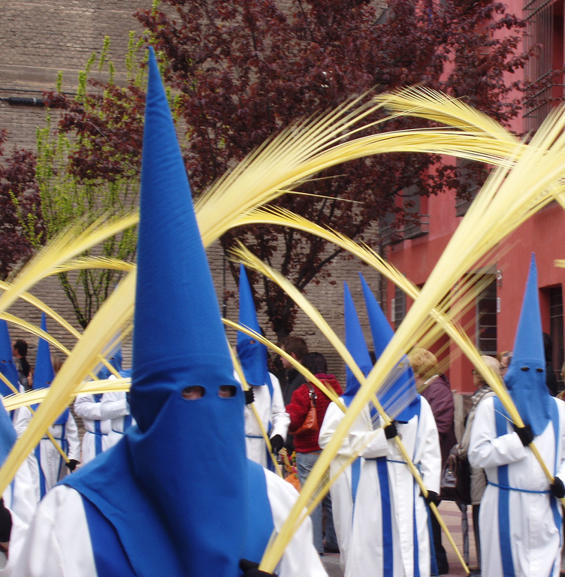
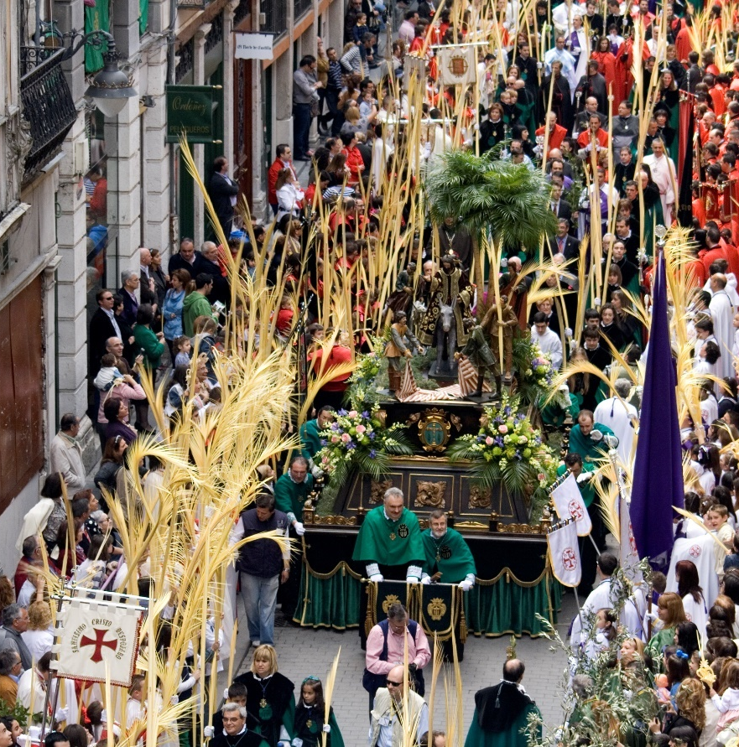
El Domingo de Ramos
Palm Sunday or Domingo de Ramos is the beginning of Easter in Spain. People buy ‘palmas’, which are made of palm branches, as they represent the palm branches that were used to welcome Jesus Christ into Jerusalem.
Photo courtesy of Iglesia en Valladolid and fernand0 (@flickr.com) - granted under creative commons licence - attribution

Slide 6
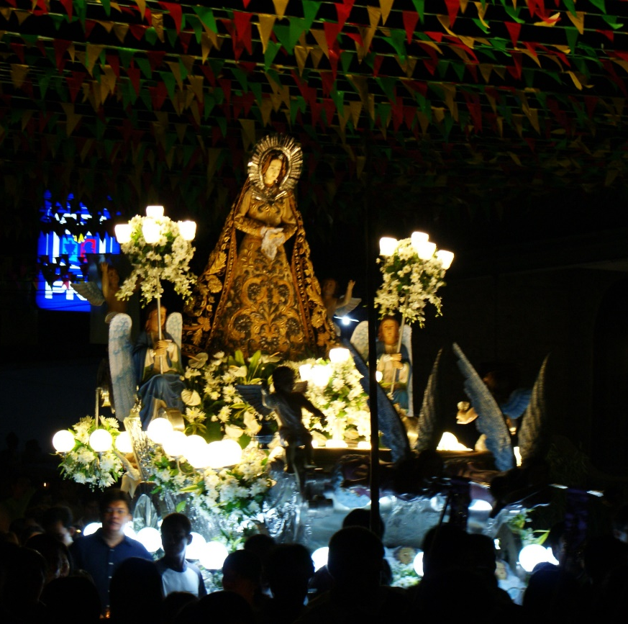
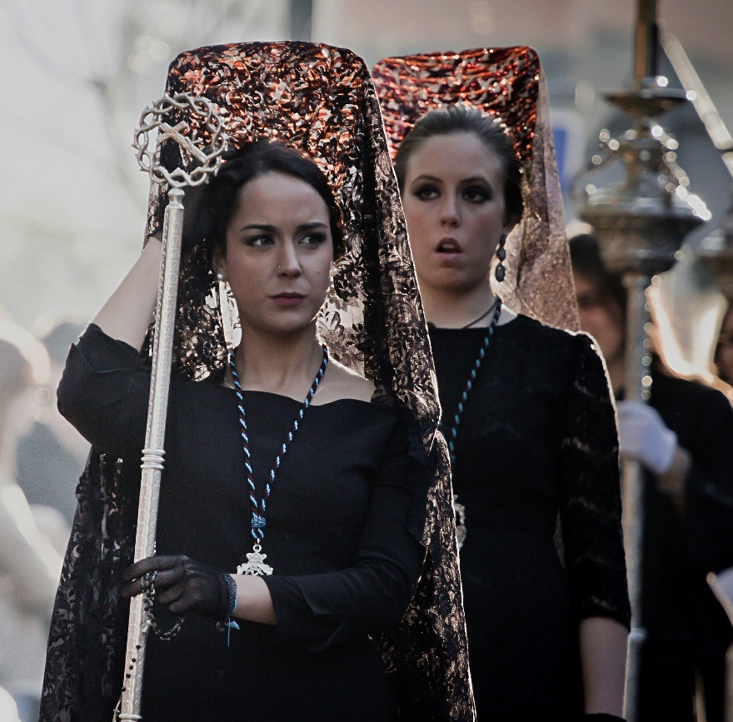
El Viernes Santo
Good Friday, or Viernes Santo, is the day where there are processions around Spain commemorating the death of Jesus. Those processions are sad and normally observed in silence. In the past, Catholic people used to wear black clothes on this day, but nowadays that’s just optional.
Photo courtesy of ralphsales and Hernan Piñera (@flickr.com) - granted under creative commons licence - attribution

Slide 7
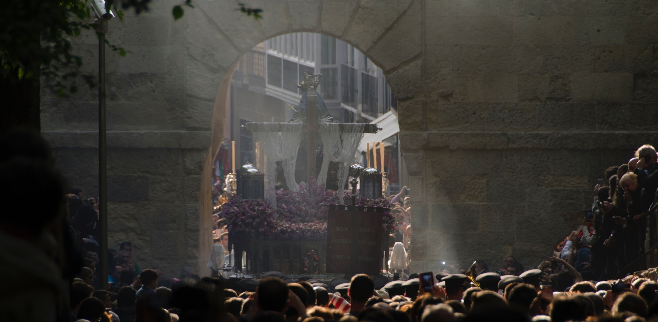
El Sábado santo
During Easter Saturday, people pray for Jesus in silence and there are fewer processions. Churches do not celebrate weddings or masses because they are in mourning for Jesus Christ.
Photo courtesy of OD Rangel (@flickr.com) - granted under creative commons licence - attribution

Slide 8
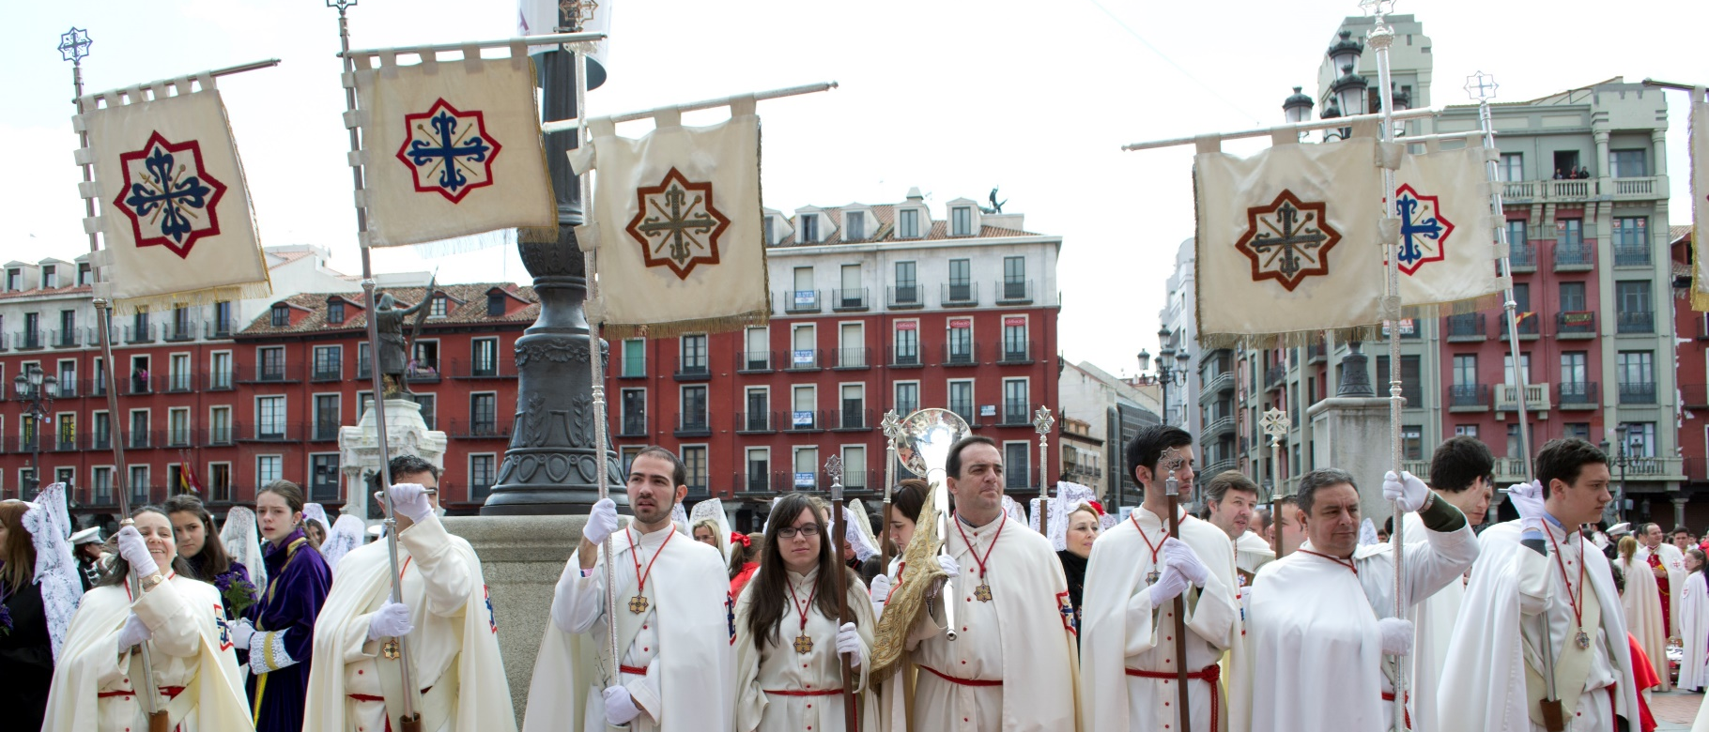
El Domingo de Resurrección o Domingo de Pascua
Easter Sunday is the most important day for Catholic people because they celebrate the Resurrection of Jesus. Processions are happier and religious people usually wear white or light clothes to celebrate it.
Photo courtesy of Iglesia en Valladolid (@flickr.com) - granted under creative commons licence - attribution

Slide 9
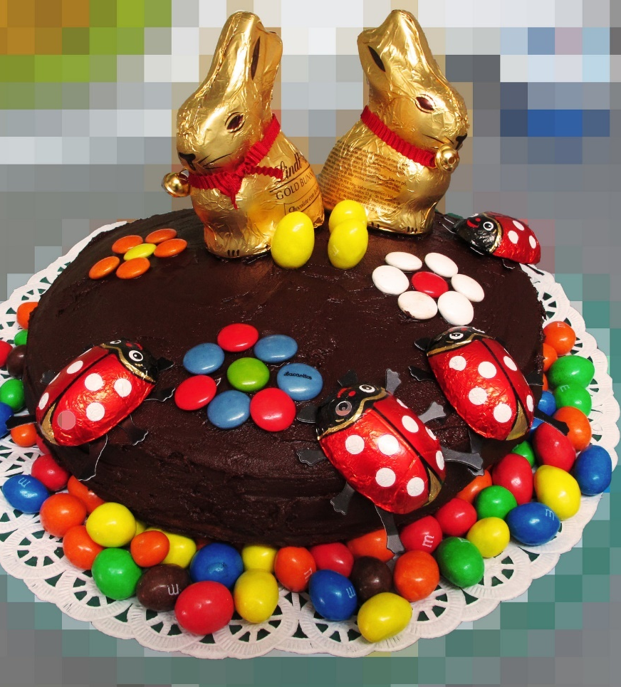
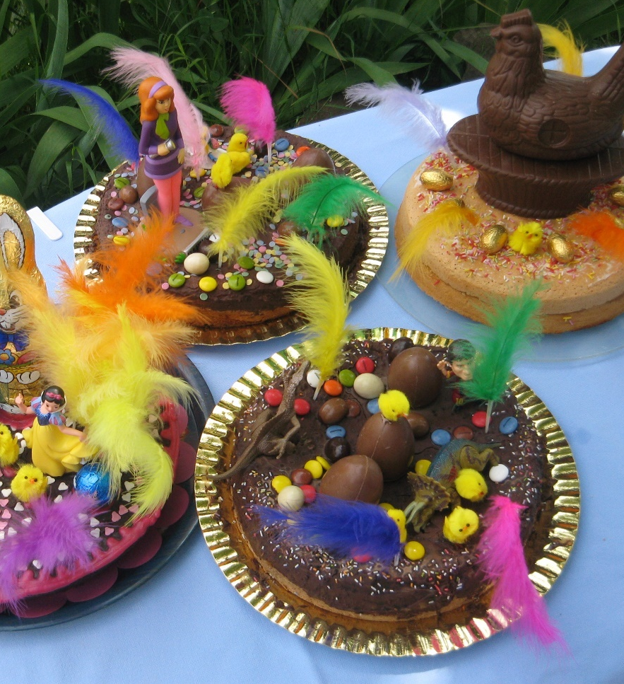
Las monas de Pascua
During Easter Sunday, people buy and eat Easter eggs (‘Huevos de Pascua’ or ‘Monas de Pascua’). They are made of chocolate and they have plenty of decorations.
Photo courtesy of Pablo Rodríguez Madroño and jacilluch (@flickr.com) - granted under creative commons licence - attribution

Slide 10
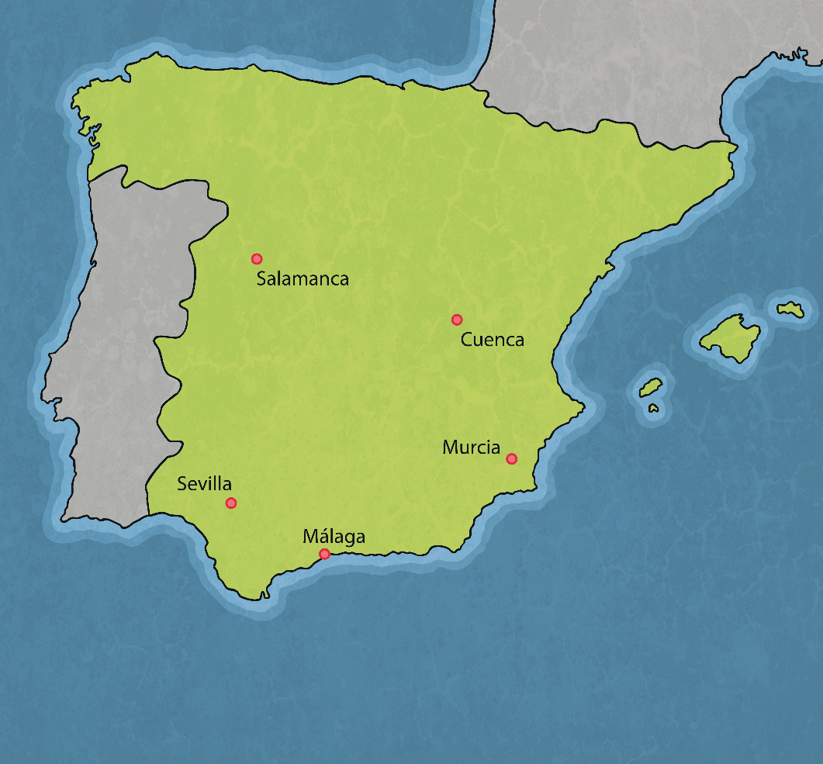
Main Cities That Celebrate Easter In Spain
The main cities that celebrate Easter in Spain are Seville, Malaga, Murcia, Cuenca, Salamanca. Every year, plenty of tourists go there to see their processions because they have been declared events of International Tourist Interest.

Slide 11
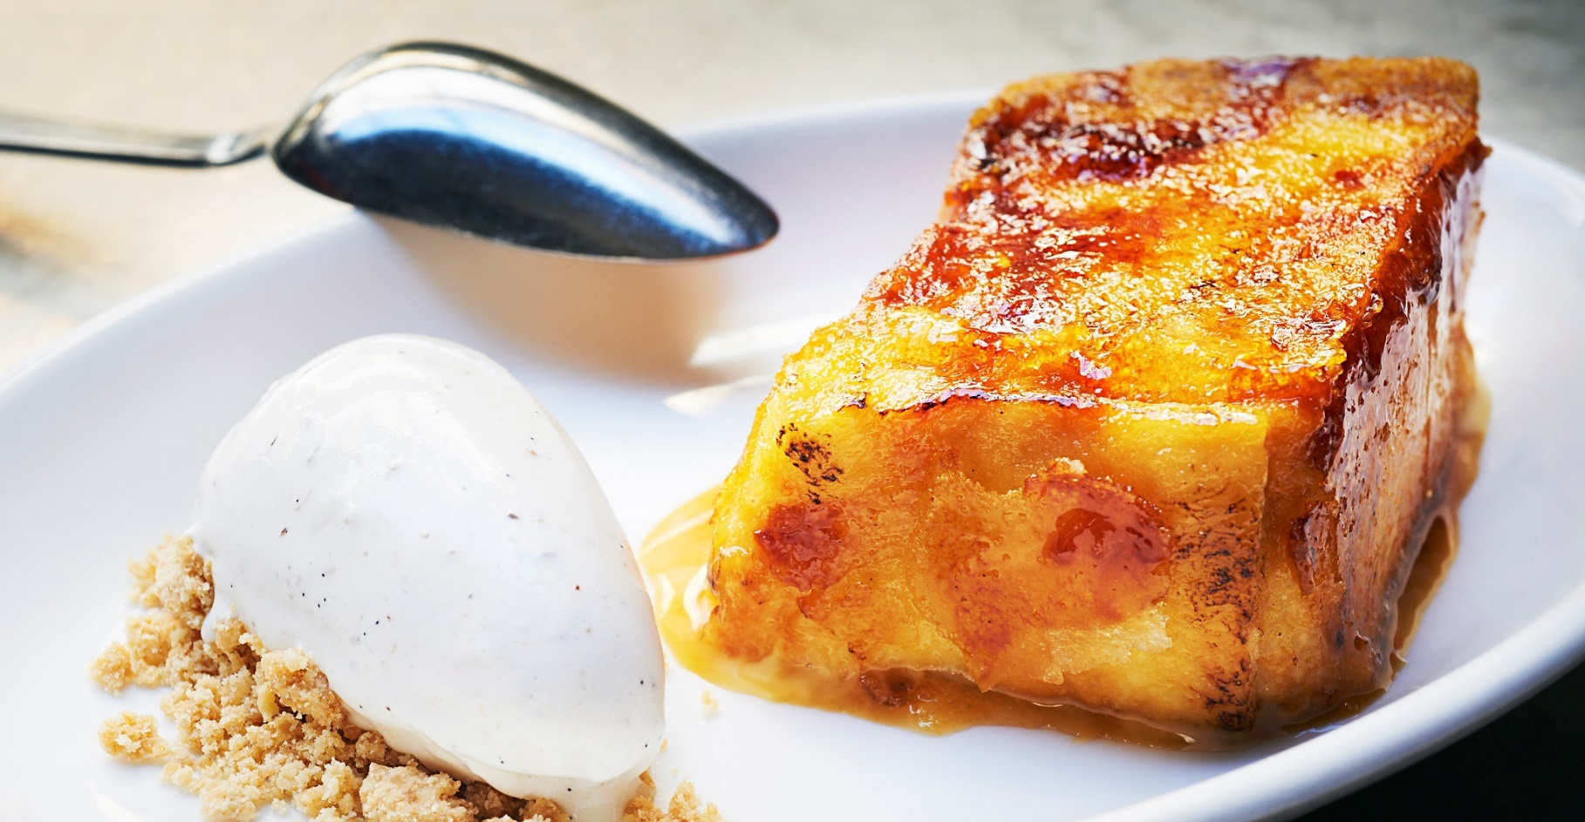
Typical Spanish Food At Easter
Las torrijas are the Spanish version of French toast. They are made with bread slides, milk and eggs and topped with cinnamon and sugar or honey!
Photo courtesy of MoritzBarcelona (@flickr.com) - granted under creative commons licence - attribution

Slide 12
Question 1:
How do you say ‘Easter’ in Spanish?
La Semana Sana
La Navidad
La Semana Santa
C. La Semana Santa

Slide 13
Question 2:
How do you say ‘Palm Sunday’?
Domingo de Flores
Domingo de Ramos
Domingo de Pascua
B. Domingo de Ramos

Slide 14
Question 3:
In the Past, what colour did people use to wear during Good Friday?
Black
Red
White
A. Black

Slide 15
Question 4:
What does the Church do during Easter Saturday?
There are parties and happy masses.
There are parties with religious music.
There are no masses or weddings.
C. There are no masses or weddings.

Slide 16
Question 5:
How do you call the Easter processions in Spanish?
Las procesiones
Las profesiones
La Cabalgata
A. Las procesiones

Slide 17
Question 6:
Easter eggs are called ‘Huevos de Pascua’ or …
Monos de Pascua
Monas de Pascua
Chocolate de Pascua
B. Monas de Pascua

Slide 18
Question 7:
What is a ‘Mona de Pascua’ made of?
Chocolate and decorations
Chocolate and fruit
Caramel and fruit
A. Chocolate and decorations

Slide 19
Question 8:
Which Spanish cities are the most touristic during Easter?
Seville, Malaga, Murcia and Salamanca
Madrid and Barcelona
Valencia, Madrid and Malaga
A. Seville, Malaga, Murcia and Salamanca

Slide 20
Question 9:
What is a ‘torrija’?
A sweet made of chocolate
A dish made of meat and vegetables
A sweet made of bread, eggs, milk, sugar and cinnamon.
C. A sweet made of bread, eggs, milk, sugar and cinnamon.

Slide 21
Question 10:
Which Easter day is the most important day for Christian people?
Good Friday
Palm Sunday
Easter Sunday
C. Easter Sunday

