Slide 1
KS2 writing Tea and Chat
22.03.23

Slide 2
Welcome!
Please be thinking about the following:
What age and stage is your child?
How do YOU feel about writing?
What are you hoping for out of today’s session?
What are your hopes for your child?

Slide 3
Vision Statement
St Mary's CE (Aided) Primary School is a 'Christ-centred school with a child-centred curriculum' where wisdom and love guide and influence learning and teaching for our whole community. We treasure each child and enable them to flourish, using their God-given potential and establishing a secure foundation for them to thrive in a rapidly changing world.

Slide 4
Some key points:
Every person has superpowers!
  ‘Be who you were made to be and you will set the world on fire.’ Catherine of Siena
Encourage children in their strengths AND encourage them in areas for development – nurture both!
  ‘Hardships often prepare ordinary people for an extraordinary destiny.’
  ‘Where there is no struggle, there is no strength.’
Start where they are and reduce cognitive load – make success attainable
If they don’t enjoy writing – make it enjoyable and rewarding

Slide 5

Equity – making goals attainable
If your child struggles with:
Spellings… give them the spellings
Stamina… give them less to achieve
Handwriting… let them type
Motivation… spark their interest
You can work on areas of weakness separately to reduce the load.
Eg:
Have a handwriting book and practice this separately
Use a spelling programme like spellingframe to practice spellings
Dyslexia - https://www.youtube.com/watch?v=FrOvfIgiDZc
ADHD - https://www.youtube.com/watch?v=Cclau3BMQ-k
https://www.youtube.com/watch?v=oxvA1qsExdY

Slide 6
Ideas for writing at home
Letter to persuade Mum, Dad, Grandma… then reward!
Letter to favourite sportsperson, popstar…
Letter to a relative that’s far away (good one if you can get them to write back)
Write a post match report
They do a line, you do a line
Make something for homework and then email the teacher about it
Write a diary
READ! Read to your children and enjoy it
Watch an animation and be inspired to write a narrative, a letter, a poster, continue the story etc. https://www.literacyshed.com/
Make a special place for them and invest in it - what would they like?
Your ideas?...
Get Google savvy!

Slide 7
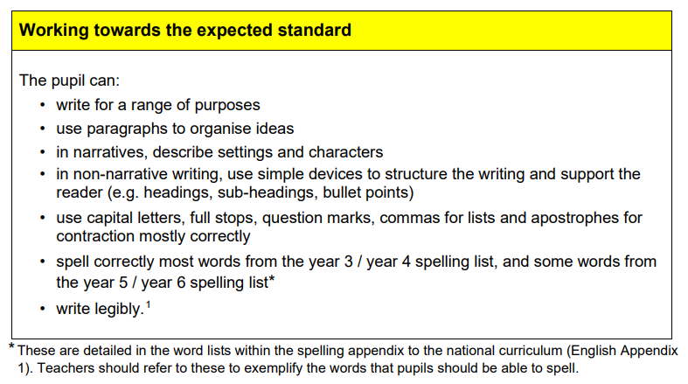
What ARE the expected standards?

Slide 8
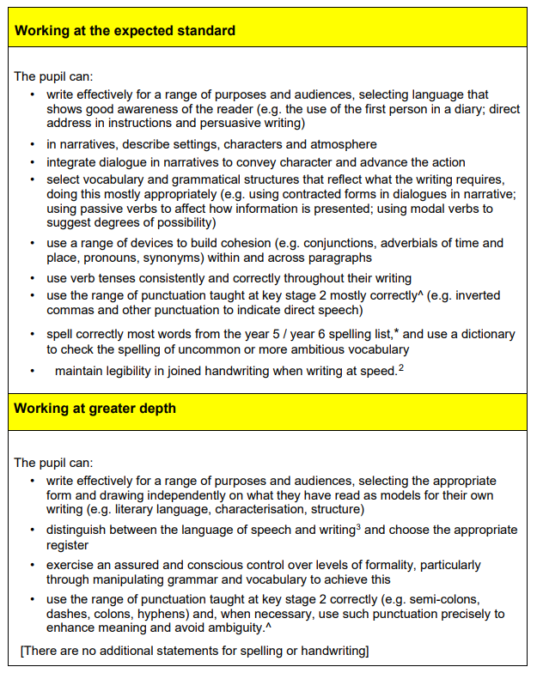

Slide 9
Packs to share:
Pencil
Rubber
Lined book
Handwriting book
My dictionary

Slide 10
Questions

Slide 11
Handy websites:
https://spellingframe.co.uk/
https://www.literacyshed.com/
https://www.pobble.com/
https://www.getepic.com/
https://www.oxfordowl.co.uk/
https://assets.publishing.service.gov.uk/government/uploads/system/uploads/attachment_data/file/425601/PRIMARY_national_curriculum.pdf
https://mathsframe.co.uk/

