Slide 1

Meet the Teacher
Good afternoon and welcome to India Class.
Mrs Huntley-Hart
Mrs Metaliaj and Mr Chinery

Slide 2
Under Section 7 of the Education Act 1996 (in England and Wales), parents of children aged 5 to 16 are legally responsible for ensuring their child receives an efficient, full-time education suitable to their age, ability, and aptitude.
We track attendance carefully in line with the Department For Education.

Slide 3
Metric | What It Means | Action Required
95% – 100% Attendance | On Track: Maximum opportunity for academic and social success. | Keep up the regular routine!
90% – 94% Attendance | At Risk: Equivalent to missing ~20 days (4 weeks) of school a year. This will leave gaps in your child’s education that we will struggle to fill. | Review morning habits; schedule appointments outside school hours. Arrive before the gates open so your child feels calm.
Below 90% | Persistent Absence: Severe impact on progress and exam outcomes. | School intervention and support meeting will be required so that we can agree ways forward.

Slide 4
Quick Attendance Impact Guide
90% Attendance: Equals missing 1/2 day per week or 4 full weeks of school a year. Over a school career, this adds up to over a full school year of missed learning. Your child will not be the strongest they can be.
80% Attendance: Equals missing 1 full day per week or more than half a term each year.
Every Day Counts!
Good attendance is directly linked to higher achievement, strong friendships, and confidence in the classroom.
How parents can help:
Set consistent morning and bedtime routines.
Schedule medical/dental appointments outside school hours whenever possible.
Avoid booking family holidays during term time. If parents exceed five days for holidays or illness WSCC can and will fine you.
Contact us immediately if your child is reluctant to attend so we can support them and get things in place early.

Slide 5
India Class Timetable
The timetable is flexible and will change each week, depending on what we need to focus on.
Each week we will be having a lesson on Relationship and Health Education (RHE). These lessons are compulsory and must be taught once a week. They will be learning about parts of the body and will know the names of different parts by the end of the year.

Slide 6
India Class Timetable
PE will be on a Tuesday and Friday every week, but please ensure PE kit is in school on the first day of every week and it will be sent home each Tuesday. On Friday, children should come to school in their PE kits (no school uniform required).
Phonics/ Spelling Patterns will be on Google Classroom and will be sent home every week for a spelling quiz on the following Monday.
Spelling Shed login details are in the back of reading logs. Games will link to the spellings each week.
Homework this half-term is a grid from which the children can choose. Please could the children complete one piece of homework each week. If you can photograph or scan the children's homework tasks and email them to the class email address, this would be fantastic

Slide 7
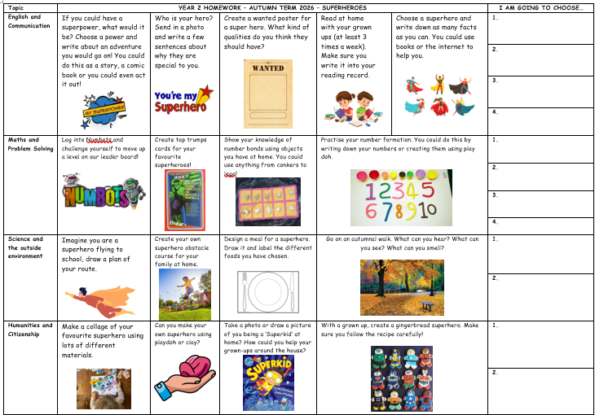

Slide 8
India Class - Reading
Reading logs will be checked daily and stamped. I will give 5 dojo for regular reading across each week
Targets or questions written will be added in across the year.
Star reader(s) – certificate for those we see making additional effort in their reading.
I will hear every child read once a week during our Guided Reading sessions.
In the comments section, please leave comments sharing anything with which your child has struggled and highlighting what they have done well.
Reading bookmark – we will introduce these soon, ask your child any of the questions to deepen their understanding of what they have read. Please do write any direct quotes of their responses into their reading log.
Reading books – To read with fluency, your child should be able to read 9/10 words. They need to read their book at least 3 times.
Myon logins – books online that can be read, or it can be read to you.
Passwords will be stuck in the back of Reading Records.

Slide 9
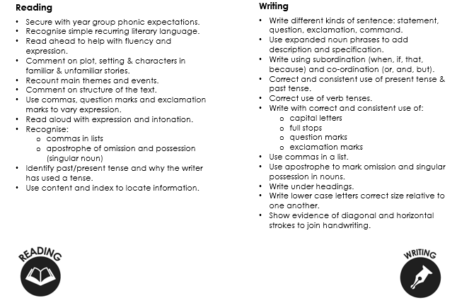
End of Year 2 expectations.

Slide 10
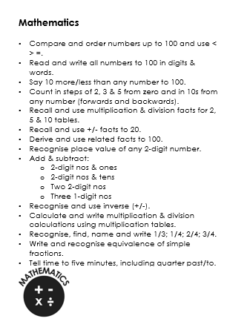
End of Year 2 expectations.

Slide 11


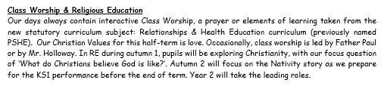
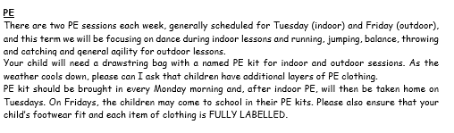

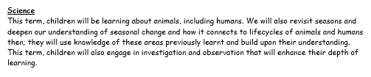
Autumn Term Learning

Slide 12



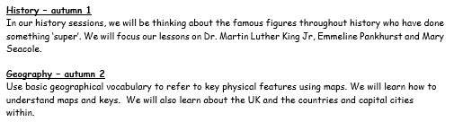


Slide 13
India Class Numbots and TTRockStars
❑ By the end of year 2 children need to know at least their 2, 5 and 10 multiplication and division facts – once these are mastered, they will move onto 3, 4, 6 and 8.
❑ Number bonds to 100
❑ TTRockstars and Numbots logins have been sent home and will be added in at the back of Reading Records – any problems, please come and see or email me.
❑ Please can children practise at home, so these are embedded.

Slide 14
Dates to Remember (Also check school’s website)
❑ Walk to Church – Friday 9th October 2026 9am
❑ Individual School Photos – Friday 16th October 2025
❑ INSET DAY –Friday 23rd October 2026
❑ Parents’ Evenings (in school) – 3rd and 5th November 2026
❑ Half-Term – Monday 26th - Friday 30th October 2026.
❑ Class Celebration Assembly – Thursday 12th November 9am
❑ KS1 Nativity – Tuesday 8th December (2pm & 5pm) Wednesday 9th December 2026 (5pm)
❑ KS1 Disco – Wednesday 16th December 2026 (5pm)
❑ Christmas Jumper Day/Class parties/Last day of term – Friday 18th December 2026
❑ School re-opens – Monday 4th January 2026

Slide 15

Handwriting
❑ As a school we have been developing our cursive handwriting policy, which has both lead ins and lead outs. We will practise handwriting every day after lunch.

Slide 16
SCHOOL UNIFORM
❑ Please make sure every item of clothing is labelled.
❑ If you notice the name is starting to wear off, please could you rewrite it, so we know to whom items belong.
❑ Please make sure uniform follows school policy.

Slide 17
WHAT TO BRING TO SCHOOL
❑ MONDAY - PE kits should be left at school.
FRIDAY – Wear PE kit to school
EVERYDAY
❑ Water bottle – clearly named please.
❑ Reading records and reading books – EVERY DAY.
❑ Snack.
❑ Coat.
REMEMBER: We are a NUT-FREE School.

Slide 18
BEHAVIOUR
❑ Good behaviour, including good listening, is rewarded with dojo points. If a child reaches a weekly target 5 times in the year, they will receive a bronze badge. If they reach the target 15 times, they will receive a silver badge. If they reach the target 25 times they will receive a gold badge. The target is 20 dojos.
❑ Every week we will decide on a Star of the Week – this may be awarded to a child who has worked consistently hard or who has been exceptional in following our Golden Rules or demonstrating one of our Christian values.
❑ Each week, our class pet – Ella Elephant– will go home with a child. Ella has her own travel journal. If your child is chosen, please ensure Ella is well cared for and her weekend journal is completed with any/all activities enjoyed. Ideally, the child should be writing in the journal (with support if needed).

Slide 19
MRS Huntley-Hart’s SHOUT OUT cards
These are in addition to Dojos.
These may be given for good work, for trying their best or even a random act of kindness.

