Slide 1

Welcome to Italy Class
2025-2026
Miss Heasman

Slide 2

Under Section 7 of the Education Act 1996 (in England and Wales), parents of children aged 5 to 16 are legally responsible for ensuring their child receives an efficient, full-time education suitable to their age, ability, and aptitude.
We track attendance carefully in line with the Department For Education.

Slide 3
Metric | What It Means | Action Required
95% – 100% Attendance | On Track: Maximum opportunity for academic and social success. | Keep up the regular routine!
90% – 94% Attendance | At Risk: Equivalent to missing ~20 days (4 weeks) of school a year. This will leave gaps in your child’s education that we will struggle to fill. | Review morning habits; schedule appointments outside school hours. Arrive before the gates open so your child feels calm.
Below 90% | Persistent Absence: Severe impact on progress and exam outcomes. | School intervention and support meeting will be required so that we can agree ways forward.

Slide 4
Quick Attendance Impact Guide
90% Attendance: Equals missing 1/2 day per week or 4 full weeks of school a year. Over a school career, this adds up to over a full school year of missed learning. Your child will not be the strongest they can be.
80% Attendance: Equals missing 1 full day per week or more than half a term each year.
Every Day Counts!
Good attendance is directly linked to higher achievement, strong friendships, and confidence in the classroom.
How parents can help:
Set consistent morning and bedtime routines.
Schedule medical/dental appointments outside school hours whenever possible.
Avoid booking family holidays during term time. If parents exceed five days for holidays or illness WSCC can and will fine you.
Contact us immediately if your child is reluctant to attend so we can support them and get things in place early.

Slide 5
Our Topics
Autumn 1 | Superheroes!
Autumn 2 | Journeys
Spring 1 | The Great Fire of London
Spring 2 | Towers, Tunnels and Turrets
Summer 1 | Our Wonderful World
Summer 2 | Land Ahoy!

Slide 6
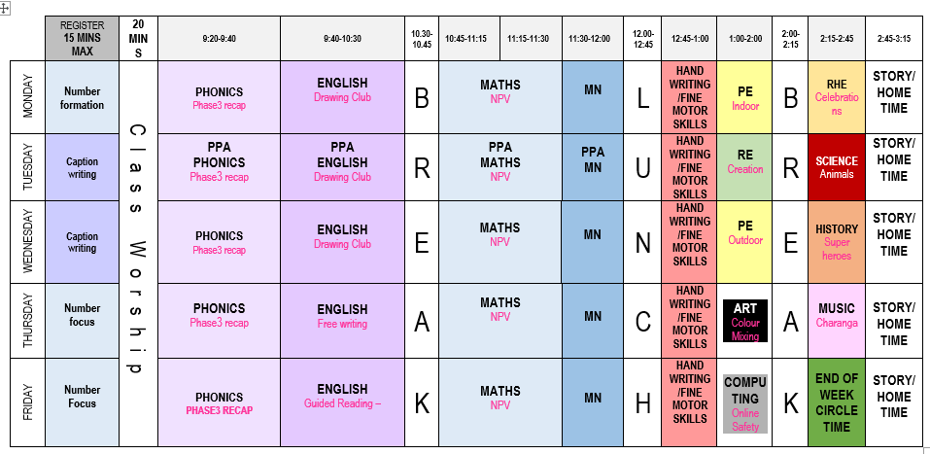
Typical Italy Class Timetable

Slide 7
English – Drawing Club! Lots of high quality texts, such as: The Colour Monster A Superhero like You Only One You Small group work, encouraging creativity and a love for writing. As we move further into Year 1, we will begin to adopt Talk 4 Writing principles into our lessons. Our focus will still be on high quality texts! | Maths – 1st half term: Place Value Addition and subtraction 2nd half term: Addition and subtraction Shape Mastering Number – Daily session to develop fluency and number sense. | Science – 1st half term: Animals including Humans – We will be describing how animals grow, understand our basic needs to survive and discuss the importance of exercise and food. 2nd half term: Seasonal changes – We will observe changes across the four seasons, and observe and describe weather associated with the seasons.

Slide 8
PE – 1st half term: Inside PE (MONDAY) – Dance Outdoor PE (TUESDAY)– Core strength and balance 2nd half term: Inside PE (MONDAY) – Gymnastics Outdoor PE (WEDNESDAY)– Traveling and agility |  | History – 1st half term: Superheroes – We will compare and contrast historical superheroes!
Geography – 2nd half term: Journeys – We will explore our local area by asking and answering simple questions. We will also use books and other sources of information to help us. | Art – 1st half term: Pop Art – We will be generating art in the style of Andy Warhol and Roy Lichtenstein. | D&T – 2nd half term: We will be designing and making our own bridges.

Slide 9
RE – 1st half term: Creation – Who made the world? 2nd half term: Incarnation - Why does Christmas matter to Christians? | Music – 1st half term: 2nd half term: We will be practising and performing our songs for our Christmas performance! | Computing – 1st half term: Online safety 2nd half term: Coding | RHE – 1st half term: Physical health and wellbeing – Fun times 2nd half term: Keeping safe and managing risk Please note that all RHE lessons follow our curriculum and are age-appropriate

Slide 10


Routines
Numbots | Reading | Reading Logs
There will be an increased focus on number facts this year. We will be participating in daily fluency sessions, called Mastering Number. Please practise Numbots with your children at home, so that they can earn certificates and move up on our leader board! | Please ensure that you are reading with you child at least 3 times a week. It is so important that they are practising their reading at home, as well as at school. | Reading logs will be collected in and checked everyday. Dojos will be awarded for children who are reading at home. Please ensure that reading is recorded in logs.

Slide 11
Routines
Water Bottle Please ensure that your child has their water bottle with them each day. | Snack Please ensure that your child comes to school with a piece of fruit or vegetable or a cereal bar. Please also note that we are a nut-free school. | Homework The homework grid will be available through Google Classroom. I have also sent out a hard copy. Please submit your child’s learning through GC or through the class email: italy@stmarysprimarypulborough.co.uk

Slide 12
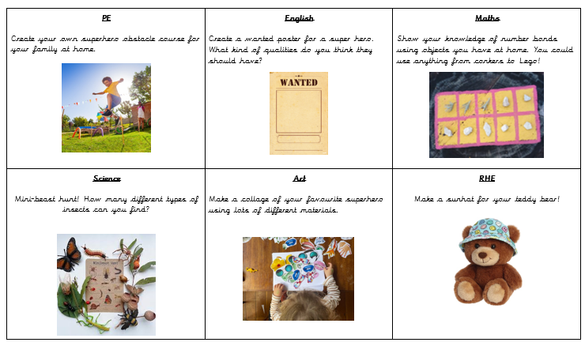
Homework

Slide 13
Behaviour
Positive behaviour management
Lots of praise! Verbal and rewards – dojos, stickers and raffle tickets. | End of week certificates – Dojo champion Star of the week | Badges – Bronze, Silver and Gold. | Head teacher awards Recognition in newsletter – vine leaves

Slide 14
Behaviour continued
Behaviour management
We must follow our Golden Rules. These are up in the classroom and are often referred to. | If your child does not follow the golden rules, they will lose minutes from their break or lunch time. | This will result in a conversation with myself in person or over the phone. | If your child continues to not follow the golden rules, there will be a meeting with myself and a member of the senior leadership team.

Slide 15
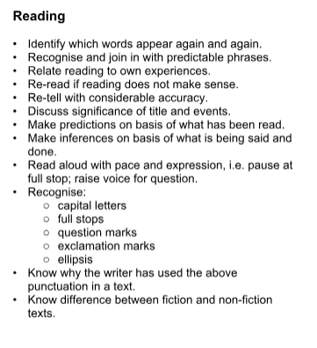
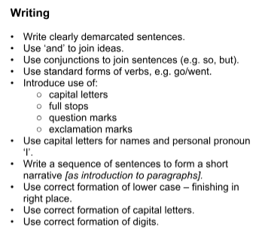
Expectations for the end of the year:

Slide 16
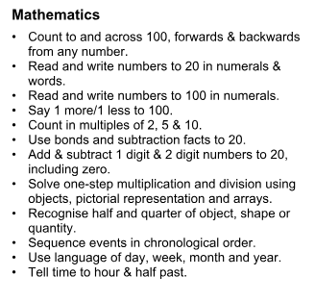
Expectations for the end of the year:

Slide 17

Key dates and Questions?
Key dates:
October Black History Month 9th – World Mental Health Day 16th – Individual School Photos 22nd – Superhero Day! 23rd – INSET day 26th – 30th – Half Term | November 3rd – Parents’ Evening 5th Parents’ Evening 6th – Fireworks 13th – Children in Need 16th – Odd socks for Mental Health 16th – 20th – Anti-bullying week 19th – Italy Class Assembly 27th – Christingle and Advent Eucharist | December 8th – Nativity performance 9th – Nativity performance 16th – Disco 17th – Pantomime 18th – Last day of term – Eucharist, Christmas jumper day, Class party

