Slide 1
Meet the Teacher
Wednesday 30th September
Thailand Class

Slide 2
Attendance
Under Section 7 of the Education Act 1996 (in England and Wales), parents of children aged 5 to 16 are legally responsible for ensuring their child receives an efficient, full-time education suitable to their age, ability, and aptitude.
We track attendance carefully in line with the Department For Education.

Slide 3
Metric | What It Means | Action Required
95% – 100% Attendance | On Track: Maximum opportunity for academic and social success. | Keep up the regular routine!
90% – 94% Attendance | At Risk: Equivalent to missing ~20 days (4 weeks) of school a year. This will leave gaps in your child’s education that we will struggle to fill. | Review morning habits; schedule appointments outside school hours. Arrive before the gates open so your child feels calm.
Below 90% | Persistent Absence: Severe impact on progress and exam outcomes. | School intervention and support meeting will be required so that we can agree ways forward.

Slide 4
Quick Attendance Impact Guide
90% Attendance: Equals missing 1/2 day per week or 4 full weeks of school a year. Over a school career, this adds up to over a full school year of missed learning. Your child will not be the strongest they can be.
80% Attendance: Equals missing 1 full day per week or more than half a term each year.
Every Day Counts!
Good attendance is directly linked to higher achievement, strong friendships, and confidence in the classroom.
How parents can help:
Set consistent morning and bedtime routines.
Schedule medical/dental appointments outside school hours whenever possible.
Avoid booking family holidays during term time. If parents exceed five days for holidays or illness WSCC can and will fine you.
Contact us immediately if your child is reluctant to attend so we can support them and get things in place early.

Slide 5
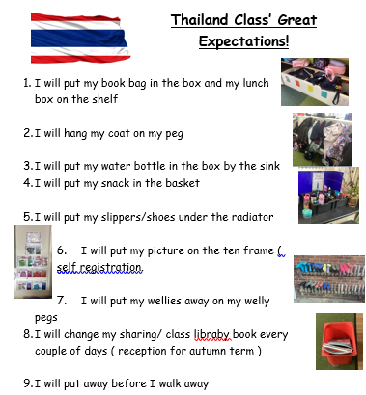
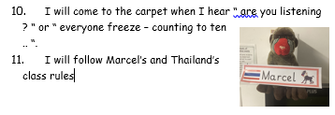

Slide 6


Slide 7
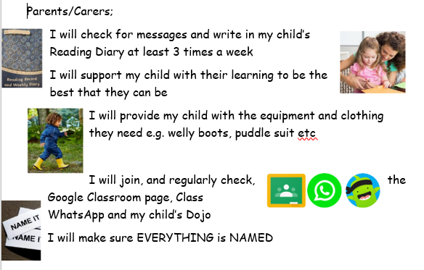

Slide 8
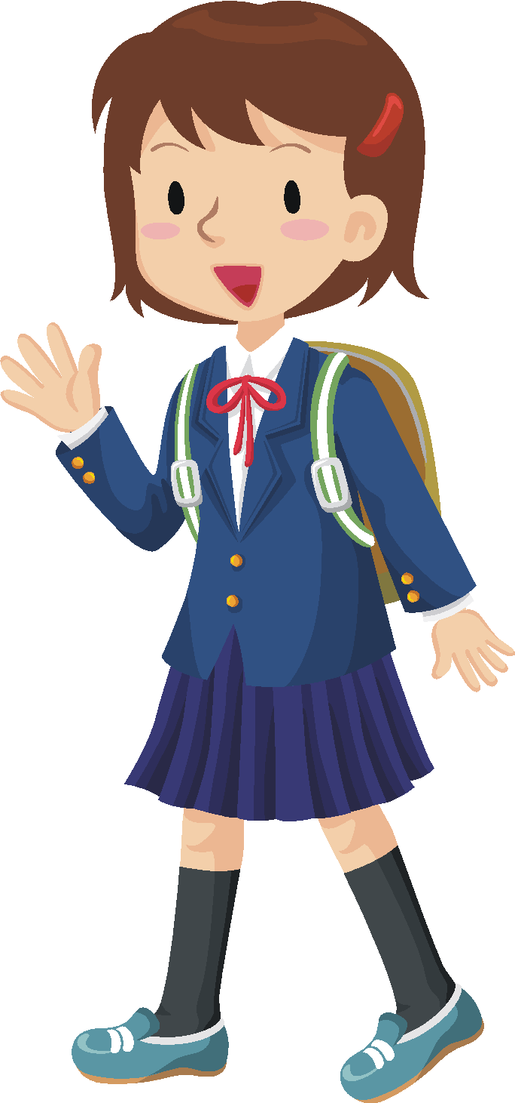

Encouraging Independence.
Please involve your child in packing their bag at home. That way they are more aware of what they have brought to school each day.
Shoes and socks - please encourage your child to put their socks and shoes on by themselves.
Clothing – please support your child in learning how to dress/undress independently - show them how to turn t-shirts/trousers/dresses the right way out.
Toileting - please support your child to become as independent as possible with this.

Slide 9




Thailand Timetable
Forest School will commence after the October half term will all children joining in with the outdoor provision.
Mr Hollisey Mclean will also teach the children every Wednesday afternoon.
Rhymes will be put on Google Classroom weekly this term.
Pink books (Phonics) will be taken home weekly and will gradually change colour with progression. School staff will monitor this and allocate children with the appriopriate text.

Slide 10

Baseline Assessment
All the children have completed the reception baseline assessment (RBA), this is always done within the first 6 weeks of starting reception.
What is the RBA?
The RBA is a short, interactive and practical assessment of your child’s early literacy, communication, language and mathematics skills when they begin school, using materials that most children of your child’s age will be familiar with.
What does participating in the RBA mean for my child?
The RBA is not about judging or labelling your child or putting them under any pressure. Your child cannot ‘pass’ or ‘fail’ the assessment.
NELI
The NELI programme provides schools with a way of identifying early language difficulties and is proven to improve children's language skills and behaviour in school. If already identified from a previous year group, we will continue to support a child with specific interventions.

Slide 11


Phonics phase 1
In order for children to be able to read and write well they must be able to listen very carefully and discriminate between sounds. They should be taught to do this in a fun, exciting and active way with both planned and self-chosen activities. ( introduced through nursery provision )
Environmental Sounds
Instrumental Sounds
Body Percussion
Rhythm and Rhyme
Alliteration
Voice Sounds
Oral blending and Segmenting (short sounds)

Slide 12
Phase 2
Teach 19 letter graphemes (shapes) and phonemes (sounds) (GPCs) all lower case.
Move from oral blending and segmenting to doing the same with letters.
Learn to read and spell VC and CVC words using magnetic letters, whiteboards, phoneme fans.
Introduced to reading two syllable words and simple captions.
Learn to read the tricky words – I, no, go, the, to and into.

Slide 13
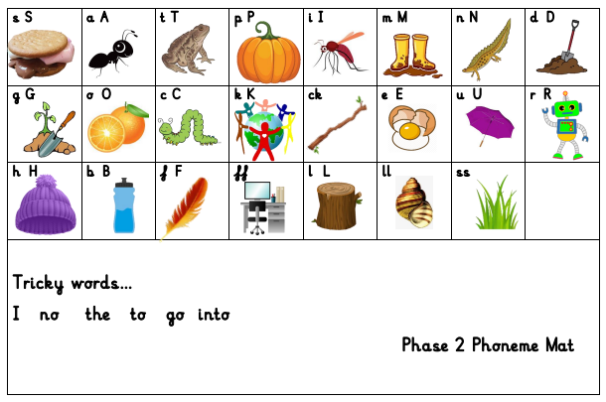
St. Mary’s phonics scheme….

Slide 14

Phase 2 - Writing
Until this point, the children have not been taught to form letters correctly.
We have been doing lots of work in Physical Development to get ourselves ready for writing, lines and shapes in preparation for writing - the children will all develop at different rates. A few are successfully forming letters, some are not ready yet. Don’t worry, the children will develop at their own speed and will get there when they’re ready.
They start by writing these in the air, in the salt, flour, in paint, using chalks and on each others backs - and when appropriate with a pencil.

Slide 15

Reading Books
Most children will already have a home reading book from school.
Please read with your children as often as possible and write in their reading log.
They should also be encouraged to read ‘real’ books from home or the library. Please try and take your child down and have a look at the lovely children's section.

Slide 16
Reading Books
Reading books need to be sent back in in the book bag.
We read every day with the children in all subjects and will write in their reading logs once a week after whole class, individual or guided group reading. If you feel your child needs to change reading levels please email us.
At this early stage when sharing picture books the focus is on talking through the pictures and developing the use of ‘story book’ language, as their phonic skills develop they will bring home books linked to the sounds we have taught.
When reading the Big Cat Phonic Reading Scheme Books it is important that phonics is the first and main strategy used to decode the words. Books will be carefully matched to the phonemes they have been taught. Children will be taught to read ‘tricky’ words by sight.

Slide 17
Book Bags
Please make sure all books and reading logs are returned daily. Due to sharing phonic texts across several class, we would appreciate all texts ( 1 at a time ) brought back into school.
Last year we lost several books because of water bottles leaking on them or fruit getting squished.
School staff will be changing phonics books at least once a week.

Slide 18

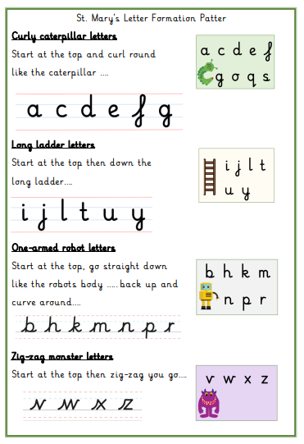
In reception, we teach children to form their letter in ‘ basic print ‘.
With their progression to Year One, we will introduce ‘ lead in’s ‘ to develop their understanding and confidence with handwriting. This will support their ability to join up their writing in their later school life.

Slide 19


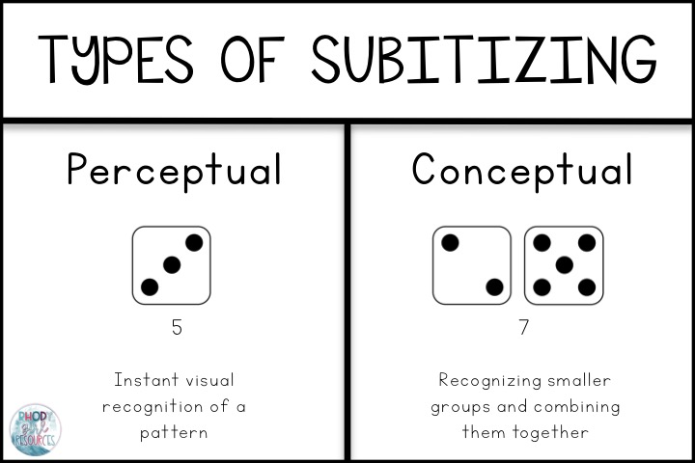

Maths Resources
Subitising
Subitising is the ability to look at a small set of objects and instantly know how many there are without counting them.

Slide 20
In EYFS and Key Stage 1:
Our priority is meeting the needs of our children – whichever class they are in.
Your child will get the required ‘diet’ for their year group – but also a diet that is tailored to their need – this may look different for children in different classes.
Classes may work completely independently… sometimes.
Classes may work with the class next door… sometimes.
Children may do things with other children in their year group – thus mixing with other classes or doing similar activities… sometimes.
For example: at Christmas, UK will work with Thailand on a performance and India will work with Italy on a different performance – each child will be included.
You may hear that children who are in another class, but are in the same year group as your child, are doing something different from your child – don’t worry! Refer to point 1!
We will try our best to communicate clearly with you. The school’s method of contact is through face to face with class teacher or school staff/ school email / class email / office
Notes:
Teachers – please delete (for your notes) – EYFS trip to Two Woods coming up will be ONLY EYFS – because they’ve never been before! Dress up days may be different for different classes or groups – all children will get equal opps. Year 1 in BOTH Christmas performances will be the chorus/choir for example.
Ask parents to EMAIL as a general rule rather than using Dojo (because of GDPR)
20

Slide 21
School Uniform
Please ensure that all of your children’s school uniform, including PE kits (when requested) and coats, are clearly labelled with their name.
Check this regularly. If you notice the name is starting to wear off please could you re-write it in so we know who items belong to.
At the end of the day we try to collect all jumpers and cardigans etc from the cloakroom to give out, please check your children’s jumpers when they get home to ensure they are not wearing somebody else’s. We can only return them if they are still clearly named.

Slide 22
Learning Journals
One of the ways in which your child’s progress is tracked in reception is through collecting evidence of things they have said or done. These are put into a ‘Learning Journal’, which is simply a collection of your child’s achievements.
Throughout reception this is used to work out your child’s learning and their next steps.
One of the ways we ask you to help with this is through emailing us and telling us of their achievements and providing evidence of things they have said or done outside of school. Email us with photos/notes to illustrate these achievements; thailand@stmarysprimarypulborough.co.uk

Slide 23
Behaviour
We follow the school Golden Rules at all times in Thailand class, Marcel keeps an eye on everyone and chooses a child to go home with each weekend who has demonstrated they can follow the rules. ( will begin in after October break due to settling in to school )
We also follow the school behaviour code in lessons and have high expectations of how we should behave in order to learn.
Good behaviour is reinforced through our RHE lessons and class assemblies.
We like to focus on positive behaviour and may send your child to share their work with Mrs Copus or Mr Hollisey Mclean , they will also get a special Headteacher sticker!

Slide 24

Helpers
All help much appreciated!
Reading
Craft Activities
Forest Schools
Gardening with the children.
Walks around the village as a part of a school trip.

Slide 25




Water bottles and Fruit
All children should have a water bottle to keep in class should they be thirsty during our Explorer Time sessions. We keep water bottles over by the sink. Children are also provided with a drink with their hot lunches.
At morning break, the children are encouraged to take a piece of fruit for a snack. Children may bring fruit from home or have a piece of school fruit. We discourage fruit winders, fruit flakes etc at break times in preference for a piece of fresh fruit. Please bring an extra piece of fruit for the afternoons.

Slide 26

Free School Milk
Milk is completely free for all children aged under 5.
Milk is subsidised for children aged 5 or over.
www.coolmilk.com

Slide 27
Other bits……
Learning Journals ( Reception )
Pupil Premium
Boxes, tubes etc for junk modelling
DBS checks - volunteers
WhatsApp, Class Dojo, Google Classroom
Numbots ( Year One )
Early Birds and Roosters
Spelling Shed – Year One
Website – dates, Newsletters, etc

Slide 28
Dates and things to look forward to at St Mary’s
Start of Black History Month this week ( 1st October ).
Individual photos ( 16th October )
Diwali Day - 8th November
Children in need ( 13th November )
Class assembly ( Year 1 – 26th November )
Reminders will be included in the school’s weekly newsletter sent out to all parents.

Slide 29
Thank you for coming.

