Slide 1
Meet the Teacher
Wednesday 30th September
UK Class

Slide 2

Under Section 7 of the Education Act 1996 (in England and Wales), parents of children aged 5 to 16 are legally responsible for ensuring their child receives an efficient, full-time education suitable to their age, ability, and aptitude.
We track attendance carefully in line with the Department For Education.

Slide 3
Metric | What It Means | Action Required
95% – 100% Attendance | On Track: Maximum opportunity for academic and social success. | Keep up the regular routine!
90% – 94% Attendance | At Risk: Equivalent to missing ~20 days (4 weeks) of school a year. This will leave gaps in your child’s education that we will struggle to fill. | Review morning habits; schedule appointments outside school hours. Arrive before the gates open so your child feels calm.
Below 90% | Persistent Absence: Severe impact on progress and exam outcomes. | School intervention and support meeting will be required so that we can agree ways forward.

Slide 4
Quick Attendance Impact Guide
90% Attendance: Equals missing 1/2 day per week or 4 full weeks of school a year. Over a school career, this adds up to over a full school year of missed learning. Your child will not be the strongest they can be.
80% Attendance: Equals missing 1 full day per week or more than half a term each year.
Every Day Counts!
Good attendance is directly linked to higher achievement, strong friendships, and confidence in the classroom.
How parents can help:
Set consistent morning and bedtime routines.
Schedule medical/dental appointments outside school hours whenever possible.
Avoid booking family holidays during term time. If parents exceed five days for holidays or illness WSCC can and will fine you.
Contact us immediately if your child is reluctant to attend so we can support them and get things in place early.

Slide 5
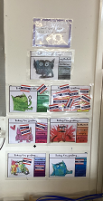
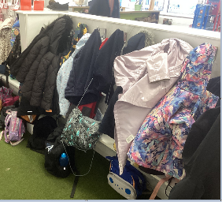
I will put my book bag in the box and my lunch box on the shelf
I will hang my coat on my peg
I will put my water bottle in the box by the sink
I will put my snack in the basket
I will put my slippers/shoes under the radiator
I will put my name on the colour monsters
I will put my wellies away on my welly pegs
I will change my sharing book every couple of days
I will put away before I walk away
I will come to the carpet when the bells ring or I hear Macaroni Cheese/Snap, Crackle, Pop

Slide 6

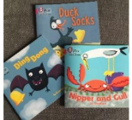

I will help pack my own bag so I know what I have
I will bring my Book Bag to school EVERY DAY
I will bring my water bottle to school EVERY DAY
I will join in with my sharing book
I will practice my new phonics learning DAILY
I will read my Big Cat Phonics Books EVERYDAY
I will dress myself
I will put my coat on by myself and do it up
I will put my shoes on by myself

Slide 7

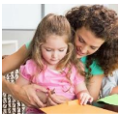


Parents/Carers
I will check for messages and write in my child’s Reading Diary at least 3 times a week
I will support my child with their learning to be the best that they can be
I will provide my child with the equipment and clothing they need e.g. welly boots, puddle suit etc
I will join, and regularly check, the Google Classroom page, Class WhatsApp and my child’s Dojo
I will make sure EVERYTHING is NAMED

Slide 8


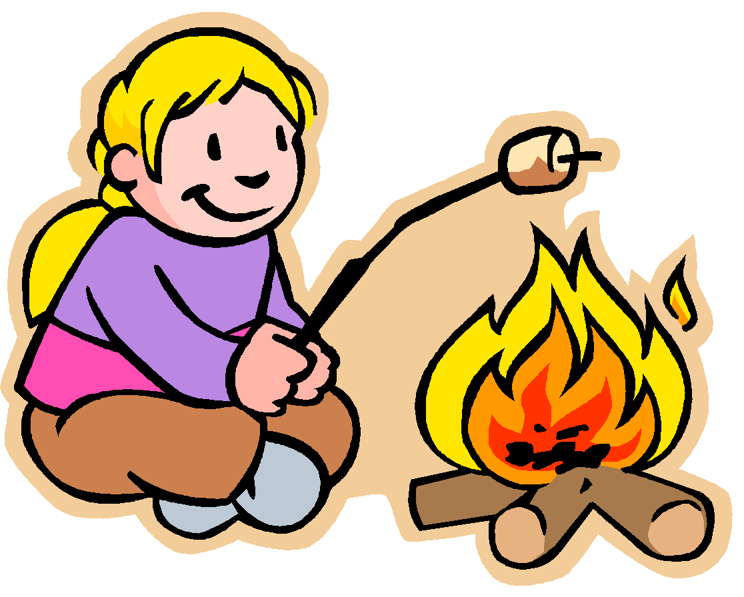
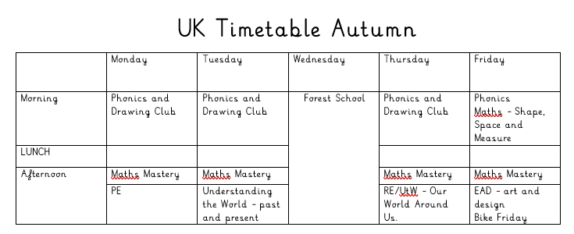

UK Timetable
Autumn 1

Slide 9

Baseline Assessment
All the children have completed the reception baseline assessment (RBA), this is always done within the first 6 weeks of starting reception.
What is the RBA?
The RBA is a short, interactive and practical assessment of your child’s early literacy, communication, language and mathematics skills when they begin school, using materials that most children of your child’s age will be familiar with.
What does participating in the RBA mean for my child?
The RBA is not about judging or labelling your child or putting them under any pressure. Your child cannot ‘pass’ or ‘fail’ the assessment.
NELI
The NELI programme provides schools with a way of identifying early language difficulties and is proven to improve children's language skills and behaviour in school

Slide 10


Phonics phase 1
In order for children to be able to read and write well they must be able to listen very carefully and discriminate between sounds. They should be taught to do this in a fun, exciting and active way with both planned and self-chosen activities.
Environmental Sounds
Instrumental Sounds
Body Percussion
Rhythm and Rhyme
Alliteration
Voice Sounds
Oral blending and Segmenting (short sounds)

Slide 11
Phase 2
Teach 19 letter graphemes (shapes) and phonemes (sounds) (GPCs) all lower case
Move from oral blending and segmenting to doing the same with letters
Learn to read and spell VC and CVC words using magnetic letters, whiteboards, phoneme fans
Introduced to reading two syllable words and simple captions.
Learn to read the tricky words – I, no, go, the, to

Slide 12
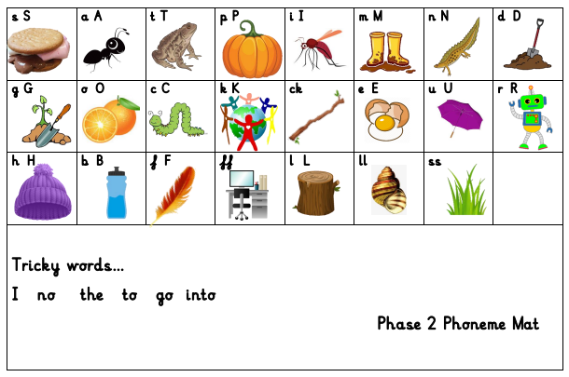
St. Mary’s phonics scheme….

Slide 13

Phase 2 - Writing
Until this point, the children have not been taught to form letters correctly.
We have been doing lots of work in Physical Development to get ourselves ready for writing, lines and shapes in preparation for writing - the children will all develop at different rates. A few are successfully forming letters, some are not ready yet. Don’t worry, the children will develop at their own speed and will get there when they’re ready.
They start by writing these in the air, in the salt, flour, in paint, using chalks and on each others backs - and when appropriate with a pencil.

Slide 14

Reading Books
Most children will already have a sharing reading book from school.
When reading the Big Cat Phonic Reading Scheme Books it is important that phonics is the first and main strategy used to decode the words. Books will be carefully matched to the phonemes they have been taught. Children will be taught to read ‘tricky’ words by sight.
Please read with your children as often as possible and write in their reading log.
They should also be encouraged to read ‘real’ books from home or the library. We are hoping to visit the village library in November. Please try and take your child down and have a look at the lovely children's section.

Slide 15

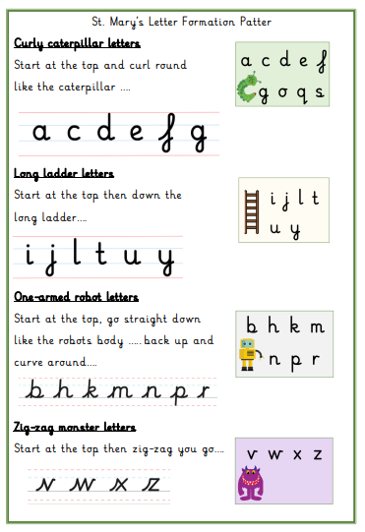

Slide 16

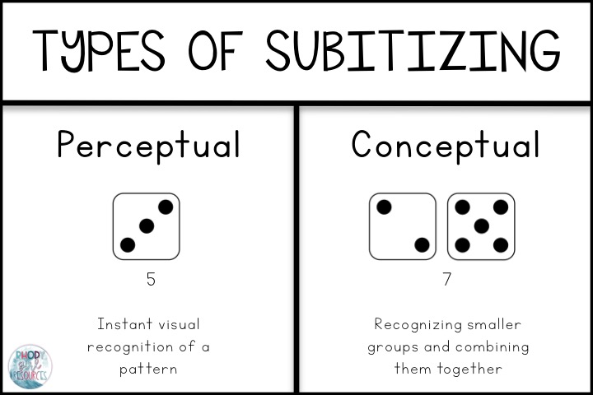

Maths Resources
Subitising
Subitising is the ability to look at a small set of objects and instantly know how many there are without counting them.

Slide 17
In EYFS and Key Stage 1:
Our priority is meeting the needs of our children – whichever class they are in.
Your child will get the required ‘diet’ for their year group – but also a diet that is tailored to their need – this may look different for children in different classes.
Classes may work completely independently… sometimes.
Classes may work with the class next door… sometimes.
Children may do things with other children in their year group – thus mixing with other classes or doing similar activities… sometimes.
For example: at Christmas, UK will work with Thailand on a performance and India will work with Italy on a different performance – each child will be included.
You may hear that children who are in another class, but are in the same year group as your child, are doing something different from your child – don’t worry! Refer to point 1!
We will try our best to communicate clearly with you.
Notes:
Teachers – please delete (for your notes) – EYFS trip to Two Woods coming up will be ONLY EYFS – because they’ve never been before! Dress up days may be different for different classes or groups – all children will get equal opps. Year 1 in BOTH Christmas performances will be the chorus/choir for example.
Ask parents to EMAIL as a general rule rather than using Dojo (because of GDPR)
17

Slide 18
School Uniform
Please ensure that all of your children’s school uniform, including PE kits (when requested) and coats, are clearly labelled with their name.
Check this regularly. If you notice the name is starting to wear off please could you re-write it in so we know who items belong to.
At the end of the day we try to collect all jumpers and cardigans etc from the cloakroom to give out, please check your children’s jumpers when they get home to ensure they are not wearing somebody else’s. We can only return them if they are still clearly named.

Slide 19
Learning Journals
One of the ways in which your child’s progress is tracked in reception is through collecting evidence of things they have said or done. These are put into a ‘Learning Journal’, which is simply a collection of your child’s achievements.
Throughout reception this is used to work out your child’s learning and their next steps.
One of the ways we ask you to help with this is through emailing us and telling us of their achievements and providing evidence of things they have said or done outside of school. Email us with photos/notes to illustrate these achievements; uk@stmarysprimarypulborough.co.uk

Slide 20
Behaviour
Positive behaviour management
Lots of praise! Verbal and rewards – dojos and stickers. | End of week certificates – Dojo champion Star of the week | Badges – Bronze, Silver and Gold. | Head teacher awards Recognition in newsletter – vine leaves

Slide 21
Behaviour continued
Behaviour management
We must follow our Golden Rules. These are up in the classroom and are often referred to. | If your child does not follow the golden rules, they will lose minutes from their break or lunch time. | This will result in a conversation with myself in person or over the phone. | If your child continues to not follow the golden rules, there will be a meeting with myself and a member of the senior leadership team.

Slide 22

Helpers
All help much appreciated!
Reading
Craft Activities
Forest Schools
Walks around the village.

Slide 23




Water bottles and Fruit
All children should have a water bottle to keep in class should they be thirsty during our Explorer Time sessions. We keep water bottles over by the sink. Children are also provided with a drink with their hot lunches.
At morning break, the children are encouraged to take a piece of fruit for a snack. Children may bring fruit from home or have a piece of school fruit. We discourage fruit winders, fruit flakes etc at break times in preference for a piece of fresh fruit. Please bring an extra piece of fruit for the afternoons.

Slide 24

Free School Milk
Milk is completely free for all children aged under 5.
Milk is subsidised for children aged 5 or over.

Slide 25

Key dates and Questions?
Key dates:
October 7th – Six weeks in meeting 9th – World Mental Health Day 16th – Individual School Photos 23rd – INSET day 26th – 30th – Half Term | November 3rd – Parents’ Evening 5th Parents’ Evening 6th – Fireworks 13th – Children in Need 16th – Odd socks for Mental Health 16th – 20th – Anti-bullying week 27th – Christingle and Advent Eucharist | December 15th – Nativity performance 2pm and 5pm 16th – Disco 17th – Pantomime 18th – Last day of term – Eucharist, Christmas jumper day, Class party

Slide 26
Things to look forward to:
Walks to the library and St. Mary’s Church- dates tbc
Diwali Week - 9th November
Nativity – 15th December 2pm and 5pm

