Slide 1

Meet the Teacher
South Africa Class
September 2026
Miss Turner – South Africa Class
sa@stmarysprimarypulborough.co.uk
TA support: Mrs Bryan, Mrs Dona,
Mrs Hayes
SEND support: Mrs Crosbie,
Mr Chinery,
Mr Barrett-Garlick
PPA Teachers (Thursday):
Mrs Burbidge – Outdoor PE
(Games/Athletics)
Miss Bell – Spanish
Mrs Flinders – Pastoral support

Slide 2
Attendance
Under Section 7 of the Education Act 1996 (in England and Wales), parents of children aged 5 to 11 are legally responsible for ensuring their child receives an efficient, full-time education suitable to their age, ability and aptitude.
We track attendance carefully in line with the Department for Education.

Slide 3
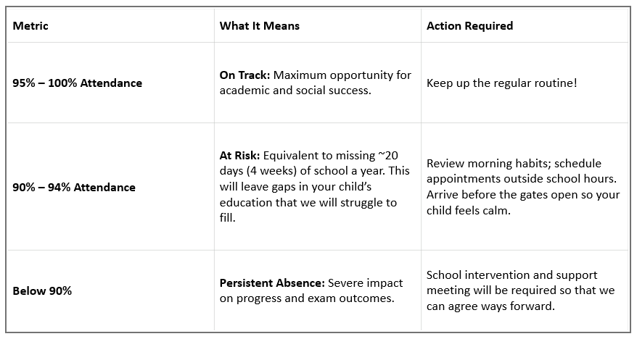
Attendance

Slide 4
Attendance
Quick Attendance Impact Guide
90% attendance: Equals missing ½ day per week or 4 full weeks of school in a year. Over a school career, this adds up to over a full school year of missed learning. Your child will not be the strongest they can be.
80% attendance: Equals missing 1 full day per week or more than half a term each year.
Every Day Counts!
Good attendance is directly linked to higher achievement, strong friendships and confidence in the classroom.
How parents can help:
Set consistent morning and bedtime routines.
Schedule medical/dental appointments outside school hours whenever possible.
Avoid booking family holidays during term time. If parents exceed five days for holidays or illness, WSCC can and will fine you.
Contact us immediately if your child is reluctant to attend so we can support them and get things in place early.

Slide 5
Lunches, snacks and water
Sign up for hot school meals at the office
Please bring in fruit or a healthy snack for break times
Please note that we are a nut free school
Water bottles are kept in the classroom and can be accessed at all times – please ensure these are named

Slide 6
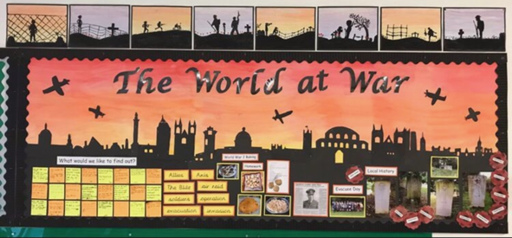
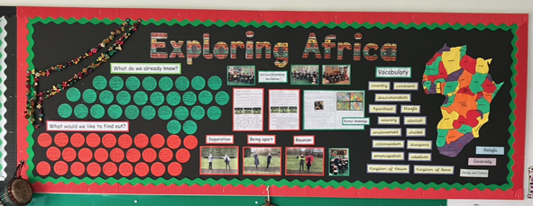
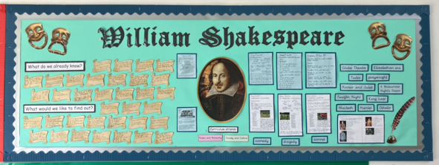
Year 5/6 Curriculum
Autumn:
The World at War
Frozen Kingdom
Spring:
Explorers and Adventurers
Exploring Africa
Summer:
Shakespeare
Me, Myself and I

Slide 7
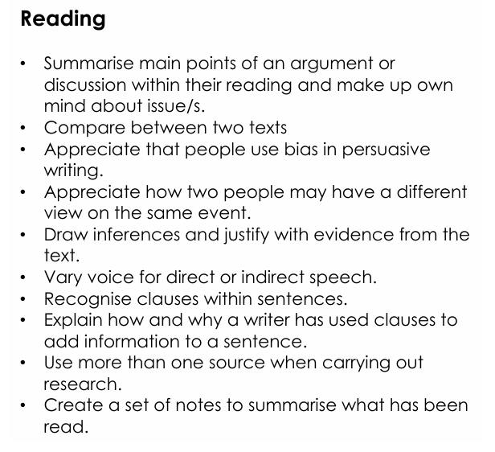
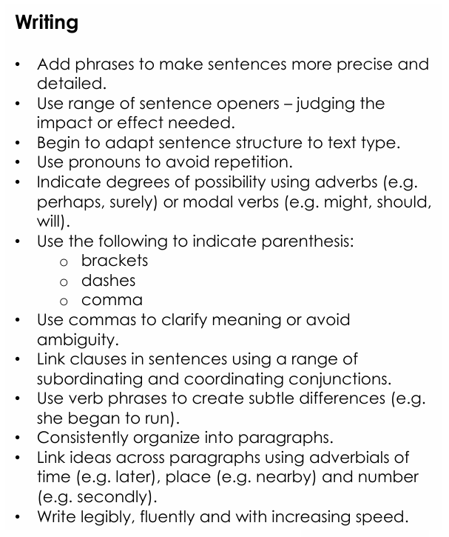
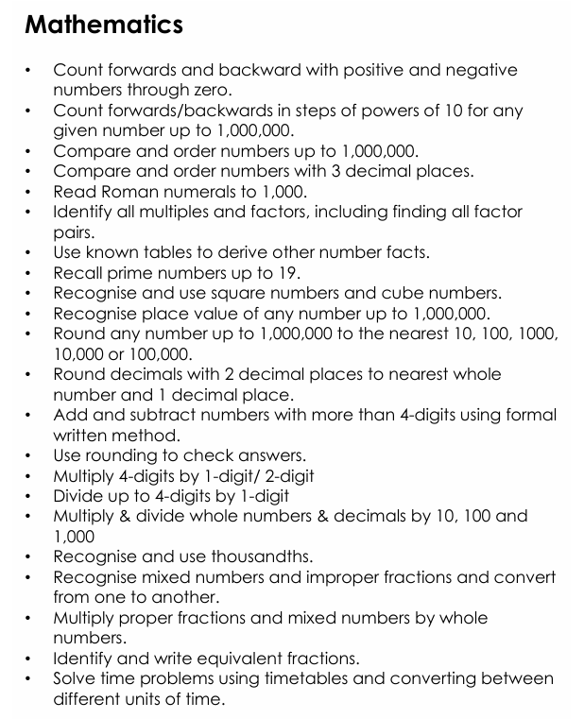
End of year expectations
Year 5:

Slide 8
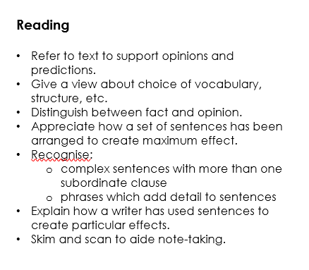
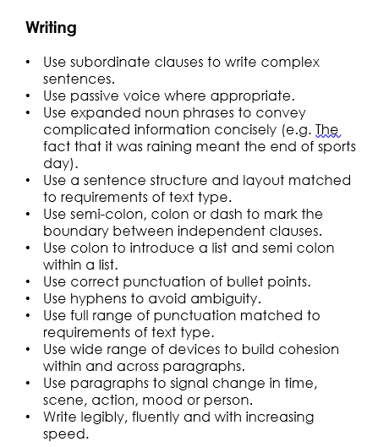
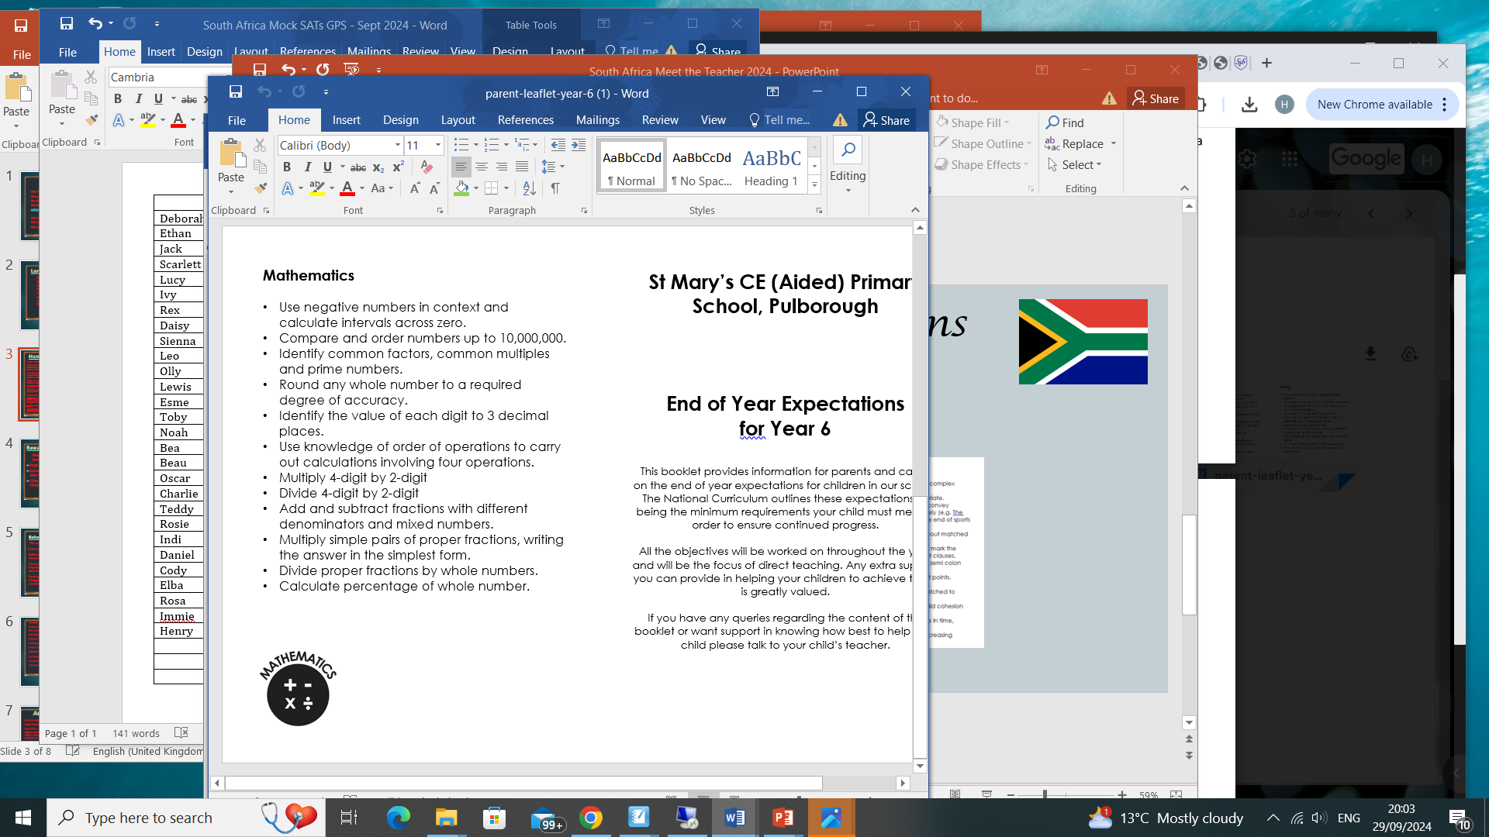
End of year expectations
Year 6:

Slide 9
Homework
Log in details for all online learning platforms have been shared via email.
Homework grids will be shared on Google Classroom half termly.
Reading logs will be checked daily – please ensure they are in school.
Our expectation is that the children will read at least 3 times per week – preferably daily. Children should respond to feedback and record their personal comments about books they have read.
Spellings will be set and tested on Mondays. Spelling books remain in school. Word lists will be uploaded to Google Classroom each week. This year, we will be using Spelling Shed, a new online platform for the teaching of spelling. Children can log in to practise spelling activities at home.
Maths: TT Rockstars, Fluent in Five, Maths with a Mouse.

Slide 10
Behaviour
Our three core expectations at St Mary’s are:
Be Ready
Be Respectful
Be Safe
Sanctions:
Verbal warning
Minutes lost from break time
Restorative conversation
Time out
We will communicate with parents to inform you of any behaviour that does not follow our school expectations.
We believe in recognising and rewarding hard work and positive behaviour.
Rewards:
Dojo points
Gold, Silver, Bronze badges
Vine leaves
Happy Book certificates
Class awards: Star of the Week/
Dojo Champion
E-Safety is covered as part of our Computing curriculum, but please be aware of – and monitor – use of devices at home.

Slide 11
Year 6
Key Stage 2 SATs – w/c Monday 10th May 2027
English: Reading
Grammar, Punctuation and Spelling
Maths: Arithmetic (1 paper)
Reasoning (2 papers)
Writing is teacher assessed.
SATs Information Meeting for parents will be held in the Spring term.
RHE: Sex Education Information Meeting – Wednesday 30th September 4:00pm

Slide 12
Autumn Term Diary Dates
Bikeability:
Year 6: Monday 28th September – Thursday 1st October
Year 5: Friday 2nd October
South Africa Class Assembly – Thursday 1st October
Individual School Photographs – Friday 16th October
Half Term – Monday 26th – Friday 30th October
Parents Evenings – Tuesday 3rd and Thursday 5th November
Year 5 Residential to Cobnor: Wednesday 5th – Friday 7th May 2027
Year 6 Residential to Marchant’s Hill: Monday 17th – Friday 21st May 2027

