Slide 1

‘Meet the Teacher’
Hello and Welcome to China Class!
Miss Fuller – Class Teacher

Slide 2
Attendance
Under Section 7 of the Education Act 1996 (in England and Wales), parents of children aged 5 to 16 are legally responsible for ensuring their child receives an efficient, full-time education suitable to their age, ability, and aptitude.
We track attendance carefully in line with the Department For Education.

Slide 3
Attendance
Metric | What It Means | Action Required
95% – 100% Attendance | On Track: Maximum opportunity for academic and social success. | Keep up the regular routine!
90% – 94% Attendance | At Risk: Equivalent to missing ~20 days (4 weeks) of school a year. This will leave gaps in your child’s education that we will struggle to fill. | Review morning habits; schedule appointments outside school hours. Arrive before the gates open so your child feels calm.
Below 90% | Persistent Absence: Severe impact on progress and exam outcomes. | School intervention and support meeting will be required so that we can agree ways forward.

Slide 4
Attendance
Quick Attendance Impact Guide
90% Attendance: Equals missing 1/2 day per week or 4 full weeks of school a year. Over a school career, this adds up to over a full school year of missed learning. Your child will not be the strongest they can be.
80% Attendance: Equals missing 1 full day per week or more than half a term each year.
Every Day Counts!
Good attendance is directly linked to higher achievement, strong friendships, and confidence in the classroom.
How parents can help:
Set consistent morning and bedtime routines.
Schedule medical/dental appointments outside school hours whenever possible.
Avoid booking family holidays during term time. If parents exceed five days for holidays or illness WSCC can and will fine you.
Contact us immediately if your child is reluctant to attend so we can support them and get things in place early.

Slide 5
Lunches, snacks and water
Sign up for hot school meals at the office.
Please bring in fruit or a healthy snack for break times - No chocolate bars at breaktime.
Playtime is at 12.15, lunch in the hall is at 12.35
Please note that we are a nut free school.
Water bottles are kept in the classroom and can be accessed at all times – please ensure these are named.

Slide 6
Break and Lunch
Children will have their playtime at 12:15 and then eat their lunch in the hall at 1:35.
Sign up for hot school meals at the office.
Fruit or a healthy snack can be brought in for break times.
Please note that we are a nut-free school.
Water bottles are kept in the classroom and can be accessed at all times. Please ensure these are named.

Slide 7
Swimming is currently on a Wednesday morning. After half term, there will be no swimming but PE will be on a Wednesday afternoon.
On Wednesday afternoon, Mrs Gowland will teach China Class.
On Thursday morning, Ms Bell and Mrs Burbidge will teach Spanish and PE.

Slide 8



Year 5 Curriculum
Autumn:
The World at War
Frozen Kingdom
Spring:
Explorers and Adventurers
Exploring Africa
Summer:
Shakespeare
Me, Myself and I

Slide 9
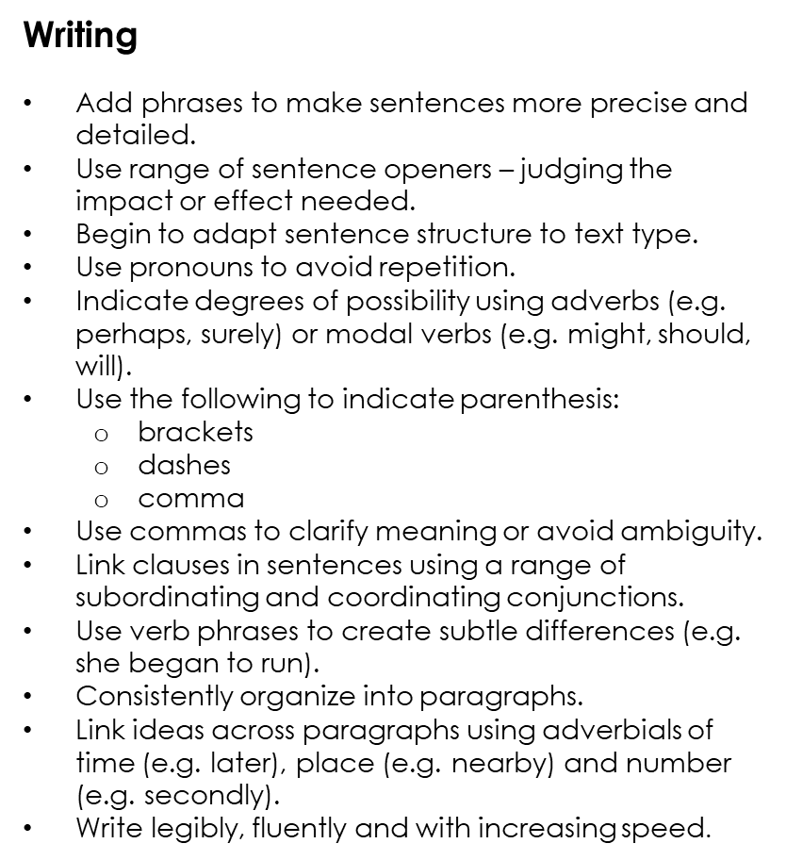
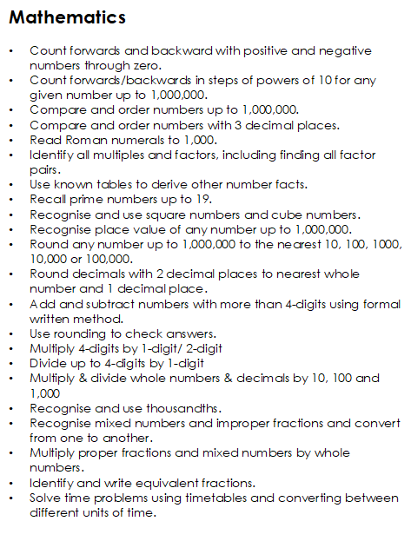
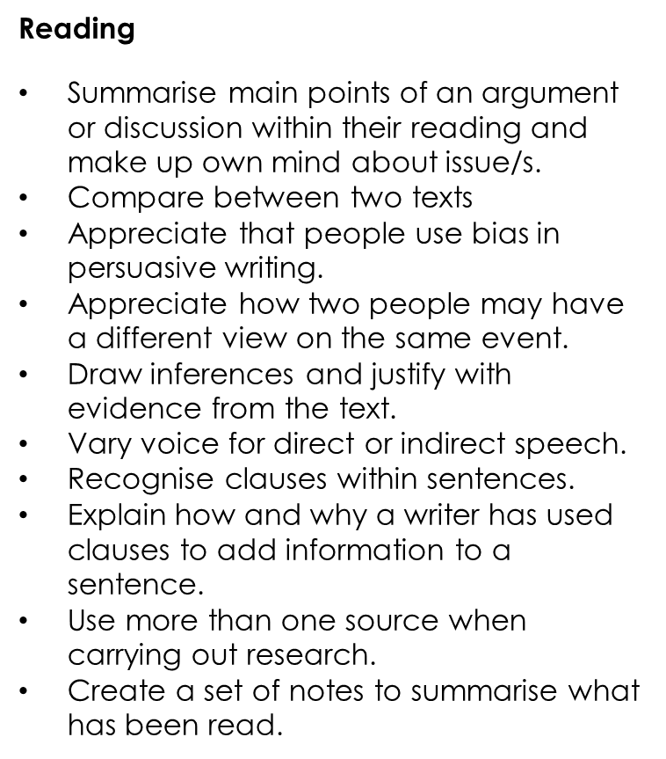
Year 5 End of Year expectations

Slide 10
Homework
Log in details for all online learning platforms have been shared via
email.
Homework grids will be shared on Google Classroom half termly.
Reading logs will be checked daily – please ensure they are in school. Our expectation is that
    the children will read at least 3 times per week – preferably daily. Children should respond to feedback and record their personal comments about books they have read.
Spellings will be set and tested on Mondays. Spelling books remain in school. Word lists will be uploaded to Google Classroom each week.
Maths: TT Rockstars, Fluent in Five, Maths with a Mouse.

Slide 11
Behaviour
Everyone at St Mary’s believes in recognising and rewarding hard work and positive behaviour.
Rewards:
Dojo points
Gold, Silver, Bronze badges
Vine leaves
Happy Book certificates
Dojo Champion
Sanctions:
Verbal warning
Minutes lost from break time
Restorative conversation
Time out
E-Safety is covered as part of our Computing curriculum, but
please be aware of – and monitor – use of devices at home.
We will communicate with parents to inform you of any behaviour that does not follow our school expectations.

Slide 12
Important dates
Year 5 Bikeability – Friday 2nd October
China Class assembly – Thursday 8th October
Individual School Photographs – Friday 16th October
Inset Day – Friday 23rd October
Half Term – Monday 26th October – Friday 30th October
Parents Evenings – Tuesday 3rd November and Thursday 5th November 3:30-6:00pm
End of term – Friday 16th December

