Slide 1

Welcome to
USA Class
Mrs Farrant and Mrs Shepherd

Slide 2
Attendance
Under Section 7 of the Education Act 1996 (in England and Wales), parents of children aged 5 to 16 are legally responsible for ensuring their child receives an efficient, full-time education suitable to their age, ability, and aptitude.
We track attendance carefully in line with the Department For Education.

Slide 3
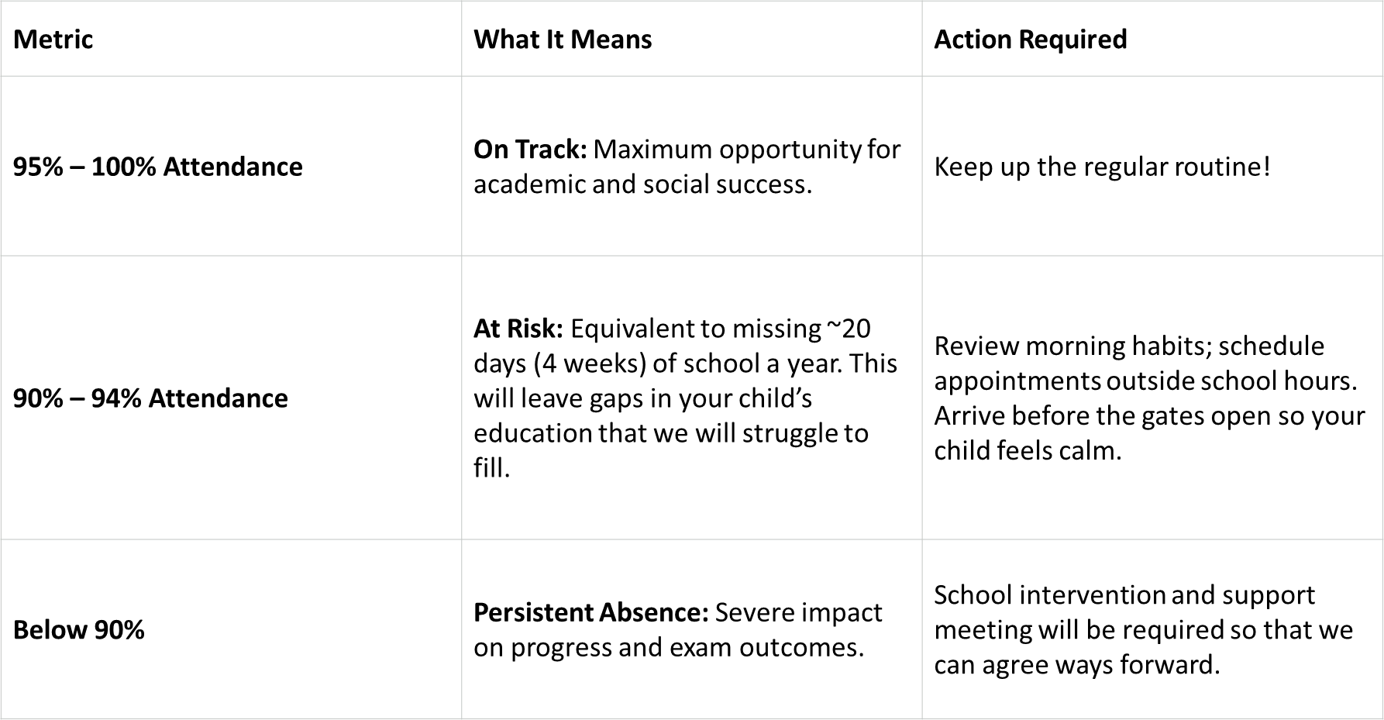
Attendance

Slide 4
Attendance
Quick Attendance Impact Guide
90% Attendance: Equals missing 1/2 day per week or 4 full weeks of school a year. Over a school career, this adds up to over a full school year of missed learning. Your child will not be the strongest they can be.
80% Attendance: Equals missing 1 full day per week or more than half a term each year.
Every Day Counts!
Good attendance is directly linked to higher achievement, strong friendships, and confidence in the classroom.
How parents can help:
Set consistent morning and bedtime routines.
Schedule medical/dental appointments outside school hours whenever possible.
Avoid booking family holidays during term time. If parents exceed five days for holidays or illness WSCC can and will fine you.
Contact us immediately if your child is reluctant to attend so we can support them and get things in place early.

Slide 5
Curriculum
Our themes for the year….

Slide 6
USA Class Timetable
Our class timetable is flexible and therefore will differ slightly on a weekly basis depending on what we need to focus on.
PE:
Swimming on Monday’s until the October half-term holiday, then indoor PE on Tuesdays with Mrs Farrant
Outdoor PE with Mrs Burbidge on Friday – Tag Rugby and Ultimate Frisbee
Spellings:
New Spelling Scheme- Spelling Shed. Each Monday, I will set tasks on Spelling Shed linked to their spellings for that week. They will then be tested on these spellings the following Monday. All children's logins are stuck in the back of their reading record, but please do let me know if you have any problems accessing this site. I have put the spellings on Google Classroom to use if you are unable to access Spelling Shed.
Homework:
‘Homework grid’ format will continue. The children have been encouraged to plan which tasks they will complete over the whole term in advance.
Two English and two Maths tasks should be completed each half term. In KS2 children should spend roughly 1 hour on their homework each week. Try and encourage your children to plan with you when homework is going to happen. The more child-led it is, the easier it should be to do ☺
Please send in homework to be shared each week, we will do this by Friday morning at the latest – thank you already, if you have done this.
Times Tables Rockstars: Please practice times tables at home as often as possible to help increase fluency and improve the children’s speed of recall.
Numbots: If your child needs to practise their number facts and fluency, please use this. The login is the same as TTRockstars.

Slide 7
USA Class Timetable
Reading logs:
These will be collected and checked every day of the week and written
in at least once a week
Please feel free to leave comments for me in your child’s reading log –
they are an important dialogue between home and school.
Children may change their books from the KS2 library.
We encourage the children to include their own comments and reflections
about what they have read:
Which part of the book did you most enjoy?
What did you like/dislike about a particular character?
What do you predict might happen next?
Would you recommend this book to a friend? Why/why not?
Regular home reading will be rewarded with dojo points!
Other staff who will be working with USA class:
Ms Bell– Spanish – Friday
Outdoor PE – Mrs Burbidge.
Mrs Shepherd and Mrs Catchpole – TAs working with the class
Mr Chalk – Clarinet teacher each Thursday for 10 weeks.

Slide 8
St Mary’s CE (Aided) Primary School, Pulborough
End of Year Expectations
for Year 4
This booklet provides information for parents and carers on the end of year expectations for children in our school. The National Curriculum outlines these expectations as being the minimum requirements your child must meet in order to ensure continued progress.
All the objectives will be worked on throughout the year and will be the focus of direct teaching. Any extra support you can provide in helping your children to achieve these is greatly valued.
If you have any queries regarding the content of this booklet or want support in knowing how best to help your child, please talk to your child’s teacher.

Slide 9
Writing
Vary sentence structure, using different openers.
Use adjectival phrases (e.g. biting cold wind).
Use appropriate choice of noun or pronoun.
Use fronted adverbials.
Use apostrophe for plural possession.
Use a comma after fronted adverbial (e.g. Later that day, I heard bad news.).
Use commas to mark clauses.
Use inverted commas and other punctuation to punctuate direct speech.
Use paragraphs to organised ideas around a theme.
Use connecting adverbs to link paragraphs.
Write with increasing legibility, consistency and fluency.

Slide 10
Reading
Give a personal point of view on a text.
Re-explain a text with confidence.
Justify inferences with evidence, predicting what might happen from details stated or implied.
Use appropriate voices for characters within a story.
Recognise apostrophe of possession (plural)
Identify how sentence type can be changed by altering word order, tenses, adding/deleting words or amending punctuation.
Explain why a writer has used different sentence types or a particular word order and the effect it has created.
Skim & scan to locate information and/or answer a question.

Slide 11
Mathematics
Count backwards through zero to include negative numbers.
Compare and order numbers beyond 1,000.
Compare and order numbers with up to 2 decimal places.
Read Roman numerals to 100.
Find 1,000 more/less than a given number.
Count in multiples of 6, 7, 9, 25 and 1000.
Recall and use multiplication and division facts all tables to 12x12.
Recognise PV of any 4-digit number.
Round any number to the nearest 10, 100 or 1,000.
Round decimals with 1dp to nearest whole number.
Add and subtract numbers with up to 4-digits using written columnar method.
Multiply:
  2-digit by 1-digit
  3-digit by 1-digit
Count up/down in hundredths.
Recognise and write equivalent fractions
Add and subtract fractions with same denominator.
Read, write and convert time between analogue and digital 12 and 24 hour clocks.

Slide 12
School Uniform
Please make sure that your child’s school uniform is clearly labelled.
Uniform must follow the school’s policy.
Earrings must be removed for PE lessons and swimming. (unless you have emailed a disclaimer)

Slide 13
What to bring to school
Named water bottles please.
Changes this year:
PE kits should be worn to school on Fridays.
Spelling books will stay in school.

Slide 14
Classroom Routines
Water bottles
These are kept by the sink in the classroom and can easily be refilled as and when necessary. If children forget their water bottle there are cups which can be used. Children can access the water bottles throughout the day, first thing in the morning, during lessons, break times and lunch breaks. We just ask children to focus on the short teaching input at the beginning of each lesson before accessing their water bottles. Children take their water bottle into the school hall for lunch if they have a packed lunch (milk or water is supplied for children having a hot school dinner).
Toilets
Children can access the toilets throughout the day. We just ask the children to avoid going out to the toilet during the short teaching input at the beginning of each lesson to avoid missing the key learning. Each class teacher tends to send only one or two children at a time to the toilet to avoid the toilets being too ‘busy’.

Slide 15
Behaviour
Good behaviour in the class is rewarded using the dojo system.
Dojo points are added up each week and at the end of each term.
Each week there will be a class dojo champion/s (the person with the most dojos).
Dojos also help contribute towards each child’s team, so earning dojos will also earn team points. Team celebrations will take place for the team with the most points at the end of the term.
Weekly class dojo target:
5 weeks – Bronze Star
15 weeks – Silver Star
25 weeks – Gold Star
We will also be awarding a class ‘Star of the Week’ each Friday.
This will be presented to somebody who has worked exceptionally hard or demonstrated one (or more) of the school’s Christian Values.
Happy Book certificates are awarded at the end of each half term.

Slide 16
MTC
Times Tables Check
As part of our teacher assessments for this year, the Year 4 children will be sitting the Multiplication Tables Check which will see how well they know their Times Tables.
Under the National Curriculum primary school children are expected to know their 12 times tables by the end of Year 4. We have been preparing students to know their times tables by the end of Year 4 for quite some time now with our weekly Times Tables tests and opportunities to use Times Tables Rockstars.

Slide 17
MTC
Times Tables Check
The check itself:
will take place in the first three weeks after the May half term.
will be online using an iPad and will be done on a one-to-one basis.
will take no longer than 5 minutes.
will feature 25 questions and children will have 6 seconds to answer each question with a 3 second rest period between each question.
does not contain any problem solving and will involve questions in the format of ‘3 x 4 = ? and 5 x 6 = ?’

Slide 18
MTC
Times Tables Check
Practise at Home: Because maths is such a big subject, and we will of course continue to teach the full curriculum, we will need your continued support to help practise the times tables with your children. Some easy ways to do this include:
asking questions such as “What’s 7 x 8?”
reciting Times Tables by rote (4 times 1 is 4, 4 times 2 is 8, etc)
using apps and games (see below about a resource your student has access to)
Topmarks
TTRockstars
Mathsframe

Slide 19
Important Dates
Half Term – Monday 26th October – Friday 30th October
Parent’s Evenings - Tuesday 3rd November and Thursday 5th November from 3.30pm-6pm in the USA Classroom

Slide 20
Any Questions?
*Reminder that we are a nut free school*
If there is anything that you are curious or concerned about, please use our class email address: usa@stmarysprimarypulborough.co.uk

