Slide 1

2025-2026
Miss Taylor
Welcome to Sierra Leone Class

Slide 2
Under Section 7 of the Education Act 1996 (in England and Wales), parents of children aged 5 to 16 are legally responsible for ensuring their child receives an efficient, full-time education suitable to their age, ability, and aptitude.
We track attendance carefully in line with the Department For Education.

Slide 3
Metric | What It Means | Action Required
95% – 100% Attendance | On Track: Maximum opportunity for academic and social success. | Keep up the regular routine!
90% – 94% Attendance | At Risk: Equivalent to missing ~20 days (4 weeks) of school a year. This will leave gaps in your child’s education that we will struggle to fill. | Review morning habits; schedule appointments outside school hours. Arrive before the gates open so your child feels calm.
Below 90% | Persistent Absence: Severe impact on progress and exam outcomes. | School intervention and support meeting will be required so that we can agree ways forward.

Slide 4
Quick Attendance Impact Guide
90% Attendance: Equals missing 1/2 day per week or 4 full weeks of school a year. Over a school career, this adds up to over a full school year of missed learning. Your child will not be the strongest they can be.
80% Attendance: Equals missing 1 full day per week or more than half a term each year.
Every Day Counts!
Good attendance is directly linked to higher achievement, strong friendships, and confidence in the classroom.
How parents can help:
Set consistent morning and bedtime routines.
Schedule medical/dental appointments outside school hours whenever possible.
Avoid booking family holidays during term time. If parents exceed five days for holidays or illness WSCC can and will fine you.
Contact us immediately if your child is reluctant to attend so we can support them and get things in place early.

Slide 5
Our Topics
Autumn 1 | Rumble in the jungle
Autumn 2 | Road trip USA
Spring 1 | Temples, Tombs and Treasures
Spring 2 | Misty Mountains and Winding Rivers
Summer 1 | Vikings
Summer 2 | Rumbles

Slide 6
Typical Sierra Leone Class Timetable
Spellings- Will be tested on a Monday
Times Tables- Will be tested on a Thursday
PE with Mrs Burbidge will be on a Friday. Please come into school in your PE kit
Swimming- Thursday

Slide 7
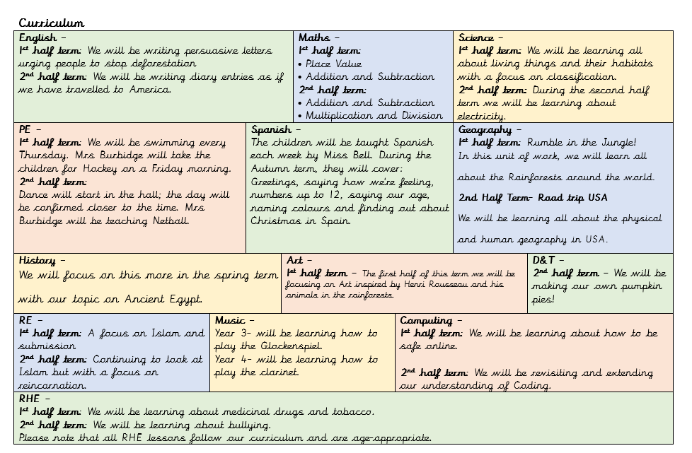

Slide 8



Routines
Times Tables | Spellings | Reading Logs
We will be testing the children each week on their understanding and will also be participating in daily maths fluency lessons, called Maths Flash. There are lots of ways to practise times tables at home. TT Rockstars. Online games – Bowling, Angry Andy must have Candy, Caterpillar carnage | We are now using a new spelling scheme called spelling shed to teach and practice spellings each week. Each child has a login in the back of their reading record to practice these at home. | Reading logs will be collected in and checked every day. Children must be reading at least 3 times a week. Dojos will be awarded for children who are reading at home. Please ensure that reading is recorded in logs. Your child can write it in themselves if they wish.

Slide 9
Routines
Water Bottle Please ensure that your child has their water bottle with them each day. | Snack Please ensure that your child comes to school with a healthy snack. This could be a piece of fruit or cereal bar. Please also note that we are a nut-free school. | Homework The homework grid will be available through Google Classroom. Please submit your child’s learning through GC or through the class email: sl@stmarysprimarypulborough.co.uk

Slide 10
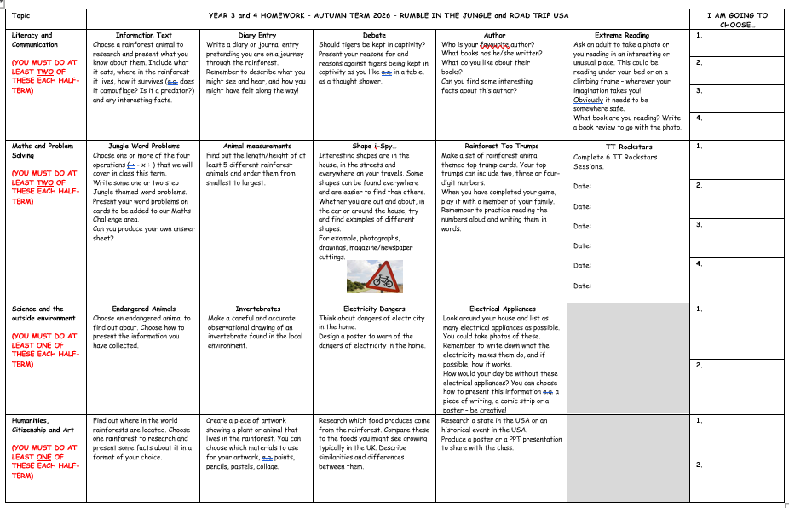
Homework

Slide 11
Behaviour
Positive behaviour management
Lots of praise! Verbal and rewards – dojos and stickers. | End of week certificates – Dojo champion Star of the week | Badges – Bronze, Silver and Gold. | Head teacher awards Recognition in newsletter – vine leaves

Slide 12
Behaviour continued
Behaviour management
We must follow our Golden Rules. These are up in the classroom and are often referred to. | If your child does not follow the golden rules, they will lose minutes from their break or lunch time. | This will result in a conversation with myself in person or over the phone. | If your child continues to not follow the golden rules, there will be a meeting with myself and a member of the senior leadership team.

Slide 13
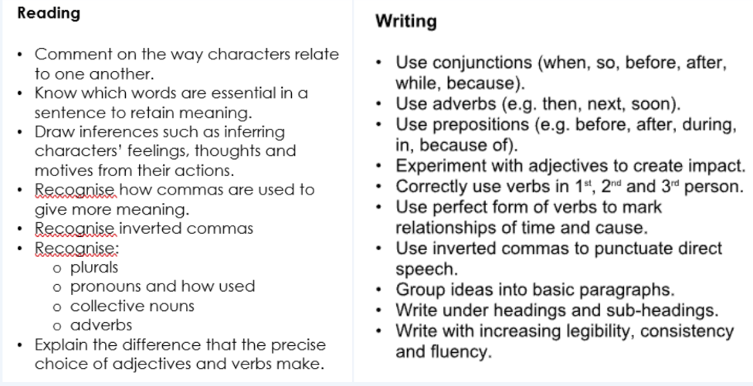
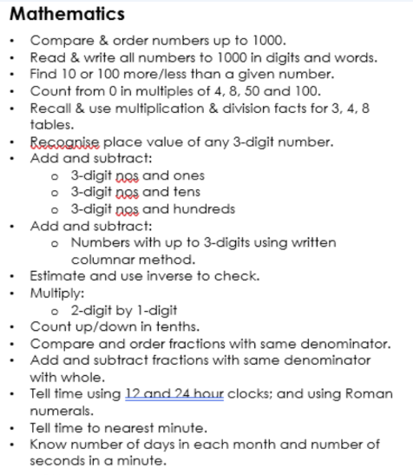
End of year 3 expectations

Slide 14
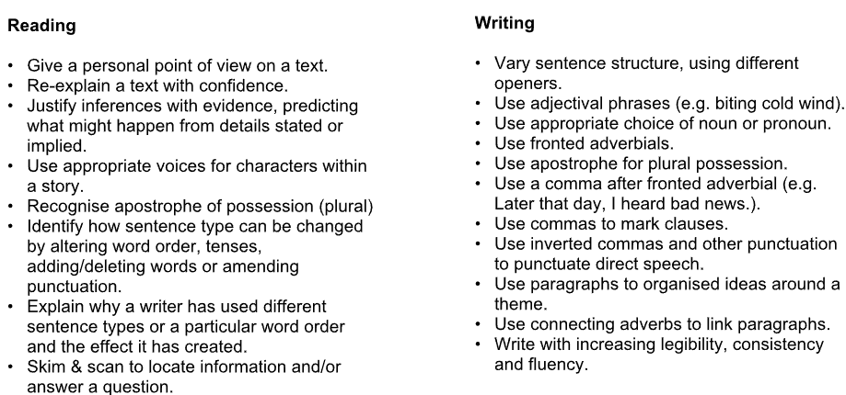
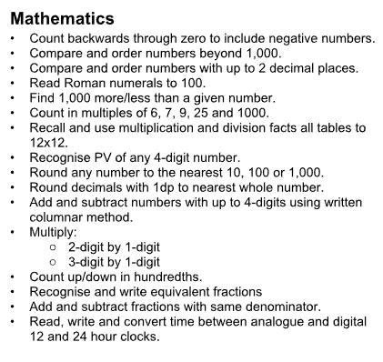
End of year 4 expectations

Slide 15
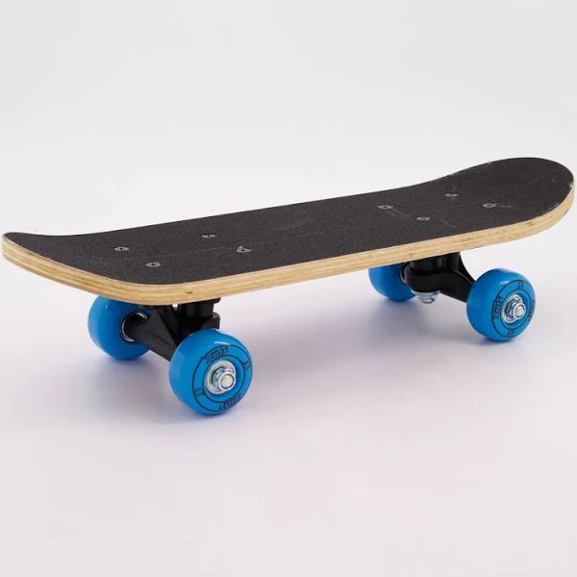

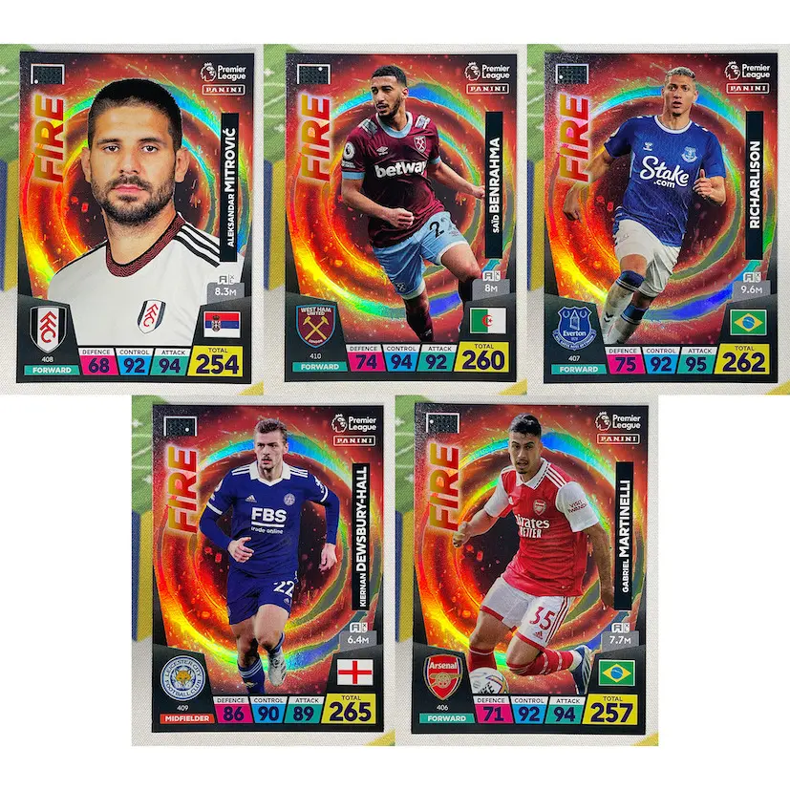
Toys vs concentration tools

Slide 16
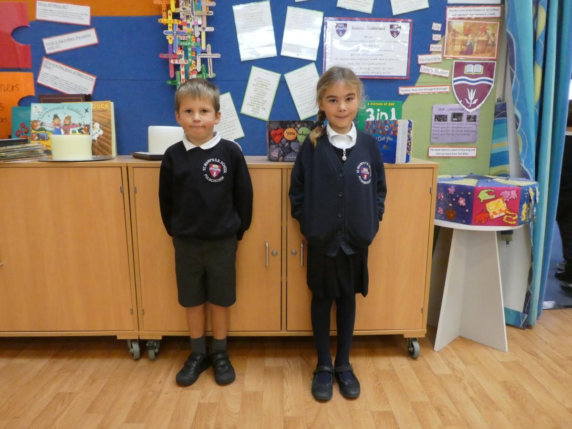
School Uniform
Please make sure that your child’s school uniform is clearly labelled.
Uniform must follow the school’s policy.
Earrings must be removed for PE lessons. (unless you have emailed a disclaimer)

Slide 17
MTC Multiplication check- Year 4 only
As part of our teacher assessments for this year, the Year 4 children will be sitting the Multiplication Tables Check which will see how well they know their Times Tables. There are some websites that have been uploaded onto Google Classroom for the children to practice with. We will be practicing using TT Rockstars, the practice Multiplication Test Check and a weekly times tables test.
Under the National Curriculum primary school children are expected to know up to their 12 times tables by the end of Year 4. We have been preparing students to know their times tables by the end of Year 4 for quite some time now with our weekly Times Tables tests and opportunities to use TT Rockstars.

Slide 18
MTC Multiplication check- Year 4 only
The check itself:
will take place in the first three weeks after the May half term.
will be online using a tablet.
will take no longer than 5 minutes.
will feature 25 questions and children will have 6 seconds to answer each question with a 3 second rest period between each question.
does not contain any problem solving and will involve questions in the format of ‘3 x 4 = ? and 5 x 6 = ?’

Slide 19
MTC Multiplication check- Year 4 only
Practise at Home: Because maths is such a big subject, and we will of course continue to teach the full curriculum, we will need your continued support to help practise the times tables with your children. Some easy ways to do this include:
asking questions such as “What’s 7 x 8?”
reciting Times Tables by rote (4 times 1 is 4, 4 times 2 is 8, etc)
using apps and games (see below about a resource your student has access to)
TTRockstars
Mathsframe
The practice version of the test so that they can become familiar with it.

Slide 20
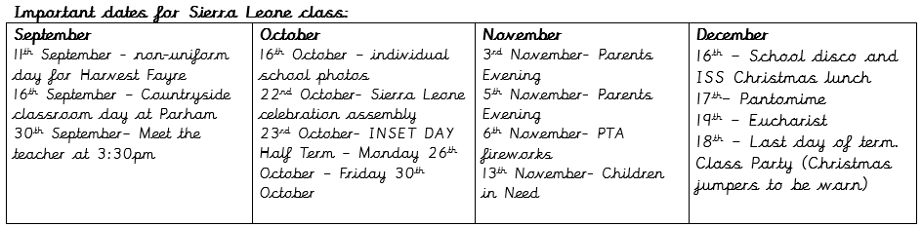

Key dates and Questions?

