Slide 1

‘Meet the Teacher’
Wednesday 30th September 2026
Good afternoon and welcome to Australia Class!
Mrs. Packham

Slide 2
School Attendance
Under Section 7 of the Education Act 1996 (in England and Wales), parents of children aged 5 to 16 are legally responsible for ensuring their child receives an efficient, full-time education suitable to their age, ability, and aptitude.
We track attendance carefully in line with the Department For Education.

Slide 3
Metric | What It Means | Action Required
95% – 100% Attendance | On Track: Maximum opportunity for academic and social success. | Keep up the regular routine!
90% – 94% Attendance | At Risk: Equivalent to missing ~20 days (4 weeks) of school a year. This will leave gaps in your child’s education that we will struggle to fill. | Review morning habits; schedule appointments outside school hours. Arrive before the gates open so your child feels calm.
Below 90% | Persistent Absence: Severe impact on progress and exam outcomes. | School intervention and support meeting will be required so that we can agree ways forward.

Slide 4
Quick Attendance Impact Guide
90% Attendance: Equals missing 1/2 day per week or 4 full weeks of school a year. Over a school career, this adds up to over a full school year of missed learning. Your child will not be the strongest they can be.
80% Attendance: Equals missing 1 full day per week or more than half a term each year.
Every Day Counts!
Good attendance is directly linked to higher achievement, strong friendships, and confidence in the classroom.
How parents can help:
Set consistent morning and bedtime routines.
Schedule medical/dental appointments outside school hours whenever possible.
Avoid booking family holidays during term time. If parents exceed five days for holidays or illness WSCC can and will fine you.
Contact us immediately if your child is reluctant to attend so we can support them and get things in place early.

Slide 5
Australia Class Timetable
The timetable is flexible and will change each week.
depending on what we need to focus on.
Each week we will be having a lesson on Relationship and Health Education (RHE). These lessons are compulsory and must be taught once a week. They will be learning about parts of the body and will know the names of different parts by the end of the year.

Slide 6
Australia Class Timetable
PE will be on a Wednesday and Friday every week, but please ensure PE kit is in school on the first day of every week and it will be sent home each Wednesday. On Friday, children should come to school in their PE kits (no school uniform required).
Phonics/ Spelling Patterns will be on Google Classroom and will be sent home every week for a spelling quiz on the following Monday.
Homework this half-term is on a grid from which the children can choose. Please could the children complete one piece of homework each week. They can complete this in their books or online. You can also photograph or scan the children's homework and email them to the class email address.

Slide 7
Australia class - Reading
Reading logs will be checked daily and stamped. I will give 5 dojos for each time a child reads.
Targets or questions written.
There will be a reader of week for awarded to all children who have read daily in a weekly period up to Friday.
I will hear every child read once a week during our Guided Reading sessions.
In the comments section, please leave comments sharing anything with which your child has struggled and highlighting what they have done well.
Reading VIPERS bookmark – ask your child any of the questions to deepen their understanding of what they have read. Please do write any direct quotes.
Reading books – To read with fluency, your child should be able to read 9/10 words. They need to read their book at least 3 times per week.
Library Readers – Some children in Australia have progressed to Library reading; which is fantastic. These children should be reading at home at least 5 times per week.
Myon logins – books online that can be read, or it can be read to you.
Passwords are in the back of Reading Records.

Slide 8
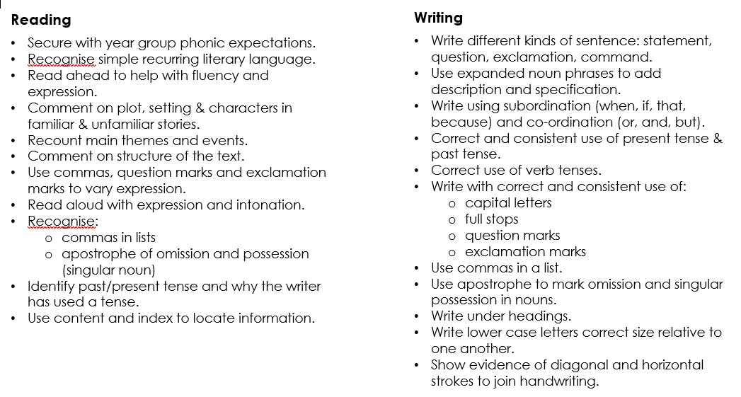
End of Year 2 expectations.

Slide 9
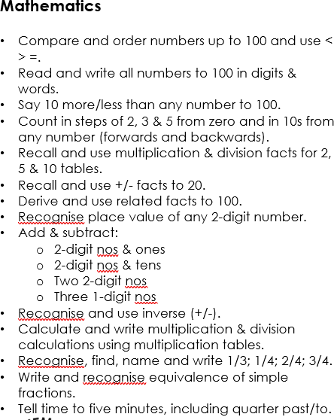
End of Year 2 expectations.

Slide 10
Autumn Term learning
Overall Themes
This half-term our Topic is ‘Superheroes’ and we will be linking our English learning to this theme alongside other curriculum areas. The second half of term is ‘Journeys’.
English
In English, we will be using a range of texts to delve further into our theme. We will explore We will explore Superkid by Clare Freeman and Supertato by Sue Hendrain greater depth to support our narrative story writing. We will also be studying poetry and writing our own poems to expand creativity in literacy.
Maths
This term, we will focus on place value, addition and subtraction and finally, Geometry. All children will learn new mathematical concepts using physical equipment (manipulatives) and pictorial representations before progressing to the abstract stage.
Science
This term, children will be learning about animals, including humans. Pupils will learn about lifecycles of animals and humans and what living things need to survive. We will also study the four seasons to expand our knowledge of the changes that take place.
Class Worship & Religious Education Our days always contain interactive Class Worship, a prayer or elements of learning taken from the new statutory curriculum subject: Relationships & Health Education curriculum. Our Christian Value for this half-term is love. In RE this half term, pupils will be exploring what Christians believe God is like. We will read and learn about the parable of the Lost Son.

Slide 11
Autumn Term learning (cont.)
RHE Year 2 pupils will be learning about physical health and wellbeing. We will discuss ways to keep themselves safe within the home (inc. online) and outdoors. We will also focus on The Colour Monster book, this explores feelings, emotions and how to manage them.
Art and Design This term, pupils will study pop art and Andy Warhol. We will create our own brightly coloured pop art pieces. In DT, pupils will look at structures and bridges. This will link well with the topic of journeys; the children will learn to make their own bridges using a variety of materials. They will then test them with various weight to test stability and strength.
History and Geography In our history sessions, we will learning about ‘superheroes’ throughout history and what makes them a hero. We will study influential figures, including Martin Luther King Jr and Emmeline Pankhurst. In geography, we will learn basic geographical vocabulary to refer to key physical features using maps. We will learn how to understand maps and keys. We will also learn about the UK and the countries and capital cities within.
Computing
We will continue to use Purple Mash as a comprehensive educational learning tool. Your child will be doing some further work on coding and algorithms. The principles of online safety will be integral throughout.
Music
Pupils will explore pulse, rhythm and pitch. They will use their voices to sing songs, chant rhymes and use their creativity to compose their own songs and chants. We then hope to perform at our Showcase class assembly later in the term.

Slide 12
Australia Class
Numbots and TTRockStars
By the end of year 2 children need to know at least their 2, 5 and 10 multiplication and division facts – once these are mastered, they will move onto 3, 4, 6 and 8.
Number bonds to 100
TTRockstars and Numbots logins at the back of Reading Records – any problems, please come and see or email me.
Please can children practise at home, so these are
embedded.

Slide 13
Dates to Remember - (Also check school’s website and newsletter for updates)
Italy/Australia/India visit to St. Mary’s Church – Friday 9th October
PTA AGM (all welcome) – Thursday 15th October @ 3:30pm
Individual School Photos – Friday 16th October – full uniform please
Superheroes Day – KS1 - Thursday 22nd October
INSET DAY – Friday 23rd October
Half-Term – Monday 26th - Friday 30th October
Parent’s evenings (in school) – w/c: Monday 2nd November
Australia Class Assembly - Thursday 5th November @ 9am
PTA Fireworks – Friday 6th November @ 5:30pm
KS1 Nativity – 8th and 9th December @ 2pm and 5pm
KS1 Disco – Wednesday 16th December 2025 (5pm)
Christmas Jumper Day/Class parties/Last day of term – Friday 18th December 2026

Slide 14
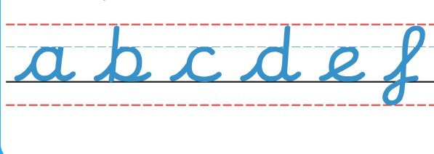
Handwriting
As a school we have been developing our cursive handwriting policy, which has both lead ins and lead outs. We will practise handwriting every day after lunch.

Slide 15
SCHOOL UNIFORM
Please make sure every item of clothing is properly labelled.
If you notice the name is starting to wear off, please could you re-write it, so we know to whom items belong.
Please make sure uniform follows school policy.

Slide 16
WHAT TO BRING TO SCHOOL
PE kits should be brought in EVERY Monday and be left at school unless otherwise stated.
Water bottle – clearly named please.
Reading records and reading books – EVERY DAY.
Snack.
Coat.
REMEMBER: We are a NUT-FREE School.

Slide 17
BEHAVIOUR
Good behaviour, including good listening, is rewarded with dojo points. If a child reaches a weekly target 5 times in the year, they will receive a bronze badge. If they reach the target 15 times, they will receive a silver badge. If they reach the target 25 times they will receive a gold badge. The target is 25 dojos.
Every week we will decide on a Star of the Week – this may be awarded to a child who has worked consistently hard or who has been exceptional in following our Golden Rules or demonstrating one of our Christian values.
Each week, our class pet – Kylie Koala – will go home with a child. Kylie has her own travel journal. If your child is chosen, please ensure Kylie is well cared for and her weekend journal is completed with any/all activities enjoyed. Ideally, the child should be writing in the journal (with support if needed).

Slide 18
MRS PACKHAM’S PRIZES
In addition to Dojos, I have created a prize box for the class.
Each child has been given a punch card which they need to keep in their tray. When they have had all the holes punched on their card; they will be allowed to choose a prize from the box.
A hole will be punched on their card for a RAK… Random Acts of Kindness. I believe that, in addition to ensuring every child is trying hard, progressing in their learning and following behavioural expectations; showing kindness, thought and care to each other is vital to ensure they are growing socially and morally.

Slide 19
QUESTIONS/CONCERNS…
If there is anything about which you are curious or concerned, please do come and see me after school or send an email to: australia@stmarysprimarypulborough.co.uk
Thank you for your attendance today and continued support in your child’s learning journey through year 2.

