Slide 1
SENsational Growth
Parent workshop: Growing Young Minds

Slide 2
Agenda for the morning
01 | Who are we?
02 | Why SENsational Growth?
03 | Managing Anxiety
04 | School Attendance
05 | Importance of Sleep Hygiene
06 | Questions

Slide 3
Kerry washington
“Your life is your story, and the adventure ahead of you is the journey to fulfil your own purpose and potential.”

Slide 4

What does this mean?
This quote inspires children to view their lives as a unique journey filled with possibilities.
It encourages them to pursue their passions and discover their purpose, fostering a sense of direction and fulfilment in their lives.
SENsational Growth was born from a desire to help all children foster their own potential and recognise that their unique skills are part of their journey and how to harness them.

Slide 5
Who are we? SENsational Growth
Hayley perry
Clare ralston
Education Mental Health Coach
SEND specialist with a focus on ADHD and Autism
I have a background spanning 18 years working in SEN provisions (specialist schools), Trauma informed Residential care and working with the Children and Young People's Services in West Sussex.
My main areas of passion and expertise lie in:
- Trauma informed practise
-Autism
-ADHD
-Fearless (Triple P programme) working with children with Anxiety
Qualified SEN Primary school teacher (KS1-3)
Dyslexia qualified
I have over 20 years experience working within Early Years and Children's Services and am a driving force in encouraging children to believe in themselves, grow in confidence and develop a passion for learning.
​My main focus and expertise lie in:
- SEND practise
- Dyslexia
- Transitions
- Family Relationships

Slide 6
Why did we create SENsational Growth?
To ensure that every child with Special Educational Needs and Disabilities (SEND) is truly seen, supported, and given the opportunity to thrive.
Across West Sussex, 14.9% of children are recorded on the SEN register; this is a significant number of families navigating complex educational, emotional, and social challenges.
While schools work hard to meet these needs, we recognised that many children require additional, more personalised support that goes beyond the traditional classroom.
The West Sussex SEND Strategy highlights the importance of early intervention, inclusive practice, and strong collaboration between education, health, and families

Slide 7
Managing Anxiety

Slide 8
What is Childhood Anxiety?
Anxiety is the body’s alarm system. It’s designed to keep us safe but in some children, that alarm goes off too often, too loudly, or at the wrong times.
For primary‑aged children, anxiety usually shows up as:
-Worry about everyday situations (school, friendships, separating from parents, trying new things).
- Fear of something going wrong, even when there’s no real danger.
- A physical response : their body reacts as if there is a threat, even when their mind knows they “shouldn’t” feel scared.
Children often don’t have the language to explain what’s happening, so anxiety is expressed through behaviour rather than words.

Slide 9
What does anxiety LOOK like in your child?
2. Emotional Signs
Excessive worry or fear
Tearfulness or irritability
Feeling overwhelmed by small tasks
Low confidence or fear of making mistakes
4. Learning‑Related Signs
Struggling to start tasks
Difficulty concentrating
Appearing distracted or “daydreaming”
Slow processing or needing instructions repeated
Avoiding challenging work
Physical Signs
Tummy aches, headaches, nausea
Fast breathing or heart rate
Feeling shaky or dizzy
Complaints of feeling “unwell” before school
Difficulty sleeping or nightmares
3. Behavioural Signs
Avoiding school, clubs, or social situations
Clinging to parents or teachers
Refusing to speak (selective mutism in some cases)
Repetitive reassurance‑seeking (“Will you be there?” “What if…?”)
Perfectionism or giving up quickly
Meltdowns, shutdowns, or withdrawal
Difficulty separating from home routines

Slide 10

- Home Tutoring for those not in school or not progressing at school with an SEN-specialised tutor.
- Emotional Regulation work with our mental health coach (examples including affirmations, grounding work and mind “safe spaces”).
- Confidence-building exercises (celebrating successes, focusing on strengths, safe environments).
- Equipping your child with skills to help them cope in challenging situations (such as rituals, self-soothing boxes).
- Liaising between school and home to create the best possible learning environment for the child.
What can we do to support your child during this period?

Slide 11
Attendance/EBSA

Slide 12
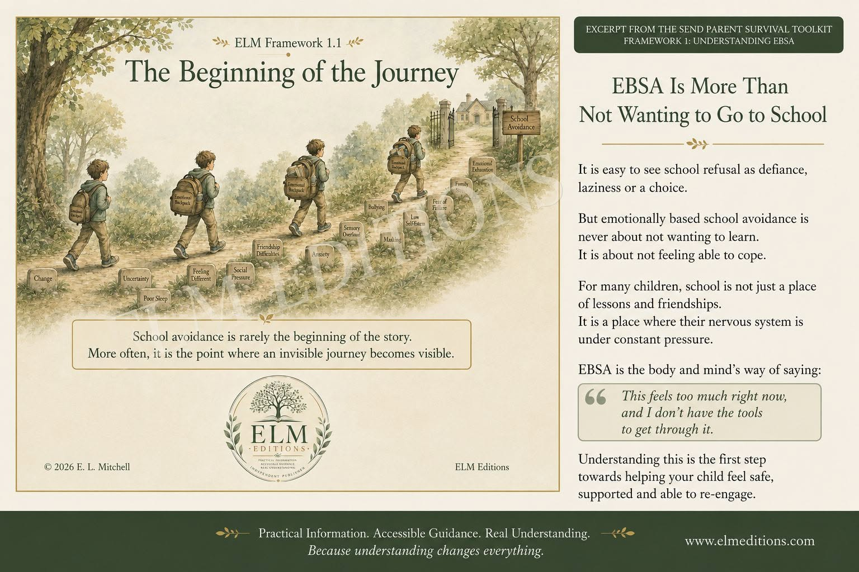
Attendance and Emotionally Based School Avoidance (EBSA).
EBSA is a broad term describing children or young people who experience persistent anxiety or emotional distress related to school.
It is not a diagnostic label but encompasses behaviours such as prolonged absences, avoidance of specific lessons or people, and heightened emotional responses to school-related situations.
EBSA can result in missed learning, social experiences, and impacts on well-being, often creating a perpetuating cycle of avoidance if not addressed early.

Slide 13
Recognising Emotionally Based School Avoidance:
Emotional symptoms include: intense anxiety/fear as shown by tearfulness, irritability and anger.
Physical symptoms include: frequent headaches, tummy upset, nausea, sweating and panic-like episodes relating to certain school days, lessons or term starts.
Schools may notice a decrease in school attendance or spot particular lessons/subjects that are being missed.
Acknowledging these symptoms and patterns early and seeking support can be vital in a child’s educational journey.

Slide 14
Sleep Hygiene

Slide 15
What do we mean by Sleep Hygiene?
What are your views?

Slide 16
Sleep Hygiene:
This is the set of habits and environmental practices that promote consistent, high-quality sleep.
Examples of good sleep hygiene include:
Creating a bedroom environment conducive to rest (such as keeping it dark, quiet and temperature controlled)
Routine and consistency.
Reducing exposure to screens before sleep (ideally an hour).
Establishing a relaxing pre-sleep routine such as a bath, reflective discussion about the day, stories, calming music.

Slide 17
Repercussions of poor sleep hygiene:
Difficulty falling asleep
Frequent awakenings through the night
Daytime sleepiness
Desire to co-sleep with parents due to restlessness/anxiety around bedtime.
Poor sleep resulting in:
Low mood
Difficulty focusing/paying attention (in school).
Social communication with peers being impacted.

Slide 18

SENsational Growth: more information
Visit www.sensationalgrowth.co.uk for our services and resources.
Check out SENsational Growth Ltd on Facebook and Instagram.
Email: admin@sensationalgrowth.co.uk

Slide 19
Any Questions?
We are around for Q&A and a cuppa, so come and chat to us.

