Slide 1
Tea and Chat: Reading for Pleasure
27.01.26

Slide 2
Why Read?
Reading motivation and frequency are associated with reading comprehension and wider attainment.
Reading:
Expand children’s understanding of the world.
Enriches their vocabulary.
Improves their writing across different purposes.
Increases wellbeing.
The DofE’s Year of Reading aims to reinvigorate reading habits, focusing on reading for pleasure.

Slide 3
The Reading Landscape
Growing evidence from multiple sources points to a decline in reading engagement across generations, beginning in the early years.
Parental reading enjoyment is weakening
Home reading environments are changing
Fewer children and young people are reading
Reading decline extends into adulthood

Slide 4
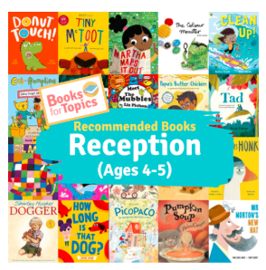
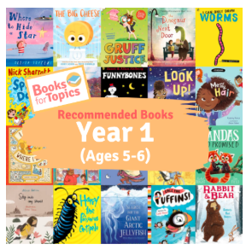
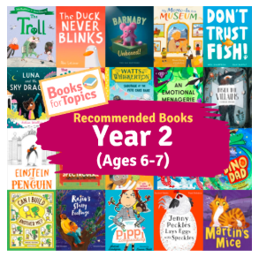
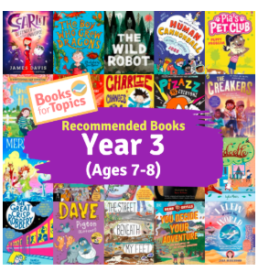
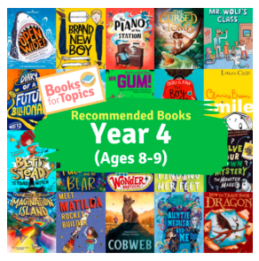
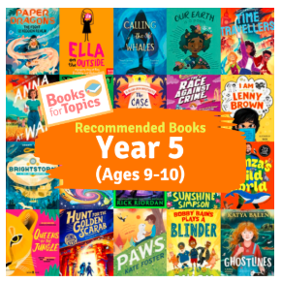
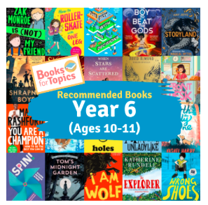
Engaging Readers: Recommendations

Slide 5
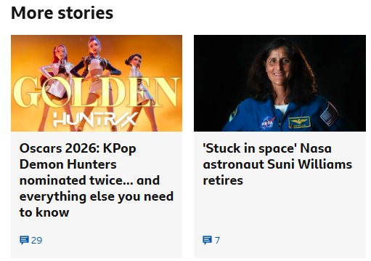
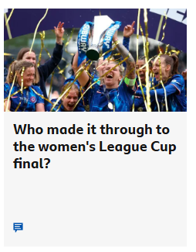
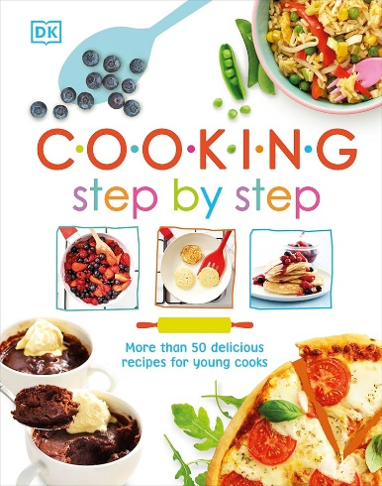
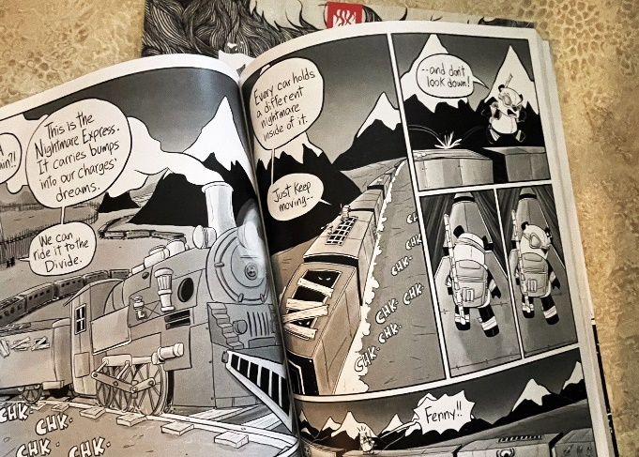





Read Their Way: What Interests Your Reader

Slide 6

Adults as Role Models
Young people’s identities are shaped by their families, teachers and peers.
- Who are you as a reader?
Read separately but together
Create time to talk
Engage in reading tasks set by the school

Slide 7
Reading Together
The simple view of reading has two components: word recognition (decoding) and language comprehension.
Your child needs to practice decoding, applying phonics and the strategies taught in school to break down familiar words.
Language comprehension is equally important and involves helping your child understand vocabulary, sentence structure, and the overall meaning of what they read or hear.

Slide 8
Reading Together
You can also share a book which could involve you reading to your child or taking turns.
Remember, that you can still read to your child no matter how old they are!
Check your child’s understanding and discuss the book together as you go.

Slide 9
Top Tips
Schedule in time for reading; even ten minutes before bed makes a difference.
Choose books that your child enjoys – meet them where they are!
Focus on understanding not perfection – gently correct mistakes.
Make it fun – use voices, act it out and enjoy the stories together.
Talk before, during and after reading – ask questions.
Show that reading matters- let your child see you read too.

Slide 10
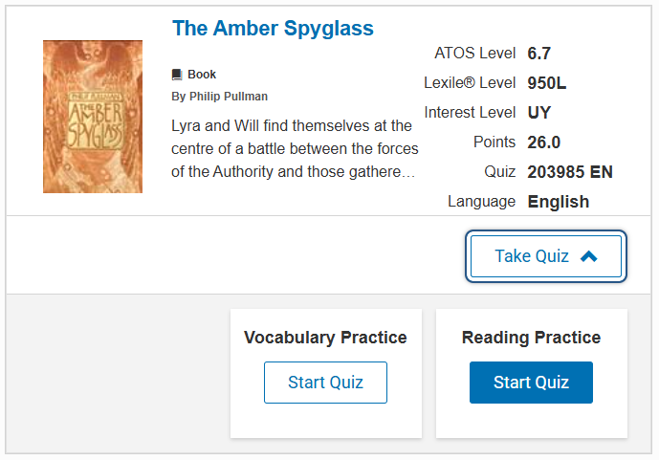

Boosting Comprehension: Accelerated Reader

