Slide 1
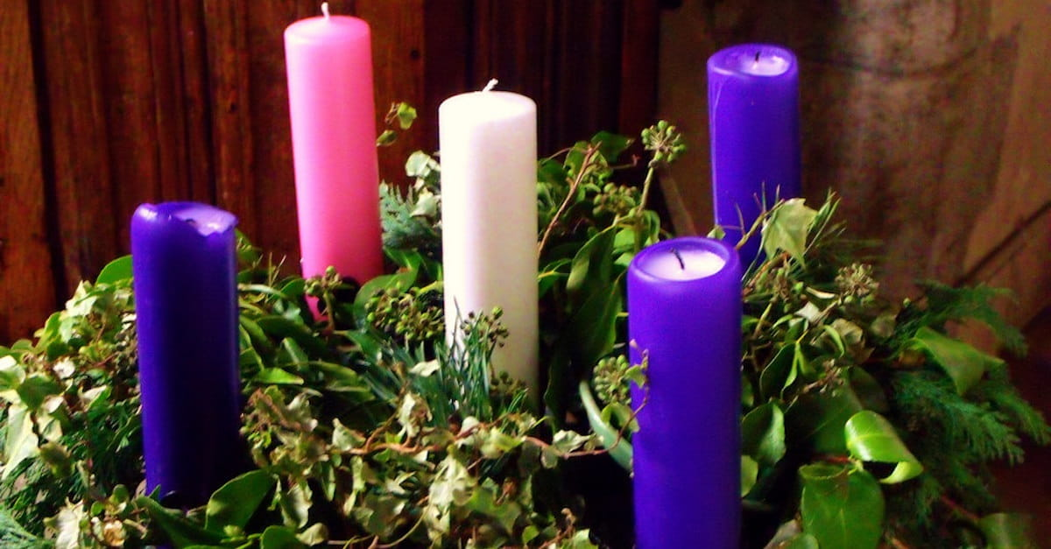
Advent Eucharist 2025

Slide 2
Like a Candle Flame – Kendrick (SCHOOL CHOIR)
Like a candle flame
Flickering small in our darkness
Uncreated light
Shines through infant eyes
God is with us, alleluia
God is with us, alleluia
Come to save us, alleluia
Come to save us
Alleluia!
Stars and angels sing
Yet the earth sleeps in shadows
Can this tiny spark
Set a world on fire?
Yet his light shall shine
From our lives, Spirit blazing
As we touch the flame
Of his holy fire

Slide 3
Greeting
XIn the name of the Father,
and of the Son,
and of the Holy Spirit. Amen
The Lord be with you
And also with you.

Slide 4
Shine Jesus Shine
Lord, the light of your love is shining
In the midst of the darkness, shining
Jesus, Light of the world, shine upon us
Set us free by the truth you now bring us
Shine on me, shine on me
Shine, Jesus, shine
Fill this land with the Father's glory
Blaze, Spirit, blaze
Set our hearts on fire
Flow, river, flow
Flood the nations with grace and mercy
Send forth your word
Lord, and let there be light
Lord, I come to your awesome presence
From the shadows into your radiance
By the blood I may enter your brightness
Search me, try me, consume all my darkness
Shine on me, shine on me

Slide 5
Shine, Jesus, shine
Fill this land with the Father's glory
Blaze, Spirit, blaze
Set our hearts on fire
Flow, river, flow
Flood the nations with grace and mercy
Send forth your word
Lord, and let there be light
As we gaze on your kingly brightness
So our faces display your likeness
Ever changing from glory to glory
Mirrored here may our lives tell your story
Shine on me, shine on me

Slide 6
Saying Sorry (Confession)
Lord Jesus you are the light shining in the dark places of the world
Lord have mercy
Lord have mercy
Lord Jesus you are the star that leads us into life in its fullness
Christ have mercy
Christ have mercy
Lord Jesus you come among us to show us how to live
Lord have mercy
Lord have mercy
May Almighty God have mercy on us,
forgive us our sins,
and bring us to everlasting life.
Amen

Slide 7
The Prayer for the first week of Advent
Almighty God,
As your kingdom dawns,
Turn us from the darkness of sin
To the light of holiness,
That we maybe ready to meet you
In our Lord and Saviour Jesus Christ.
Amen.
Halle, halle, halle-lu-jah!
Halle, halle, halle-lu-jah!
Halle, halle, halle-lu-jah!
Hallelujah, hallelujah

Slide 8
At the Gospel
The Lord be with you
And also with you
Hear the Gospel of our Lord Jesus Christ according to …
Glory to you O Lord
The Gospel reading is now read.
This is the Gospel of the Lord
Praise to you, O Christ
Address by Father Paul

Slide 9
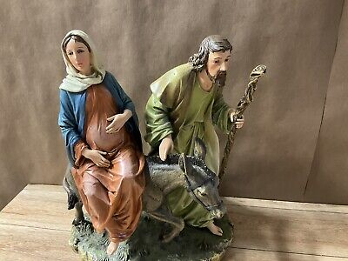

Slide 10
Prayers – Led by Year 5
Lord in your Mercy
Hear our prayer
The Prayer of St Richard of Chichester
Thanks be to you, my Lord Jesus Christ
For all the benefits which you have given me;
For all the pains and insults which you have borne for me.
O most merciful Redeemer, Friend and Brother,
May I know you more clearly, love you more dearly
and follow you more nearly.
Amen.

Slide 11
Merciful Father,
Accept these prayers
for the sake of your Son,
our Saviour Jesus Christ.
Amen.

Slide 12
The Peace
The peace of the Lord be always with you.
And also with you.
Let us offer one another the sign of peace.
Shalom
Shalom, my friend,
Shalom, my friend,
Shalom, shalom.
The peace of Christ I give you today.
Shalom, shalom. X2

Slide 13
Be Still
Be still for the presence of the Lord,
The Holy One is here
Come bow before Him now,
With reverence and fear
In Him no sin is found
We stand on holy ground
Be still for the presence of the Lord,
The Holy One is here

Slide 14
Be still for the glory of the Lord,
Is shining all around
He burns with holy fire,
With splendour He is crowned
How awesome is the sight
Our radiant King of light
Be still for the glory of the Lord,
Is shining all around

Slide 15
Be still, for the power of the Lord
is moving in this place:
he comes to cleanse and heal,
to minister his grace-
no work too hard for him.
In faith receive from him.
Be still, for the power of the Lord
is moving in this place.

Slide 16
Prayer of Thanksgiving (The Eucharistic Prayer)
The Lord be with you
And also with you.
Lift up your hearts
We lift them to the Lord
Let us give thanks to the Lord our God
It is right to give thanks and praise
Why is it right to give thanks and praise?
Listen, and we will hear.
Lord of all life, you created the universe,
where all living things reflect your glory.
You give us this great and beautiful earth,
to discover and to cherish.
You give us happy times and things to celebrate.
In these we taste your kingdom, a feast for all your children.
You made us all, each wonderfully different,
to join with the angels and sing your praise:

Slide 17
Holy, Holy, Holy Lord,
God of pow’r and God of might:
Heaven and earth, heaven and earth,
Are full of your glory, your pow’r and might:
Hosanna, hosanna, hosanna in the highest heav’ns.
Hosanna, hosanna, hosanna in the highest heav’ns.
Blessed, blessed is he who comes,
blessed blessed is he who comes;
Blessed is he, blessed is he who comes in the name of the Lord.
Hosanna, hosanna, hosanna in the highest heav’ns
Hosanna, hosanna, hosanna in the highest heav’ns

Slide 18
We thank you, loving Father,
because, when we turned away,
you sent Jesus, your Son.
He gave his life for us on the cross
and shows us the way to live.
Send your Holy Spirit
that these gifts of bread and wine
may be for us Christ’s body and his blood.
Why do we share this bread and wine?
Listen, and we will hear.

Slide 19
On the night before he died,
when darkness had fallen,
Jesus took bread.
He gave thanks, broke it,
and shared it with his disciples saying:
‘This is my body, given for you. Do this to remember me.’
After they had eaten, he took the cup of wine,
Gave thanks, and shared it with his disciples saying;
‘This is my blood, poured out for you and for many,
for the forgiveness of sins.’

Slide 20
So Father, with this bread and this cup
We celebrate his love, his death, his risen life.
As you feed us with these gifts,
Send your Holy Spirit,
And change us more and more
To be like Jesus our Saviour.
How do we follow Jesus Christ?
Listen, and we will hear.

Slide 21
Help us, Father, to love one another,
As we look forward to that day when suffering is ended,
And all creation is gathered in your loving arms.
And now, with the Blessed Virgin Mary,
St Richard, St Wilfrid and all your saints,
We give you glory.
Through Jesus Christ,
In the strength of the Spirit,
Today and for ever.
Amen.

Slide 22
The Lord’s Prayer
As our Saviour has taught us, so we pray:
Our Father, who art in heaven,
hallowed be thy name;
thy kingdom come;
thy will be done
on earth as it is in heaven.
Give us this day our daily bread.
And forgive us our trespasses,
as we forgive those who trespass against us.
And lead us not into temptation;
but deliver us from evil.
For thine is the kingdom,
the power and the glory,
for ever and ever. Amen.

Slide 23
Breaking of the Bread
We break this bread
to share in the body of Christ.
Though we are many, we are one body,
because we all share in one bread.

Slide 24
Lamb of God,
you take away the sin of the world,
have mercy on us.
Lamb of God,
you take away the sin of the world,
have mercy on us.
Lamb of God,
you take away the sin of the world,
grant us peace.

Slide 25
Giving of Communion
This is the Lamb of God
who takes away the sin of the world.
Happy are those who are called to his supper.
Lord I am not worthy to receive you,
but only say the word,
and I shall be healed.

Slide 26
Communion Hymn
Give me joy in my heart, keep me praising,
give me joy in my heart, I pray;
give me joy in my heart, keep me praising,
keep me praising till the break of day:
Chorus: Sing hosanna, sing hosanna,
Sing hosanna to the King of kings!
Sing hosanna, sing hosanna,
Sing hosanna to the King!
Give me peace in my heart, keep me loving,
give me peace in my heart, I pray;
give me peace in my heart, keep me loving,
keep me loving till the break of day:
Chorus:

Slide 27
Give me love in my heart, keep me serving,
give me love in my heart, I pray;
give me love in my heart, keep me serving,
keep me serving till the break of day:
Chorus: Sing hosanna, sing hosanna,
Sing hosanna to the King of kings!
Sing hosanna, sing hosanna,
Sing hosanna to the King!

Slide 28
Prayer after Communion
Almighty God,
we thank you for feeding us
with the body and blood of your Son Jesus Christ.
Through him we offer you our souls and bodies
to be a living sacrifice.
Send us out in the power of your Spirit
to live and work
to your praise and glory.
Amen.
The Blessing

Slide 29
The Dismissal
Go in the peace of Christ.
Thanks be to God.

Slide 30
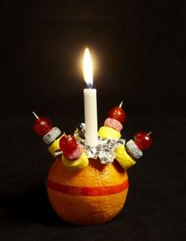
Advent Eucharist
.

