Slide 1
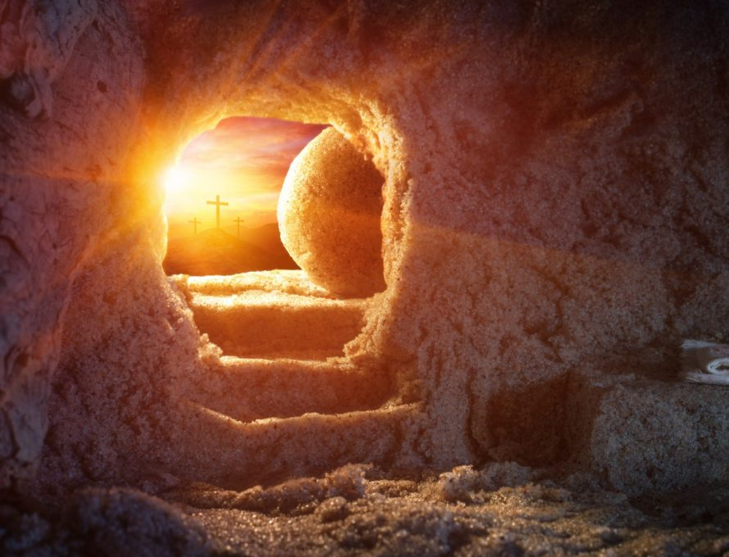
St Mary’s C of E (Aided) Primary School
Easter Service 2025

Slide 2
CHORUS Risen! Risen! Jesus is risen!
The Spirit was given – Jesus is alive!
Risen! Risen! Jesus is risen!
The Spirit was given – Jesus is alive!
Early in the morning on the first day of the week,
Women went to visit at the tomb.
Angels came and told them, ‘The one you’ve come to see,
He isn’t here, but you will meet Him soon!’
CHORUS
Fearful and excited, amazed by all they’d seen,
Mary and her friends ran from the tomb.
Finding the disciples together where they’d meet,
Bursting with joy they ran into the room.

Slide 3
Two of the believers, with thoughts about the week,
Walked the road so lonely and confused.
While they spoke of Jesus and all he’d come to mean,
He came along beside them with the news:
CHORUS Risen! Risen! Jesus is risen!
The Spirit was given – Jesus is alive!
Risen! Risen! Jesus is risen!
The Spirit was given – Jesus is alive!
All of the disciples were terrified to see
Jesus there before them in the room.
‘Why are you so frightened?’ He said. ‘It’s really me!
All of the things I told you have come true!’
CHORUS

Slide 4
Greeting
XIn the name of the Father,
and of the Son,
and of the Holy Spirit.
Amen
The Lord be with you
And also with you.
Alleluia Christ is Risen.
He is risen indeed. Alleluia.

Slide 5
Saying sorry
Lord, we have not loved you as we should
Lord have mercy
Lord have mercy
Lord, we have not loved our neighbours as we should
Christ have mercy
Christ have mercy
Lord, we have not loved ourselves as we should
Lord have mercy
Lord have mercy

Slide 6
May Almighty God have mercy on us,
forgive us our sins,
and bring us to everlasting life.
Amen

Slide 7
The Gloria - Anderson
Gloria, gloria, in excelsis Deo.
Gloria, gloria, in excelsis Deo.
Lord God, heavenly King, peace you bring to us;
We worship you, we give you thanks, we sing our song of praise R
Jesus, Saviour of all, Lord, God, Lamb of God,
You take away our sins, O Lord, have mercy on us all. R
At the Father’s right hand, Lord receive our prayer,
For you alone are the Holy One, and you alone are Lord. R
Glory, Father and Son, glory, Holy Spirit,
To you we raise our hands up high, we glorify your name. R

Slide 8
Prayer for today
God of glory,
by the raising of your Son
you have broken the chains of death and hell:
fill your Church with faith and hope;
for a new day has dawned
and the way to life stands open
in our Saviour Jesus Christ who is alive and reigns with you in the unity of the Holy Spirit, one God now and forever.
Amen

Slide 9
Alleluia …..

Slide 10
Gospel Reading
Hear the Gospel of our Lord Jesus Christ according to John.
Glory to you, O Lord.
This is the Gospel of The Lord.
Praise to you, O Christ.
Father Paul…

Slide 11
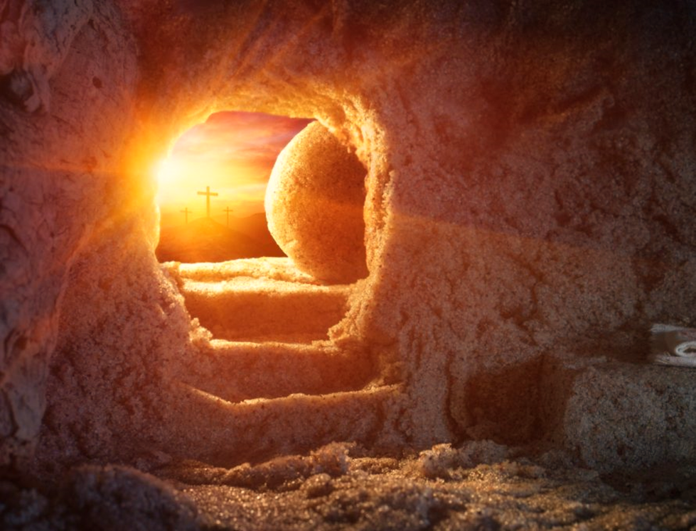

Slide 12
Prayers – Led by year 4
Lord in your mercy
Hear our prayer

Slide 13
The Prayer of St Richard.
Thanks be to you, my Lord Jesus Christ
For all the benefits which you have given me;
For all the pains and insults which you have borne for me.
O most merciful Redeemer, Friend and Brother,
May I know you more clearly, love you more dearly
and follow you more nearly.
Amen.
Merciful Father,
Accept these prayers
for the sake of your Son
our Saviour Jesus Christ.
Amen.

Slide 14
Celebrate
Sing a song, sing a joyful song,
Sing a joyful song to celebrate!
(Repeat)
Jesus is alive, you know,
He’s risen from the dead. (Oh yeah)
He was crucified but now he’s
Risen like he said! (Hallelujah)

Slide 15
Jump up and down, up and down and around,
Up and down and around to celebrate!
(Repeat)
Jesus is alive, you know,
He’s risen from the dead. (Oh yeah)
He was crucified but now he’s
Risen like he said! (Hallelujah)

Slide 16
Clap your hands, clap your hands like this,
Clap your hands like this to celebrate!
(Repeat)
Jesus is alive, you know,
He’s risen from the dead. (Oh yeah)
He was crucified but now he’s
Risen like he said! (Hallelujah)

Slide 17
Dance to the beat, to the beat of the drum,
To the beat of the drum to celebrate!
(Repeat)
Jesus is alive, you know,
He’s risen from the dead. (Oh yeah)
He was crucified but now he’s
Risen like he said! (Hallelujah)

Slide 18
Wave your hands, wave your hands in the air,
Wave your hands in the air to celebrate!
(Repeat)
Jesus is alive you know,
He’s risen from the dead. (Oh yeah)
He was crucified but now he’s
Risen like he said! (Hallelujah)

Slide 19
Sing a song, sing a joyful song,
Sing a joyful song to celebrate!
Sing a song, sing a joyful song,
Sing a joyful song to celebrate!

Slide 20
The Lord’s Prayer
As our Saviour has taught us, so we pray:
Our Father, who art in heaven,
hallowed be thy name;
thy kingdom come;
thy will be done
on earth as it is in heaven.
Give us this day our daily bread.
And forgive us our trespasses,
as we forgive those who trespass against us.
And lead us not into temptation;
but deliver us from evil.
For thine is the kingdom,
the power and the glory,
for ever and ever. Amen.

Slide 21

The Blessing
Amen.

Slide 22
Hymn
Easter Jubilation
Easter jubilation fills the streets and towns,
Celebrations have begun.
Hear the music and the dancing now,
Join the laughter and the fun!
OH! Raise a joyful shout!
Clap your hands and dance – let your feelings out.
OH! Hear what it’s about,
Christ the Lord has come to set us free!

Slide 23
Put aside your sorrows, wipe your tears away,
For a better time will come.
There’s a promise of a brighter day,
Join the laughter and the fun.
OH! Raise a joyful shout!
Clap your hands and dance – let your feelings out.
OH! Hear what it’s about,
Christ the Lord has come to set us free!

Slide 24
La, la la la la la la etc, ….. (Clap)
OH! Raise a joyful shout!
Clap your hands and dance – let your feelings out.
OH! Hear what it’s about,
Christ the Lord has come to set us free!

Slide 25
Easter jubilation fills the streets and towns,
Celebrations have begun.
Hear the music and the dancing now,
Join the laughter and the fun!
OH! Raise a joyful shout!
Clap your hands and dance – let your feelings out.
OH! Hear what it’s about,
Christ the Lord has come to set us free!
Christ the Lord has come to set us free!

Slide 26
The Dismissal
Go in the peace of Christ. Alleluia, Alleluia.
Thanks be to God. Alleluia, Alleluia.

Slide 27
Celebrate
Words and Music by Mark and Helen Johnson
©1995 OUT OF THE ARK MUSIC
Recessional Hymn
Easter Jubilation
Words and Music by Mark and Helen Johnson
©1995 OUT OF THE ARK MUSIC

Slide 28

Easter Eucharist
The staff, Governors and children of
St Mary’s wish you peace and joy.

