Slide 1
Topic Redesign

Slide 2
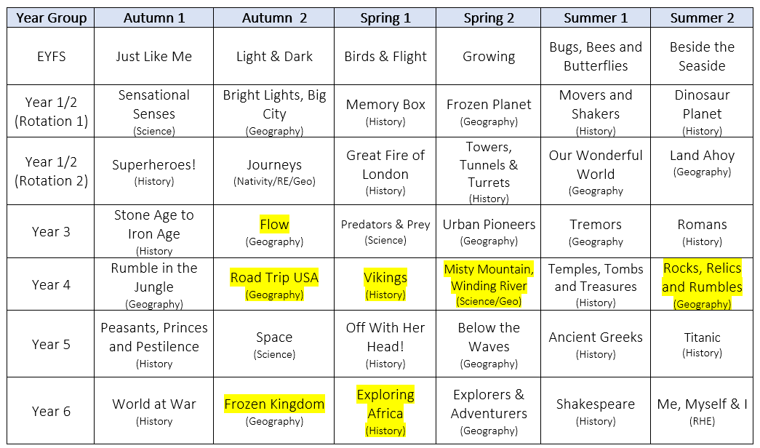
Topics
Increase engagement.
Offer more breadth and depth.
Ensure there are no gaps in our national curriculum coverage.
Notes:
Our reasons behind extending our curriculum. The main ones being to increase children’s engagement, offer more breadth and depth in learning, and so more exciting opportunities, and to ensure that we cover all of the statutory content from the national curriculum.
In terms of the first, we have now moved over to half termly topics with some new and some established – the children have shown lots of excitement so far. They have had renewed enthusiasm for their new learning in Autumn 2. We have also made sure to choose varying topics with both Science, Geography and History focuses. This has increased breadth and depth by covering a greater variety of historical periods and geographical concepts. For example, the children get more opportunity to study the geological features of our world in depth during Flow, Misty Mountain, Winding River, Rocks, Relics and Rumbles and Frozen Kingdom.
We’ve also ensured to strategically choose topics which our gaps – for example during Vikings in Year 4 they will cover the Scots, Anglo Saxons and Viking Invasion. Then in Year Six they will spend a half term on a non European History study during Exploring Africa.

Slide 3
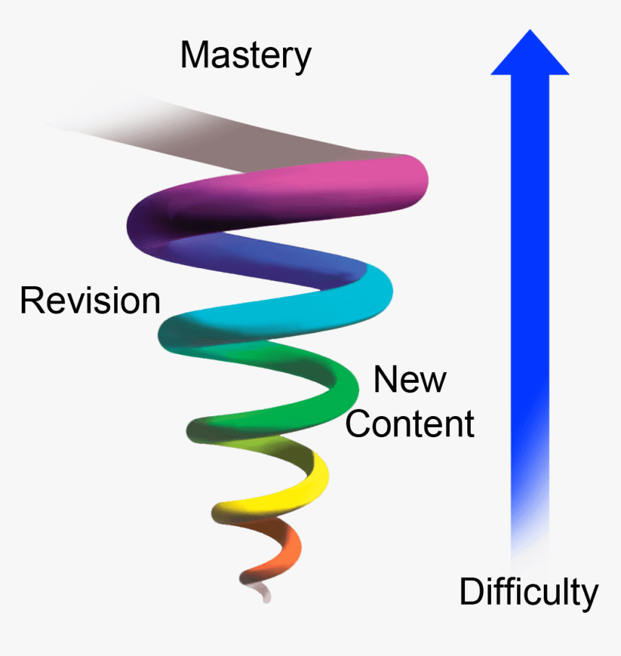
Spiral Curriculum
Notes:
Another big consideration is how we are designing our curriculum purposefully to build children’s understanding of concepts throughout their time with us. Our long term aim is to hook the learning across our topics onto strands which are entwined throughout our curriculum. We want to design a 'spiral curriculum' which has been widely attributed to Jerome Bruner. So these key concepts are introduced and then revisited repeatedly with more complexity and reinforcing previous learning each time. This makes it much more likely children will recall learning in the long term.

Slide 4
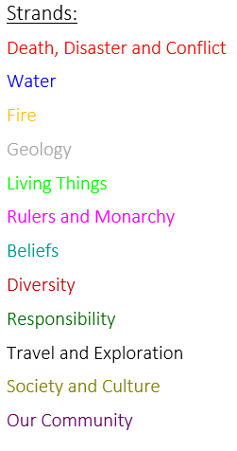
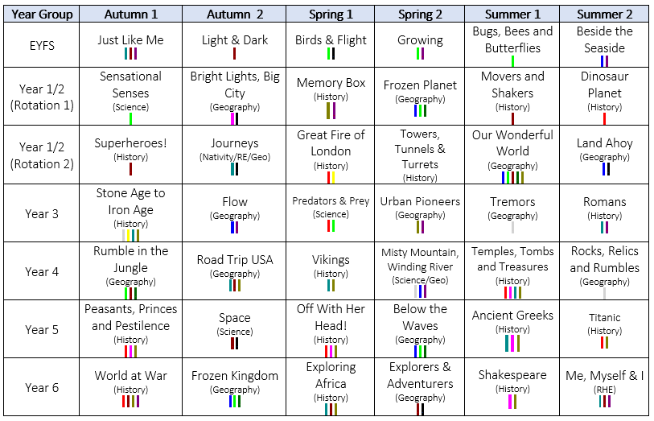






Spiral Curriculum
Notes:
On the left hand side, you can see the strands that we have identified within our curriculum. Each is visited and revisited throughout the curriculum with increasing depth as they move up the school.
For example, you can track the strand water from Frozen Planet in Year 1, Land Ahoy Year 2, Flow Year 3, Misty Mountain, Winding River Year 4, Below the Waves Year 5 then Frozen Kingdom Year 6. Children will review previous learning and be exposed to new content relating to this strand each time, increasing in complexity and difficulty.

Slide 5
Pupil Voice - Focus and Questions
Looking to see if children can articulate:
An understanding of the distinct disciplines of history and geography and what they involve.
The journey they are on for their new topic including prior, current and future learning.
Through asking:
What is your new topic?
Do you think you will focus on history or geography?
What do you think history/geography is?
What have you learnt about so far?
What else do you think you will learn about this half term?
What have you learnt about in other years groups that is going to be important?
Which of these ideas (curriculum strands) will you look at?
Notes:
Monitoring through pupil voice - I spoke to children across KS2 to get a better idea of their current understanding as well as actions going forward.
I took two children from each class, a boy and a girl, from a range of abilities and including Pupil Premium children
The focus of my discussions was to see if children could articulate
An understanding of the distinct disciplines of history and geography and what they involve.
The journey they are on for their new topic including prior, current and future learning
The questions I asked were:
What is your new topic?
Do you think you will focus on history or geography?
What do you think history/geography is?
What have you learnt about so far?
What else do you think you will learn about this half term?
What have you learnt about in other years groups that is going to be important?
Which of these ideas (curriculum strands) will you look at?
Children were really enthusiastic about new topics.

Slide 6
Actions
Teach History and Geography explicitly as subjects in their own right.
Incorporate both substantive and procedural knowledge into both subjects.
Make the topic learning journey explicit by using curriculum strands.
Notes:
Actions moving forward

Slide 7
History and Geography
In general children responded:
History - looking at the past.
Geography - looking at places around the world.
Children should understand that these are distinct disciplines where they will study:
History - the past and how historians investigate it.
Geography - how people and places interact as well as the physical features of the earth and its atmosphere.
Notes:
We looked at children’s understanding of history and geography as subjects.
A topic based approach works well in our school and engages children by creating opportunities for cross curricular learning. However, the recent research into outstanding geog/history published by Ofsted has highlighted that this can lead to 'subjects being diluted or lost'. To combat this, we need to make sure we’re not referring to Geo/Hist as 'topic' or just the 'humanities' and make it explicit to the children that these are distinct disciplines with their own skills and knowledge.
In history the majority did correctly identify that they are learning about the past but they also need to recognise that a big part of this subject is disciplinary knowledge of how historians investigate past – being a historian.

Slide 8
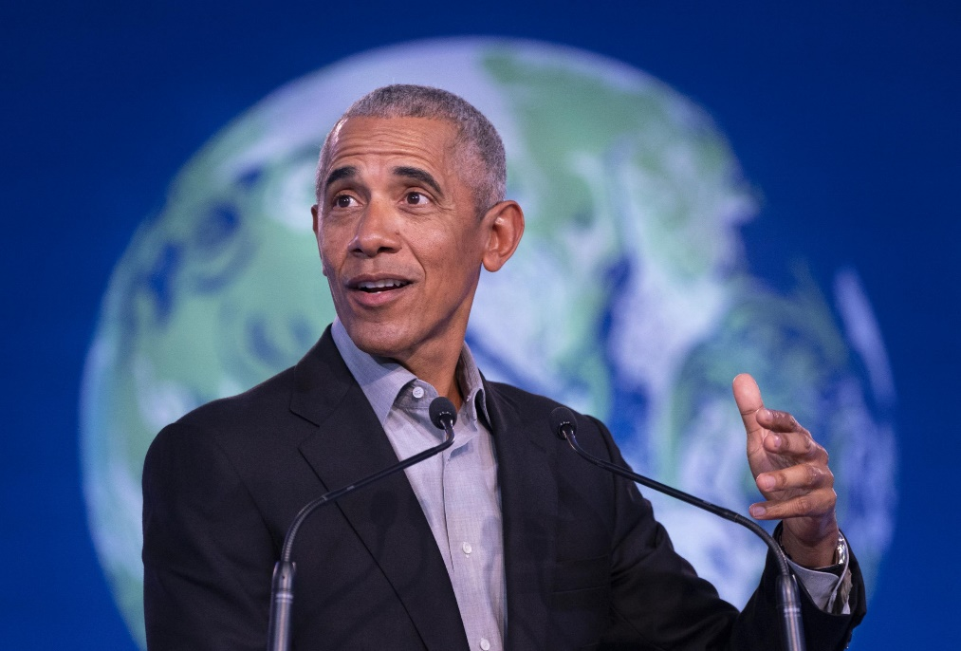
History and Geography
The study of geography is about more than just memorising places on a map. It’s about understanding the complexity of our world, appreciating the diversity of cultures that exist across continents. And in the end, it’s about using all that knowledge to help bridge divides and bring people together.
Children should understand that these are distinct disciplines where they will study:
Geography - how people and places interact as well as the physical features of the earth and its atmosphere.
Notes:
In Geography the children were very much focused on places around the world which is important, but as Barrack Obama has said the study of geography is about more than just memorising places on a map. It’s about understanding the complexity of our world, appreciating the diversity of cultures that exist across continents. And in the end, it’s about using all that knowledge to help bridge divides and bring people together.
Geography is this huge multidisciplinary subject that divided into so many sub-fields but I think we really want our children to understand that it is the study of how people and places interact as well as the physical features of the earth and its atmosphere.

Slide 9
Substantive and Disciplinary Knowledge
Substantive Knowledge
The specific, factual content for the subjects.
Knowing what.
E.g.
Name the world's 7 continents and 5 oceans.
Disciplinary Knowledge
The action taken within a particular subject to gain knowledge
Knowing how to.
E.g.
Use world maps, atlases and globes to identify countries, continents and oceans studied.
Notes:
We want the children to learn the substantive knowledge (factual contenting – know what) but also the disciplinary knowledge (the action taken within a particular subject to gain knowledge). This is really about being a geographer or a historian and practicing the required skills by applying the substantive knowledge. For example, rather than just naming the 7 continents and 5 oceans in KS1, they need to also use maps, atlases and globes to locate them. You can see there’s lots of overlap.
I personally think that the children’s responses reflect the gaps in our curriculum – there’s a real focus on substantive knowledge and less on the skills of the discipline/

Slide 10
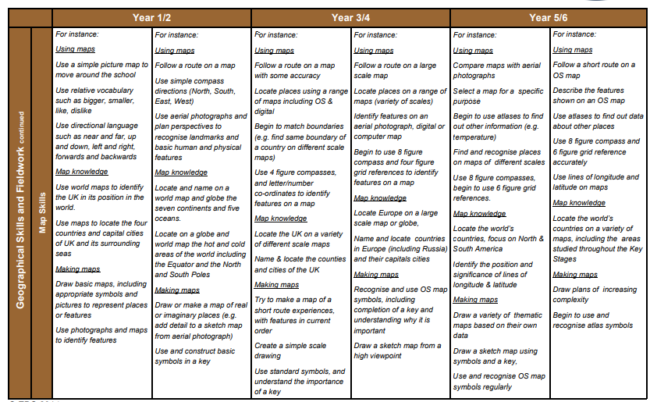
Substantive and Disciplinary Knowledge
Notes:
We are now incorporating more of that disciplinary knowledge is to refer to the skills progression documents we use as a school when planning for our classes as it breaks down the skills. So for example, with map skills, they can then see what would be expected for each year group.

Slide 11








Learning Journey
Notes:
Going forward, we will be using our curriculum strands to revisit and activate prior learning and build their understanding of key concepts. By all teachers linking learning into these strands, the children will be enabled to talk about their learning in a much more meaningful way. For example, if I was in Year 5 and beginning ‘Off with Her Head’ one of the strands that I could link this into is Rulers and Monarchy. Firstly with guidance but eventually more independently, they might recall Wat Tyler and King Richard during the peasants revolt, Egyptians pharaohs such as Tutankhamun, King Alfred during the Saxon times and Viking invasion, Julius Caeser, Augustus and in Year 1, Queen Elizabeth.

Slide 12
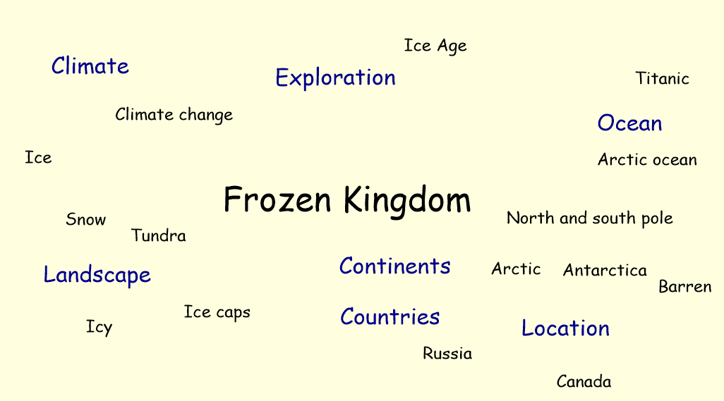
Learning Journey
Notes:
Firstly, we used our topic mind maps to begin activating children’s prior learning using key words and questioning.

Slide 13
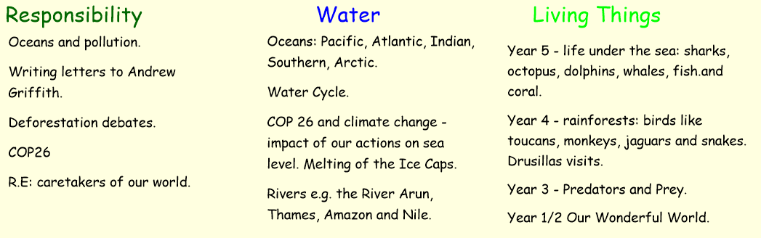
Learning Journey
Notes:
Then we introduced the key concepts we’d be looking at during our topic. I definitely noticed in my classroom children were able to much more able to easily recall prior learning, make connections using the concepts. This are a few examples from South Africa class.

Slide 14
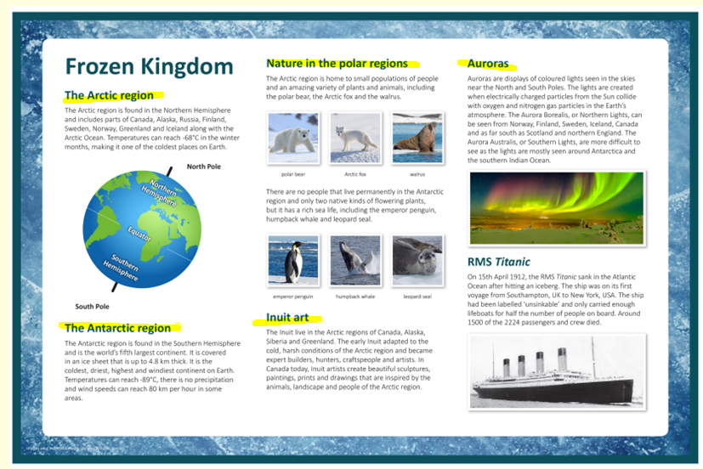
Learning Journey
Notes:
We then spoke about what they children would go onto learn in the topic using a knowledge organiser. They are now much clearer on our learning journey.

Slide 15
Summary
Teach History and Geography explicitly as subjects in their own right.
Incorporate both substantive and procedural knowledge into both subjects.
Make the topic learning journey explicit by using curriculum strands.
Notes:
We then spoke about what they children would go onto learn in the topic using a knowledge organiser. They were then much clearer on our learning journey.

