Slide 1

Welcome to our Year 6 RHE Parent Information Meeting
Miss Turner – South Africa Class
Miss Callender – Japan Class

Slide 2
Key aims of the meeting
To define the term RHE
To provide you with an opportunity to view resources that will be used to help teach your child
To clarify your rights as a parent
To prepare you for some possible sensitive questions at home
To reinforce the importance of a home-school partnership

Slide 3
What is Relationships and Sex Education?
Sex and Relationships Education (SRE/RSE) in primary schools is the learning about our bodies. Reproduction and puberty within the context of emotions, relationships and healthy choices. It plays a significant part in helping children understand themselves and how they relate to others and prepares them for adulthood.
SRE is a key aspect of Science and RHE (Relationship and Health Education) in primary schools, ensuring that children:
Develop confidence in talking, listening and thinking about feelings and relationships
Are able to name parts of the body and describe how their bodies work
Can protect themselves and ask for help and support
Are prepared for puberty
Emotional intelligence and self esteem are also important skills for young people to have to make informed, healthy choices, and it is therefore essential that teaching and learning about sex and relationships is planned and implemented within a broad framework (DFEE, 2000).

Slide 4
Why do we teach RSE?
Every local education authority, headteacher and governing body has a statutory responsibility to make sure that RSE is provided.
The biological content of RSE must be taught as part of the Science National Curriculum. These are legal requirements and emphasises best practice by recommending that RSE is planned and delivered as part of Personal, Social, Health, Economic and Citizenship Education.

Slide 5
Why do we teach RSE?
Ofsted expressed concern in its 2013 PSHE report that lack of high-quality, age-appropriate RSE in over a third of schools left young people vulnerable to inappropriate sexual behaviours and exploitation. It is clear, therefore, that PSHE education plays a vital part in helping to meet schools’ responsibilities to safeguard their pupils.

Slide 6
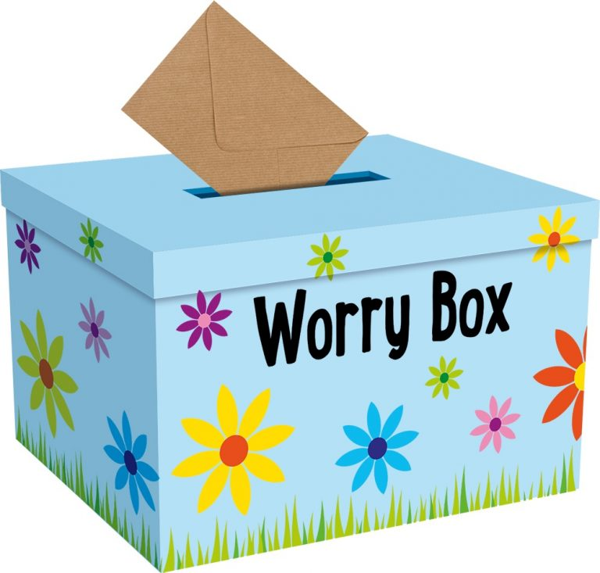
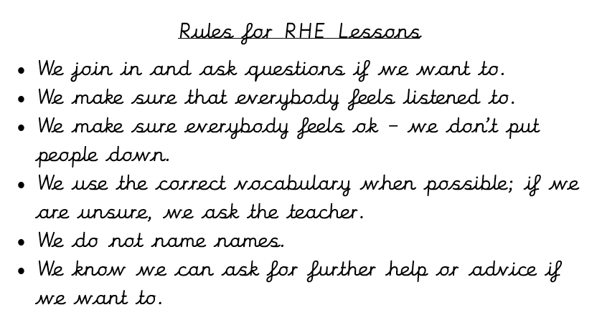

RHE at St Mary’s

Slide 7
What will we be covering in our lessons?
Sessions include:
Understanding the need for personal hygiene – that bacteria and viruses can affect health and that simple, safe routines can reduce their spread.
To know some of the bodily changes that occur in a female body (including menstruation).
To know of the bodily changes that occur in a male body.
To know that positive relationships are based on love and friendship (including marriage).
To understand about human reproduction.

Slide 8
Our eight lessons
Lesson 1: LO: To learn about the changes that occur during puberty.
Lesson 2: LO: To consider different attitudes and values around gender stereotyping.
Lesson 3: LO: To understand sexuality and demonstrate positive attitudes.
Lesson 4: LO: To learn what values are important in relationships and to appreciate the
importance of friendship in intimate relationships.
Lesson 5: LO: To learn about human reproduction in the context of the human life cycle.
Lesson 6: LO: To learn how a baby is made and grows (conception and pregnancy).
Lesson 7: LO: To learn about the roles and responsibilities of carers and parents.
Lesson 8: LO: To summarise what we have learnt about sex and relationships, and know
where to find support and advice.

Slide 9
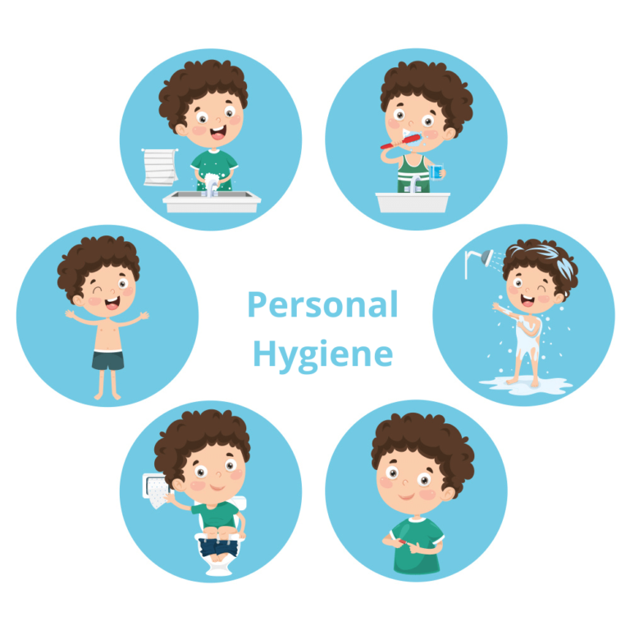
Personal hygiene
Importance of cleanliness and personal hygiene
What to expect and what to do as growing up

Slide 10
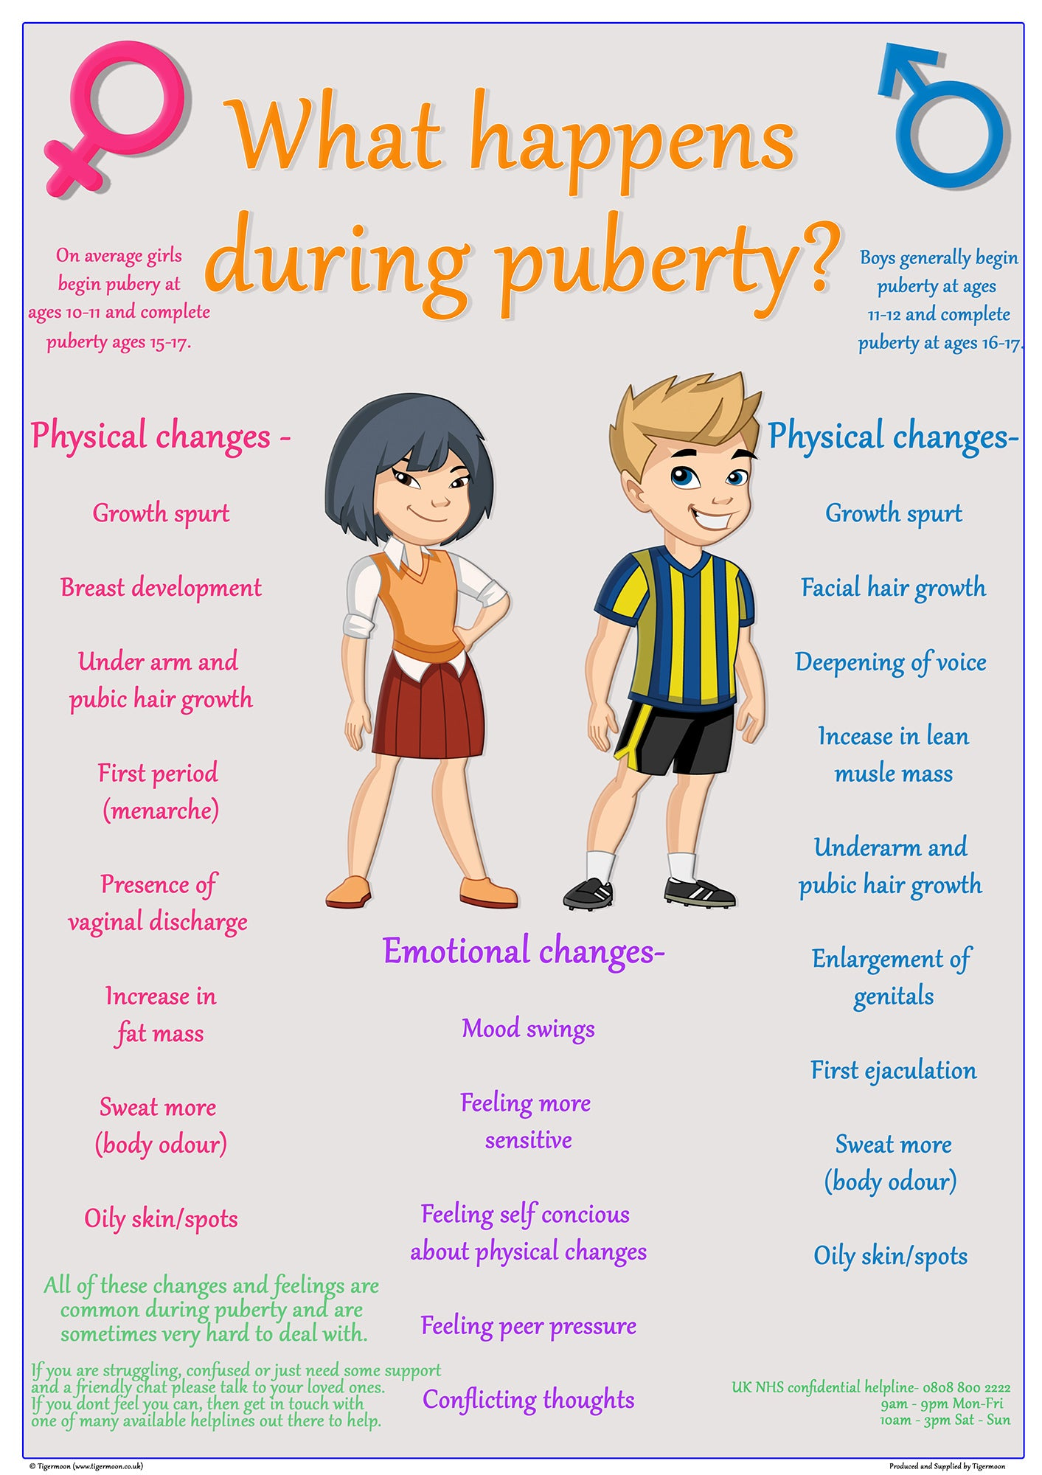
Becoming an adult
Puberty
Emotional and physical changes
Making informed choices

Slide 11
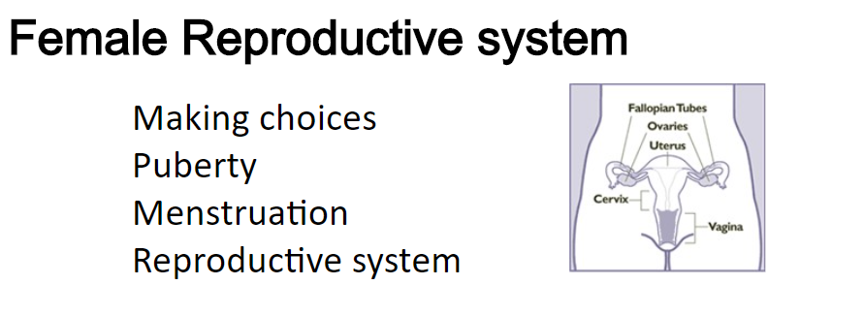
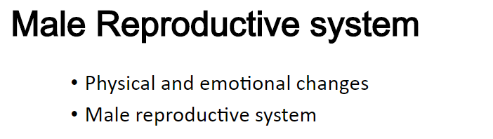
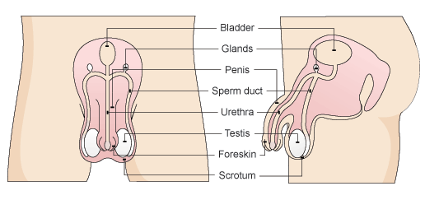

Slide 12
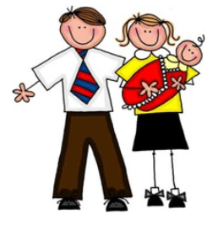
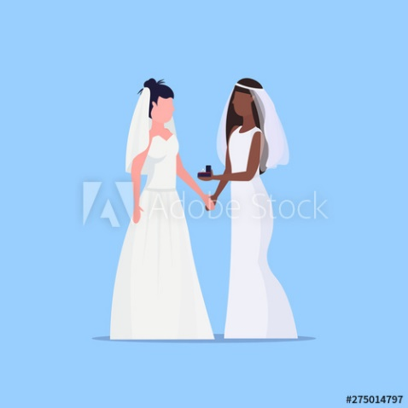
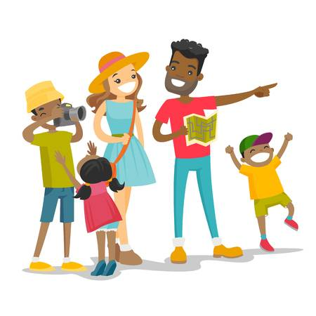
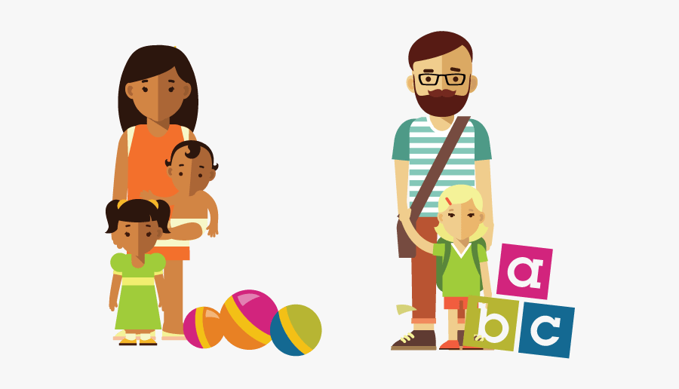
Relationships and families
How babies are made/conception
Birth of a baby
Loving relationships

Slide 13
Sensitive issues
Tackling tricky questions
Confidentiality
Right to withdraw

Slide 14

Any questions?

