Slide 1
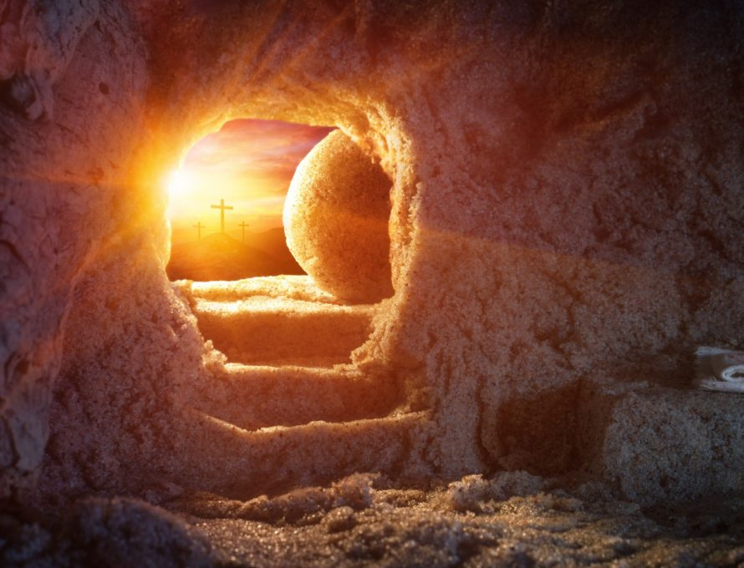
St Mary’s C of E (Aided) Primary School
Easter Eucharist 2024

Slide 2
Greeting
XIn the name of the Father,
and of the Son,
and of the Holy Spirit.
Amen
The Lord be with you
And also with you.

Slide 3
Hymn – When I think about the cross
When I think about the cross
When I think of Jesus,
I’m reminded of His love –
Love that never leaves me.
Who am I that He should die,
Giving life so freely?
When I think about the cross,
Help me to believe it.
(Repeat twice more)

Slide 4
Saying sorry
Lord, we have not loved you as we should
Lord have mercy
Lord have mercy
Lord, we have not loved our neighbours as we should
Christ have mercy
Christ have mercy
Lord, we have not loved ourselves as we should
Lord have mercy
Lord have mercy

Slide 5
May Almighty God have mercy on us,
forgive us our sins,
and bring us to everlasting life.
Amen

Slide 6
The Gloria - Anderson
Gloria, gloria, in excelsis Deo.
Gloria, gloria, in excelsis Deo.
Lord God, heavenly King, peace you bring to us;
We worship you, we give you thanks, we sing our song of praise R
Jesus, Saviour of all, Lord, God, Lamb of God,
You take away our sins, O Lord, have mercy on us all. R
At the Father’s right hand, Lord receive our prayer,
For you alone are the Holy One, and you alone are Lord. R
Glory, Father and Son, glory, Holy Spirit,
To you we raise our hands up high, we glorify your name. R

Slide 7
Prayer for today
God of glory,
by the raising of your Son
you have broken the chains of death and hell:
fill your Church with faith and hope;
for a new day has dawned
and the way to life stands open
in our Saviour Jesus Christ who is alive and reigns with you in the unity of the Holy Spirit, one God now and forever.
Amen

Slide 8
For God So Loved the World
For God so loved the world
He gave his only son,
And whoever believes in him
Shall not die, but have eternal life.
L is for love that he has for me,
I am the reason he died on the tree.
F is for forgiveness and now I am free,
E is to enjoy being in his company.
For God so loved the world
He gave his only son,
And whoever believes in him
Shall not die, but have eternal life.

Slide 9
Gospel Reading
Hear the Gospel of our Lord Jesus Christ according to John.
Glory to you, O Lord.
This is the Gospel of The Lord.
Praise to you, O Christ.
Father Paul …

Slide 10
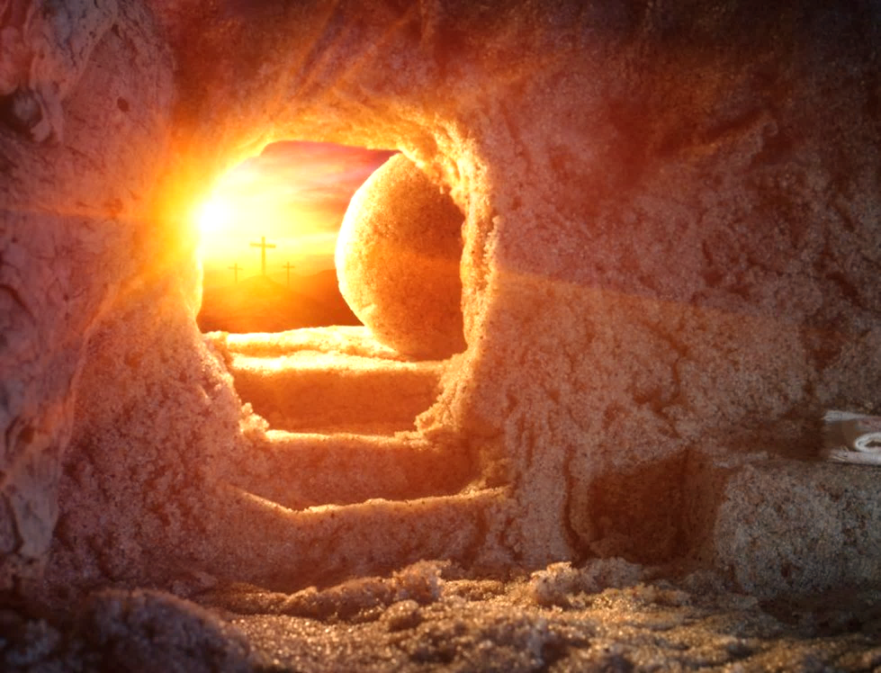

Slide 11
Prayers – Led by year 6
Lord in your mercy
Hear our prayer

Slide 12
The Prayer of St Richard.
Thanks be to you, my Lord Jesus Christ
For all the benefits which you have given me;
For all the pains and insults which you have borne for me.
O most merciful Redeemer, Friend and Brother,
May I know you more clearly, love you more dearly
and follow you more nearly.
Amen.
Merciful Father,
Accept these prayers
for the sake of your Son
our Saviour Jesus Christ.
Amen.

Slide 13
The Peace
Shalom, my friend,
Shalom, my friend,
Shalom, shalom.
The peace of Christ I give you today.
Shalom, shalom.

Slide 14
The Offertory Hymn - Celebrate
Sing a song, sing a joyful song,
Sing a joyful song to celebrate!
(Repeat)
Jesus is alive, you know,
He’s risen from the dead. (Oh yeah)
He was crucified but now he’s
Risen like he said! (Hallelujah)

Slide 15
Jump up and down, up and down and around,
Up and down and around to celebrate!
(Repeat)
Jesus is alive, you know,
He’s risen from the dead. (Oh yeah)
He was crucified but now he’s
Risen like he said! (Hallelujah)

Slide 16
Clap your hands, clap your hands like this,
Clap your hands like this to celebrate!
(Repeat)
Jesus is alive, you know,
He’s risen from the dead. (Oh yeah)
He was crucified but now he’s
Risen like he said! (Hallelujah)

Slide 17
Dance to the beat, to the beat of the drum,
To the beat of the drum to celebrate!
(Repeat)
Jesus is alive, you know,
He’s risen from the dead. (Oh yeah)
He was crucified but now he’s
Risen like he said! (Hallelujah)

Slide 18
Wave your hands, wave your hands in the air,
Wave your hands in the air to celebrate!
(Repeat)
Jesus is alive you know,
He’s risen from the dead. (Oh yeah)
He was crucified but now he’s
Risen like he said! (Hallelujah)

Slide 19
Sing a song, sing a joyful song,
Sing a joyful song to celebrate!
Sing a song, sing a joyful song,
Sing a joyful song to celebrate!

Slide 20
Prayer of Thanksgiving (The Eucharistic Prayer)
The Lord be with you
And also with you
Lift up your hearts
We lift them to the Lord
Let us give thanks to the Lord our God
It is right to give thanks and praise
Why is it right to give thanks and praise?
Listen, and we will hear.
Father Paul then continues with the prayer until …

Slide 21
Holy, Holy, Holy Lord,
God of pow’r and God of might:
Heaven and earth, heaven and earth,
Are full of your glory, your pow’r and might:
Hosanna, hosanna, hosanna in the highest heav’ns.
Hosanna, hosanna, hosanna in the highest heav’ns.
Blessed, blessed is he who comes,
Blessed blessed is he who comes;
Blessed is he, blessed is he who comes in the name of the Lord.
Hosanna, hosanna, hosanna in the highest heav’ns
Hosanna, hosanna, hosanna in the highest heav’ns

Slide 22
We thank you, loving Father,
Because when we turned away,
You sent Jesus, your Son.
He gave his life for us on the cross
And shows us the way to live.
Send your Holy Spirit
That these gifts of bread and wine
May be for us Christs body and his blood.
Why do we share this bread and wine?
Listen, and we will hear.

Slide 23
On the night before he died,
When darkness had fallen,
Jesus took bread.
He gave thanks, broke it,
And shared it with this disciples saying:
“This is my body, given for you. Do this to remember me.”
After they had eaten, he took the cup of wine,
Gave thanks, and shared it with his disciples saying:
“This is my blood, poured out for you and for many,
For the forgiveness of sins.”

Slide 24
So Father, with this bread and this cup
We celebrate his love, his death, his risen life.
And you feed us with these gifts.
Send your Holy Spirit
And change us more and more
To be like Jesus our Saviour.
How do we follow Jesus?
Listen, and we will hear.

Slide 25
Help us, Father, to love one another,
As we look forward to that day when suffering is ended,
And all creation is gathered in your loving arms.
And now, with the Blessed Virgin Mary,
St Richard, St Wilfrid and all your saints,
We give you glory,
Through Jesus Christ,
In the strength of the Spirit,
Today and for ever.
Amen.

Slide 26
The Lord’s Prayer
As our Saviour has taught us, so we pray:
Our Father, who art in heaven,
hallowed be thy name;
thy kingdom come;
thy will be done
on earth as it is in heaven.
Give us this day our daily bread.
And forgive us our trespasses,
as we forgive those who trespass against us.
And lead us not into temptation;
but deliver us from evil.
For thine is the kingdom,
the power and the glory,
for ever and ever. Amen.

Slide 27
Breaking of the Bread
We break this bread
to share in the body of Christ.
Though we are many, we are one body,
because we all share in one bread.

Slide 28
Lamb of God,
you take away the sin of the world,
have mercy on us.
Lamb of God,
you take away the sin of the world,
have mercy on us.
Lamb of God,
you take away the sin of the world,
grant us peace.

Slide 29
Giving of Communion
This is the Lamb of God
who takes away the sin of the world.
Blessed are those who are called to his supper.
Lord I am not worthy to receive you,
but only say the word,
and I shall be healed.

Slide 30
CHORUS Risen! Risen! Jesus is risen!
The Spirit was given – Jesus is alive!
Risen! Risen! Jesus is risen!
The Spirit was given – Jesus is alive!
Early in the morning on the first day of the week,
Women went to visit at the tomb.
Angels came and told them, ‘The one you’ve come to see,
He isn’t here, but you will meet Him soon!’
CHORUS
Fearful and excited, amazed by all they’d seen,
Mary and her friends ran from the tomb.
Finding the disciples together where they’d meet,
Bursting with joy they ran into the room.

Slide 31
Two of the believers, with thoughts about the week,
Walked the road so lonely and confused.
While they spoke of Jesus and all he’d come to mean,
He came along beside them with the news:
CHORUS Risen! Risen! Jesus is risen!
The Spirit was given – Jesus is alive!
Risen! Risen! Jesus is risen!
The Spirit was given – Jesus is alive!
All of the disciples were terrified to see
Jesus there before them in the room.
‘Why are you so frightened?’ He said. ‘It’s really me!
All of the things I told you have come true!’
CHORUS

Slide 32

Prayer after Communion
Almighty God,
we thank you for feeding us
with the body and blood of your Son Jesus Christ.
Through him we offer you our souls and bodies
to be a living sacrifice.
Send us out in the power of your Spirit
to live and work
to your praise and glory.
Amen.
The Blessing
Amen.

Slide 33
The Dismissal
Go in the peace of Christ.
Thanks be to God. Amen.

Slide 34
Initial hymn
When I think about the Cross
Words and Music by Mark and Helen Johnson
©1995 OUT OF THE ARK MUSIC
Hymn before the Gospel
Mary’s Song
Words and Music by Mark and Helen Johnson
©1995 OUT OF THE ARK MUSIC
The Offertory Hymn
Celebrate
Words and Music by Mark and Helen Johnson
©1995 OUT OF THE ARK MUSIC
The Communion Hymn
Lord of the Dance
Words by Sydney Carter
© 1963 Stainer & Bell Ltd
Recessional Hymn
Easter Jubilation
Words and Music by Mark and Helen Johnson
©1995 OUT OF THE ARK MUSIC

Slide 35
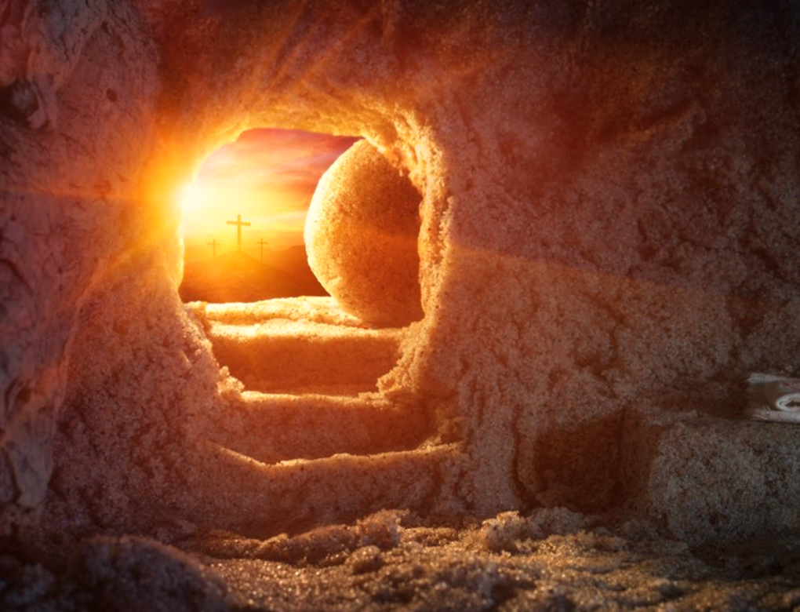
Easter Eucharist
The staff, Governors and children of
St Mary’s wish you peace and joy.

Slide 37
One mother hen sat on 4 little eggs, Keeping them warm in her little egg nest,
Then one day she heard a crack, and a little voice said, as the egg was hatched;
I'm a spring chicken! I'm yellow and small.
My feathers are fluffy and they're keeping me warm. My legs are not long, so I'll never be tall,
But I'm a real spring chicken and I'm having a ball! (Chicken I'm a chicken, I'm a having a ball!)
One mother hen sat on 3 little eggs, keeping them warm in her little egg nest.
Then one day she fell asleep and a little voice said in a whispered tweet:

Slide 38
One mother hen sat on 2 little eggs, Keeping them warm in her little egg nest.
Then one day she moved about and a little voice said, as a chick popped out:
I'm a spring chicken! I'm yellow and small.
My feathers are fluffy and they're keeping me warm. My legs are not long, so I'll never be tall,
But I'm a real spring chicken and I'm having a ball! (Chicken I'm a chicken, I'm a having a ball!)
One mother hen sat on 1 little egg, Keeping it warm in her little egg nest.
Then one day she gave a sigh and a little voice said SURPRISE! SURPRISE!!

Slide 39
Easter Eucharist
The staff, Governors and children of
St Mary’s wish you peace and joy.

Slide 42
