Slide 1
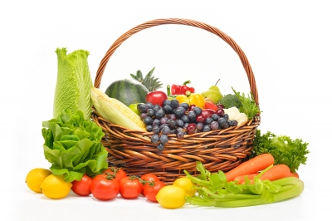
St Mary’s C of E (Aided) Primary School
Harvest Eucharist 2024

Slide 2
Greeting
XIn the name of the Father,
and of the Son,
and of the Holy Spirit.
Amen
The Lord be with you
And also with you.

Slide 3
We Plough the Fields and Scatter
We plough the fields and scatter
the good seed on the land,
but it is fed and watered
by God's almighty hand;
he sends the snow in winter,
the warmth to swell the grain,
the breezes and the sunshine
and soft refreshing rain.
  All good gifts around us are sent from heaven above,
  Then thank the Lord, O thank the Lord for all his love.

Slide 4
He only is the maker
of all things near and far;
he paints the wayside flower,
he lights the evening star;
the wind and waves obey him,
by him the birds are fed;
much more to us his children,
he gives our daily bread.
  All good gifts around us are sent from heaven above,
  Then thank the Lord, O thank the Lord for all his love.

Slide 5
We thank you, then, O Father,
for all things bright and good,
the seed-time and the harvest,
our life, our health, our food:
accept the gifts we offer
for all your love imparts;
and that which you most welcome,
our humble, thankful hearts.
  All good gifts around us are sent from heaven above,
  Then thank the Lord, O thank the Lord for all his love.

Slide 6
Saying sorry
Lord, for not appreciating the beautiful world you have given us
Lord have mercy
Lord have mercy
Lord, for not caring enough about all the living creatures around us
Christ have mercy
Christ have mercy

Slide 7
Lord, for spoiling the beauty and harmony of your world
Lord have mercy
Lord have mercy
May Almighty God have mercy on us,
Forgive us our sins,
And bring us to everlasting life.
Amen

Slide 8
The Gloria - Anderson
Gloria, gloria, in excelsis Deo.
Gloria, gloria, in excelsis Deo.
Lord God, heavenly King, peace you bring to us;
We worship you, we give you thanks,
we sing our song of praise R
Jesus, Saviour of all, Lord, God, Lamb of God,
You take away our sins, O Lord, have mercy on us all. R
At the Father’s right hand, Lord receive our prayer,
For you alone are the Holy One, and you alone are Lord. R
Glory, Father and Son, glory, Holy Spirit,
To you we raise our hands up high, we glorify your name. R

Slide 9
Prayer for today
Creator God,
you made the goodness of the land,
the riches of the sea
and the rhythm of the seasons;
As we thank you for the harvest,
may we cherish and respect
this planet and its people,
Through Jesus Christ our Lord. Amen.

Slide 10
Gradual Hymn
We sing this twice before the Gospel reading:
Halle, halle, halle-lu-jah!
Halle, halle, halle-lu-jah!
Halle, halle, halle-lu-jah!
Hallelujah, hallelujah

Slide 11
Gospel Reading
Hear the Gospel of our Lord Jesus Christ
Glory to you, O Lord.
The Gospel is read
This is the Gospel of the Lord.
Praise to you, O Christ.
Address

Slide 12
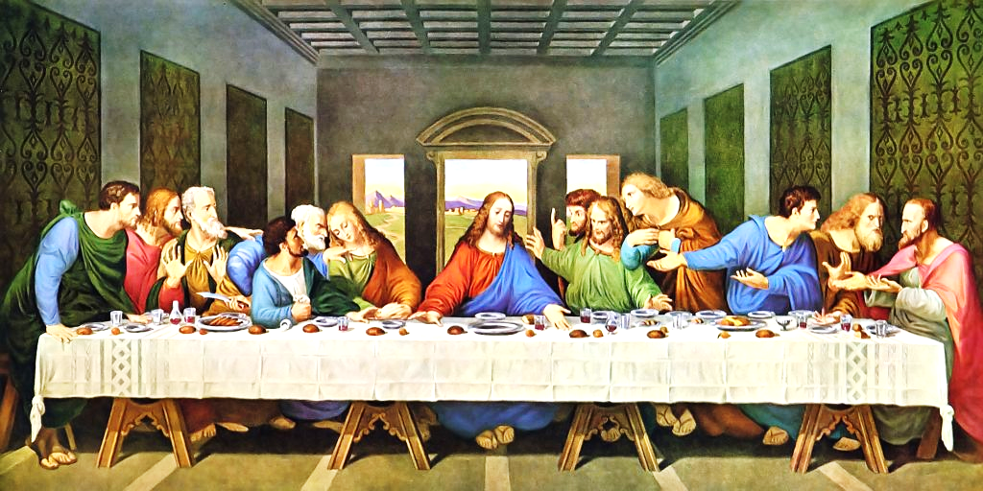

Slide 13
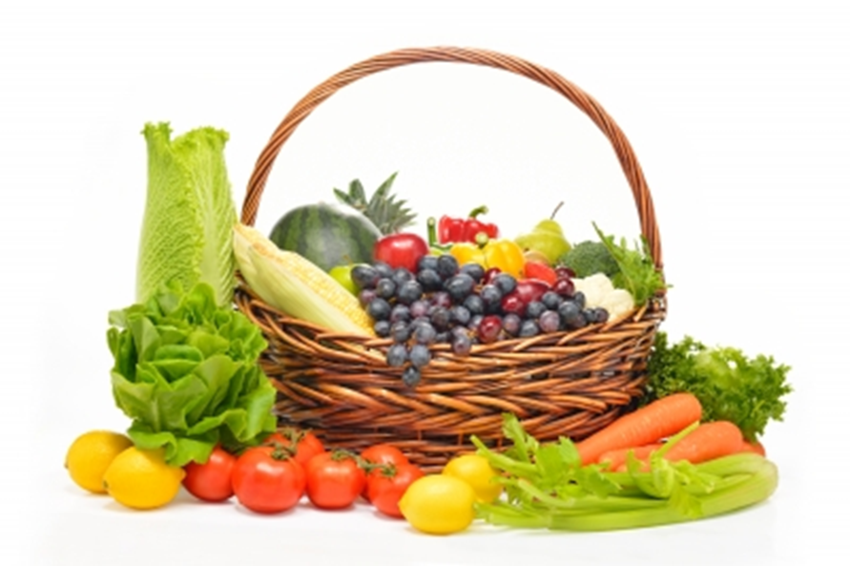

Slide 14
Prayers of Intercession - by Year 4
Lord in your mercy
Hear our prayer
Prayer of St Richard
Thanks be to you, my Lord Jesus Christ
For all the benefits which you have given me;
For all the pains and insults which you have borne for me.
O most merciful Redeemer, Friend and Brother,
May I know you more clearly, love you more dearly
and follow you more nearly.
Amen

Slide 15
Merciful Father,
Accept these prayers
for the sake of your Son,
our Saviour Jesus Christ.
Amen.

Slide 16
The Peace
Shalom, my friend,
Shalom, my friend,
Shalom, shalom.
The peace of Christ I give you today.
Shalom, shalom.

Slide 17
The Offertory Hymn
Harvest Samba
Cabbages and greens,
Broccoli and beans,
Cauliflower and roasted potatoes
Taste so good to me!
Apricots and plums,
Ripened in the sun,
Oranges and yellow bananas,
Good for everyone!

Slide 18
It’s another Harvest festival,
When we bring our fruit and vegetables.
‘Cause we want to share the best of all
The good things that we’ve been given.
It’s another opportunity
To be grateful for the food we eat.
With a Samba celebration to
Say, ‘Thank you’ to God the Father.

Slide 19
Golden corn and wheat,
Oats and sugar beet.
Fluffy rice and tasty spaghetti,
Wonderful to eat!
Coffee, cocoa, tea,
Growing naturally,
Herbal plants and all kinds of spices,
Very nice indeed!

Slide 20
It’s another Harvest festival,
When we bring our fruit and vegetables.
‘Cause we want to share the best of all
The good things that we’ve been given.
It’s another opportunity
To be grateful for the food we eat.
With a Samba celebration to
Say, ‘Thank you’ to God the Father.

Slide 21
Thank you for the harvest,
Thank you for your goodness,
For all of the fruit and vegetables
And the wonderful things that grow.
(repeat)

Slide 22
Group one
Cabbages and greens,
Broccoli and beans,
Cauliflower and roasted potatoes,
Taste so good to me!
Group two
Thank you for the harvest,
Thank you for your goodness,
For all of the fruit and vegetables
And the wonderful things that grow.

Slide 23
Group one
Apricots and plums,
Ripened in the sun,
Oranges and yellow bananas,
Good for everyone!
Group two
Thank you for the harvest,
Thank you for your goodness,
For all of the fruit and vegetables
And the wonderful things that grow.

Slide 24
It’s another Harvest festival,
When we bring our fruit and vegetables.
‘Cause we want to share the best of all
The good things that we’ve been given.
It’s another opportunity
To be grateful for the food we eat.
With a Samba celebration to
Say, ‘Thank you’ to God the Father.
….. God the Father

Slide 25
Prayer of Thanksgiving (The Eucharistic Prayer)
The Lord be with you
And also with you
Lift up your hearts
We lift them to the Lord
Let us give thanks to the Lord our God
It is right to give thanks and praise
Why is it right to give thanks and praise
Listen, and we will hear.
Father Paul will continue with the prayer until we sing.

Slide 26
Holy, Holy, Holy Lord,
God of pow’r and God of might:
Heaven and earth, heaven and earth,
Are full of your glory, your pow’r and might:
Hosanna, hosanna, hosanna in the highest heav’ns.
Hosanna, hosanna, hosanna in the highest heav’ns.
Blessed, blessed is he who comes,
Blessed, blessed is he who comes;
Blessed is he, blessed is he who comes in the name of the Lord.
Hosanna, hosanna, hosanna in the highest heav’ns
Hosanna, hosanna, hosanna in the highest heav’ns

Slide 27
We thank you, loving Father,
Because when we turned away,
You sent Jesus, your son.
He gave his life for us on the cross
And shows us the way to live.
Send your Holy Spirit
That these gifts of bread and wine
May be for us Christ’s body and his blood.
Why do we share this bread and this wine?
Listen, and we will hear.

Slide 28
On the night before he died,
When darkness had fallen,
Jesus took bread.
He gave thanks, broke it,
And shared it with his disciples saying:
“This is my body, given for you. Do this to remember me.”
After they had eaten, he took the cup of wine,
Gave thanks, and shared it with his disciples saying:
“This is my blood, poured out for you and for many,
For the forgiveness of sins.”

Slide 29
So Father, with bread and this cup
We celebrate his love, his death, his risen life.
And you feed us with these gifts.
Send your Holy Spirit
And change us more and more
To be like Jesus our Saviour.
How do we follow Jesus?
Listen, and we will hear.

Slide 30
Help us, Father, to love one another,
As we look forward to the day when suffering is ended,
And all creation is gathered in your loving arms.
And now, with Blessed Virgin Mary, St Francis,
St Richard, St Wilfrid and all your saints,
We give you glory,
Through Jesus Christ,
In the strength of the Spirit,
Today and for ever.
Amen.

Slide 31
The Lord’s Prayer
As our Saviour has taught us, so we pray:
Our Father, who art in heaven,
hallowed be thy name;
thy kingdom come;
thy will be done
on earth as it is in heaven.
Give us this day our daily bread.
And forgive us our trespasses,
as we forgive those who trespass against us.
And lead us not into temptation;
but deliver us from evil.
For thine is the kingdom,
the power and the glory,
for ever and ever. Amen.

Slide 32
Breaking of the Bread
We break this bread
to share in the body of Christ.
Though we are many, we are one body,
because we all share in one bread.

Slide 33
Lamb of God,
you take away the sin of the world,
have mercy on us.
Lamb of God,
you take away the sin of the world,
have mercy on us.
Lamb of God,
you take away the sin of the world,
grant us peace.

Slide 34
Giving of Communion
Jesus is the Lamb of God
who takes away the sin of the world.
Happy are those who are called to his supper.
Lord I am not worthy to receive you,
but only say the word,
and I shall be healed.

Slide 35
Communion Hymn
Harvest Hymn
Long before the summer started
Fields were ploughed and sown.
Seeds were scattered, crops were planted,
Now they are full grown.
Give thanks for the harvest,
The sun, the seed, the rain.
Give thanks to God the Father,
For harvest time again.

Slide 36
April showers and sunny weather
Fed the earth again.
Warmth and moisture both together
Helped to grow the grain.
Give thanks for the harvest,
The sun, the seed, the rain.
Give thanks to God the Father,
For harvest time again.

Slide 37
Every field of golden yellow,
Standing in the sun,
Tells how God in all His splendour
Cares for everyone.
Give thanks for the harvest,
The sun, the seed, the rain,
Give thanks to God the Father,
For harvest time again.

Slide 38
Come with thankful hearts and voices,
Come with joyful song,
For the good food all around us,
Now the work is done.
Give thanks for the harvest,
The sun, the seed, the rain,
Give thanks to God the Father,
For harvest time again.
(repeat)

Slide 39
Prayer after Communion
Almighty God,
we thank you for feeding us
with the body and blood of your Son Jesus Christ.
Through him we offer you our souls and bodies
to be a living sacrifice.
Send us out in the power of your Spirit
to live and work
to your praise and glory.
Amen.
The Blessing

Slide 40
Recessional Hymn
Harvest Song
There is a farmer who stands in the fields,
And he sees all the work to be done.
He has been watching for many a month,
He’s been waiting for this day to come.
There’s a song to sing as the harvest comes in.
To the One who gives sunshine and rain.
Let us all join in with a thank-offering
For the harvest that’s gathered again.

Slide 41
There was time with the fields were prepared,
And the good soil was carefully ploughed.
Then came the day for the farmer to sow
And the seeds were all scattered around.
There’s a song to sing as the harvest comes in,
To the One who gives sunshine and rain.
Let us all join in with a thank-offering
For the harvest that’s gathered again.

Slide 42
There was a time for the farmer to wait
As the seeds slowly grew out of sight.
Then came the day when the first shoots appeared,
And the farmer was filled with delight.
There’s a song to sing as the harvest comes in,
To the One who gives sunshine and rain.
Let us all join in with a thank-offering
For the harvest that’s gathered again.

Slide 43
Now is the time when the crops are full grown,
And the farmer must gather them in.
He’ll need some help ‘cause there’s lots to be done,
And it’s hard to know where to begin.
There’s a song to sing as the harvest comes in,
To the One who gives sunshine and rain.
Let us all join in with a thank-offering
For the harvest that’s gathered again. (repeat)

Slide 44
The Dismissal
Go in the peace of Christ.
Thanks be to God.

Slide 45
The Offertory Hymn
Harvest Samba
Words and music by Mark and Helen Johnson
©2002 Out of the Ark Music Ltd., Hersham Green KT12 4RQ
The Communion Hymn
Harvest Hymn (Give Thanks)
Words and music by Mark and Helen Johnson
©2002 Out of the Ark Music Ltd., Hersham Green KT12 4RQ
Recessional Hymn
Harvest song.
Words and music by Mark and Helen Johnson
©1991,2002, 2008 Out of the Ark Music Ltd., Middlesex TW12 2HD
CCLI Song No. 1574998

Slide 46
Harvest Eucharist
The staff, governors and children of
St Mary’s wish you a happy harvest time.
Thank you for your generosity.

