Slide 1
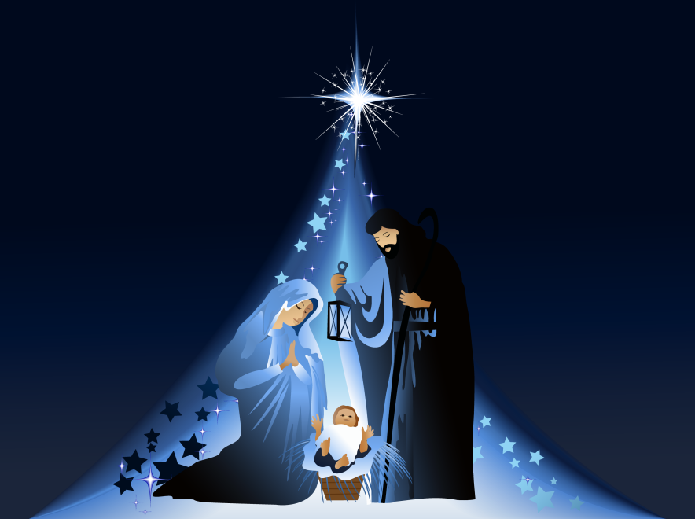
Christmas Eucharist 2024

Slide 2
O little town of Bethlehem
O little town of Bethlehem,
How still we see thee lie.
Above thy deep and dreamless sleep,
The silent stars go by.
Yet in thy dark streets shineth
The everlasting light.
The hopes and fears of all the years
Are met in thee tonight.

Slide 3
O morning stars together
Proclaim the holy birth.
And praises sing to God the King
And peace to men on earth.
For Christ is born of Mary
And gathered all above
While mortals sleep, the angels keep
Their watch of wondering love.

Slide 4
How silently, how silently,
The wondrous gift is given!
So God imparts to human hearts
The blessings of his heaven.
No ear may hear his coming,
But in this world of sin,
Where meek souls will receive him, still
The dear Christ enters in.

Slide 5
O holy child of Bethlehem,
Descend to us, we pray;
cast out our sin, and enter in,
be born in us today.
We hear the Christmas angels
the great glad tidings tell:
O come to us, abide with us
our Lord Emmanuel.

Slide 6
Greeting
X In the name of the Father,
and of the Son,
and of the Holy Spirit. Amen
The Lord be with you
And also with you.
Saying Sorry (Confession)
Lord Jesus you are the light shining in the dark places of the world
Lord have mercy
Lord have mercy

Slide 7
Lord Jesus you are the star that leads us into life in its fullness
Christ have mercy
Christ have mercy
Lord Jesus you come among us to show us how to live
Lord have mercy
Lord have mercy
May Almighty God have mercy on us,
forgive us our sins,
and bring us to everlasting life.
Amen

Slide 8
The Gloria - Anderson
Response:
Gloria, gloria, in excelsis Deo.
Gloria, gloria, in excelsis Deo.
Lord God, heavenly King, peace you bring to us;
We worship you, we give you thanks,
we sing our song of praise R
Jesus, Saviour of all, Lord, God, Lamb of God,
You take away our sins, O Lord, have mercy on us all. R
At the Father’s right hand, Lord receive our prayer,
For you alone are the Holy One, and you alone are Lord. R
Glory, Father and Son, glory, Holy Spirit,
To you we raise our hands up high, we glorify your name. R

Slide 9
The Prayer for Christmas
Almighty God,
As we prepare with joy
To celebrate the gift of the Christ-child,
Embrace the earth with your glory
And be for us a living hope
In Jesus Christ our Lord.
Amen.
Halle, halle, halle-lu-jah!
Halle, halle, halle-lu-jah!
Halle, halle, halle-lu-jah!
Hallelujah, hallelujah

Slide 10
At the Gospel
The Lord be with you
And also with you
A reading from the Holy Gospel according to …
Glory to you O Lord
The Gospel reading is now read.
This is the Gospel of the Lord
Praise to you, O Christ
Address by Father Paul

Slide 11
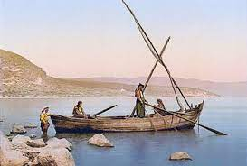

Slide 12
Nativity scene
Prayers – Led by Year 6
Lord in your Mercy
Hear our prayer
The Prayer of St Richard of Chichester
Thanks be to you, my Lord Jesus Christ
For all the benefits which you have given me;
For all the pains and insults which you have borne for me.
O most merciful Redeemer, Friend and Brother,
May I know you more clearly, love you more dearly
and follow you more nearly.
Amen.

Slide 13
Merciful Father,
Accept these prayers
for the sake of your Son,
our Saviour Jesus Christ.
Amen.

Slide 14
The Peace
The peace of the Lord be always with you.
And also with you.
Let us offer one another the sign of peace.
Shalom
Shalom, my friend,
Shalom, my friend,
Shalom, shalom.
The peace of Christ I give you today.
Shalom, shalom. x2

Slide 15
The Offertory Hymn
The Gift
© 1994 Out of the Ark Music. Mark & Helen Johnson
Over two thousand years ago,
Under a starlit sky,
Many events were taking place
As the ancients had prophesied.
And a gift was given from heaven to earth,
The everlasting light.
So let us adore the Saviour born,
Emmanuel, here tonight.

Slide 16
Heavenly hosts of angels,
Praising God on high,
Sang of the promised child to come,
The Saviour Jesus Christ.
And a gift was given from heaven to earth,
The everlasting light.
So let us adore the Saviour born,
Emmanuel, here tonight.

Slide 17
Darkness was over Bethlehem,
Brightly the star did shine,
Showing the way to where he lay
In a manger for all to find.
And a gift was given from heaven to earth
The everlasting light.
So let us adore the Saviour born,
Emmanuel, here tonight.

Slide 18
Never before in history,
Had there been such a sign,
For God was born in human form
For the sake of all mankind.
And a gift was given from heaven to earth,
The everlasting light.
So let us adore the Saviour born
Emmanuel here tonight.
So let us adore him, Christ the Lord,
Emmanuel here tonight!

Slide 19
Prayer of Thanksgiving (The Eucharistic Prayer)
The Lord be with you
And also with you.
Lift up your hearts
We lift them to the Lord
Let us give thanks to the Lord our God
It is right to give thanks and praise
Why is it right to give thanks and praise?
Listen, and we will hear.
Lord of all life, you created the universe,
where all living things reflect your glory.
You give us this great and beautiful earth,
to discover and to cherish.
You give us happy times and things to celebrate.
In these we taste your kingdom, a feast for all your children.
You made us all, each wonderfully different,
to join with the angels and sing your praise:

Slide 20
Holy, Holy, Holy Lord,
God of pow’r and God of might:
Heaven and earth, heaven and earth,
Are full of your glory, your pow’r and might:
Hosanna, hosanna, hosanna in the highest heav’ns.
Hosanna, hosanna, hosanna in the highest heav’ns.
Blessed, blessed is he who comes,
blessed blessed is he who comes;
Blessed is he, blessed is he who comes in the name of the Lord.
Hosanna, hosanna, hosanna in the highest heav’ns
Hosanna, hosanna, hosanna in the highest heav’ns

Slide 21
We thank you, loving Father,
because, when we turned away,
you sent Jesus, your Son.
He gave his life for us on the cross
and shows us the way to live.
Send your Holy Spirit
that these gifts of bread and wine
may be for us Christ’s body and his blood.
Why do we share this bread and wine?
Listen, and we will hear.

Slide 22
On the night before he died,
when darkness had fallen,
Jesus took bread.
He gave thanks, broke it,
and shared it with his disciples saying:
‘This is my body, given for you. Do this to remember me.’
After they had eaten, he took the cup of wine,
Gave thanks, and shared it with his disciples saying;
‘This is my blood, poured out for you and for many,
for the forgiveness of sins.’

Slide 23
So Father, with this bread and this cup
We celebrate his love, his death, his risen life.
As you feed us with these gifts,
Send your Holy Spirit,
And change us more and more
To be like Jesus our Saviour.
How do we follow Jesus Christ?
Listen, and we will hear.

Slide 24
Help us, Father, to love one another,
As we look forward to that day when suffering is ended,
And all creation is gathered in your loving arms.
And now, with the Blessed Virgin Mary,
St Richard, St Wilfrid and all your saints,
We give you glory.
Through Jesus Christ,
In the strength of the Spirit,
Today and for ever.
Amen.

Slide 25
The Lord’s Prayer
As our Saviour has taught us, so we pray:
Our Father, who art in heaven,
hallowed be thy name;
thy kingdom come;
thy will be done
on earth as it is in heaven.
Give us this day our daily bread.
And forgive us our trespasses,
as we forgive those who trespass against us.
And lead us not into temptation;
but deliver us from evil.
For thine is the kingdom,
the power and the glory,
for ever and ever. Amen.

Slide 26
Lamb of God,
you take away the sin of the world,
have mercy on us.
Lamb of God,
you take away the sin of the world,
have mercy on us.
Lamb of God,
you take away the sin of the world,
grant us peace.

Slide 27
Giving of Communion
Jesus is the Lamb of God
who takes away the sin of the world.
Blessed are those who are called to his supper.
Lord I am not worthy to receive you,
but only say the word,
and I shall be healed.

Slide 28
Communion Hymn
Away in a manger
Away in a manger, no crib for a bed,
The little Lord Jesus lay down His sweet head.
The stars in the bright sky looked down where He lay,
The little Lord Jesus asleep in the hay.
The cattle are lowing, the baby awakes,
But little Lord Jesus, no crying He makes.
I love Thee, Lord Jesus, look down from the sky.
And stay by my side until morning is nigh.

Slide 29
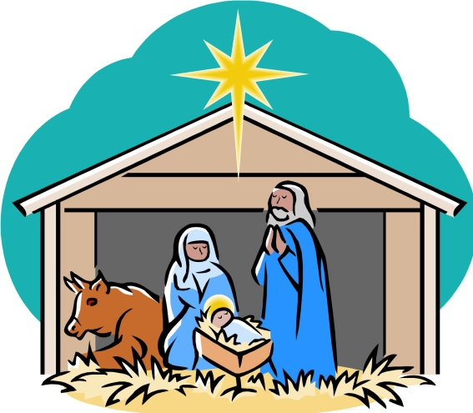
Be near me Lord Jesus, I ask thee to stay
Close by me forever and love me I pray.
Bless all the dear children in thy tender care
And fit us for heaven to live with thee there.

Slide 30
Prayer after Communion
Almighty God,
we thank you for feeding us
with the body and blood of your Son Jesus Christ.
Through him we offer you our souls and bodies
to be a living sacrifice.
Send us out in the power of your Spirit
to live and work
to your praise and glory.
Amen.
The Blessing

Slide 31
Hymn
Rock Around the Shops
Come on ev’rybody there’s a whole lot of shopping going on!
Gotta get a movin’ there’s some picking and a choosing to be done!
We’re going crazy! We can’t be lazy!
It’s only days we have left…. the rush has begun.

Slide 32
Come on ev’rybody there’s a whole lot of shopping going on!
Gotta get a movin’ there’s some picking and a choosing to be done!
They’ve got the sizes at lovely prices,
I’m gonna buy these today, or they will be gone.

Slide 33
Can’t afford to stop,
Got to pop into a shop before they close.
I’m rocking round the shops ‘til I drop
And it’s time to go home.

Slide 34
Come on ev’rybody there’s a whole lot of shopping going on!
Gotta get a movin’ there’s some picking and a choosing to be done!
I’ve got a bargain for Uncle Marvin
We’ll have a laugh when we see him trying it on.

Slide 35
Come on ev’rybody there’s a whole lot of shopping going on!
Gotta get a movin’ there’s some picking and a choosing to be done!
I bought some chocolates with lovely soft bits.
There was a box full but now the top layer’s gone!

Slide 36
Can’t afford to stop,
Got to pop into a shop before they close.
I’m rocking round the shops ‘til I drop
And it’s time to go home.

Slide 37
Come on ev’rybody there’s a whole lot of shopping going on!
Gotta get a movin’ there’s some picking and a choosing to be done!
I’ve found a record for Aunty Ethel
She’s rather deaf, but she’ll still be jiving along!

Slide 38
Instrumental chorus
Come on ev’rybody there’s a whole lot of shopping going on!
Gotta get a movin’ there’s some picking and a choosing to be done!
We’re going crazy! We can’t be lazy!
It’s only days we have left… the rush has begun.
(repeat the last two lines).

Slide 39
The Dismissal
Go in the peace of Christ.
Thanks be to God.

Slide 40

Christmas Eucharist
The staff, Governors and children of
St Mary’s wish you all a very merry Christmas.

Slide 41
The Gift© 1994 Out of the Ark Music
Mark and Helen Johnson
O Little Town of Bethlehem – traditional
Away in a Manger – traditional
Unto us a Child is born – traditional
Rock around the shops © 1994 Out of the Ark Music
Mark and Helen Johnson

Slide 42


