Slide 1
Early Identification
Strategies for identifying and supporting potentially dyslexic children in the Early Years

Slide 2
Dyslexic or Young?
Dyslexic traits
Extreme youth traits
Short term memory (auditory)
Short term memory (visual)
Easily distracted
Reverses letters/ numbers
Sequencing problems
Language /wordfinding
Organisation of self/work
Gross / fine motor skills
Patterns and relationships
Short term memory (auditory)
Short term memory (visual)
Easily distracted
Reverses letters/ numbers
Sequencing problems
Language /wordfinding
Organisation of self/work
Gross / fine motor skills
Patterns and relationships

Slide 3
So what is the difference?
History of dyslexia in the family
Apparently ‘clever’ child who is not making progress
Loves stories, but slow / no progress in reading
Reluctance to write but may be good at drawing, drama and have creative ideas

Slide 4
Why intervene?
Interventions will help any child progress
Early help will reduce risk of ‘failure’, losing confidence and low self esteem
Strategies will become life-long tools
Reduce risk of child becoming a ‘naughty’ problem

Slide 5
What can be done?
Use a dyslexia screening program
Find out the child’s strengths and weaknesses
Use the strengths to support weaker areas
Get the child to repeat oral instructions before starting a task

Slide 6
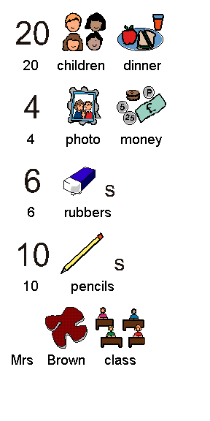
What can be done?
Use a dyslexia screening program
Find out the child’s strengths and weaknesses
Use the strengths to support weaker areas
Get the child to repeat oral instructions before starting a task
Where possible, provide visual prompts

Slide 7
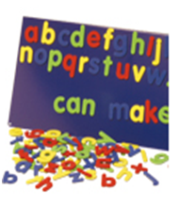
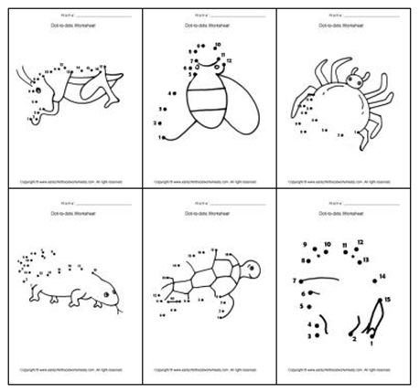
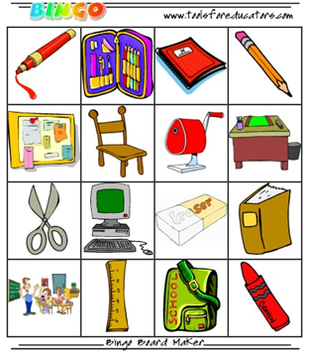
Provide a multisensory learning environment
Encourage appropriate use of assistive technology
Provide dyslexia-friendly materials

Slide 8
Case Study: T
Family history of dyslexia
Older brother on Gifted and Talented Register at 5 years
T bright / good language / problems with phonics at 5 years
School recognised ‘problem’
Put her in Nurture group for literacy and numeracy in Reception
Support continued in small group for Y 1-3
One day a week before-school reading club in Y3
Awarded the Lower KS2 Creative Writing Trophy in Y3
Currently Y5 – confident, happy child who reads books avidly / spelling idiosynchratic / writes copious stories, party plans, playlets

Slide 9
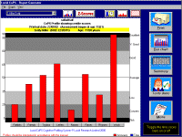
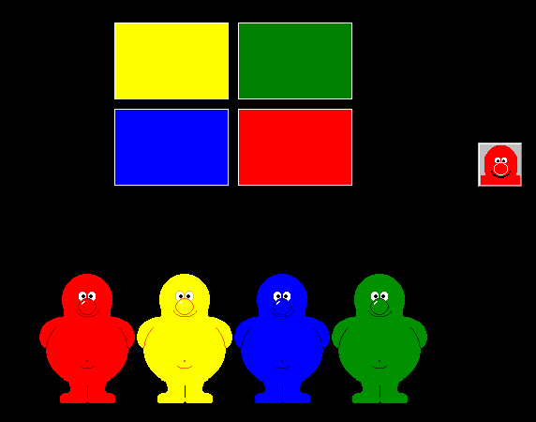
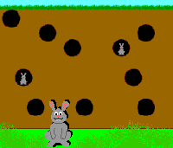
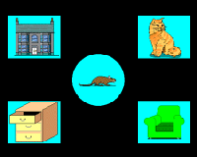
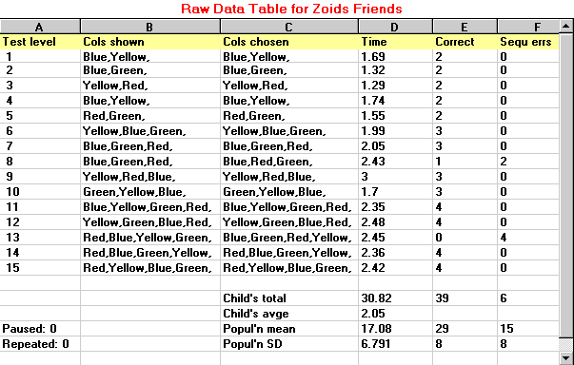
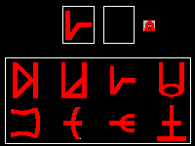
What to use
Lucid CoPS

Slide 10
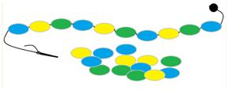
Multisensory Environment
Sand, water, paint, playdough etc
Singing games
Sequencing games
Playing with letters and numbers in various formats
Pelmanism
Movement activities

Slide 11
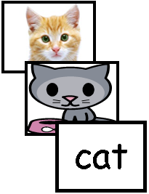
Using Technology
Initial screening
Multisensory support for learning/overlearning
Producing support materials
Developing coping strategies for:
Encouraging language development
Groundwork for literacy and numeracy skills
Organising work / life

Slide 12
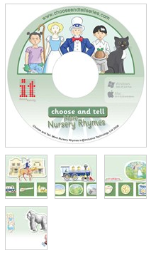
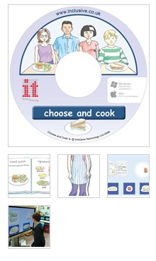
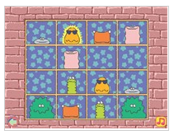
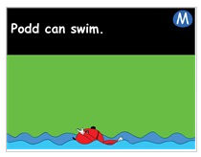
Spoken language development
Choose and cook
Choose and tell: Nursery Rhymes
Leaps and bounds
Podd

Slide 13
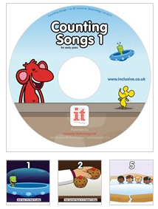
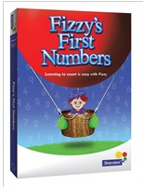
Early Number
Counting Songs
ChooseIT Readymades: Numeracy
Fizzy’s First Numbers

Slide 14
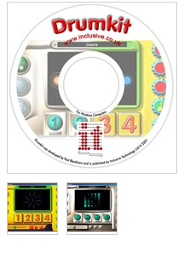
Singing and Rhythm
Drumkit
Counting Songs

Slide 15
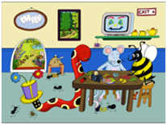
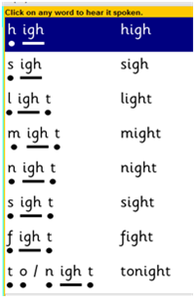
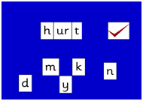
Early Phonics
Clicker Phonics
Jolly Phonics Smart Phonics
Wordshark Phonics

Slide 16
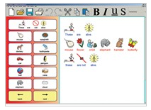
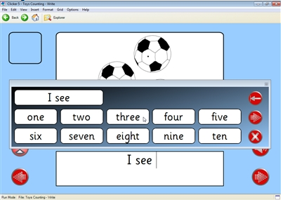
Early Writing
Clicker6
Communicate:SymWriter

Slide 17
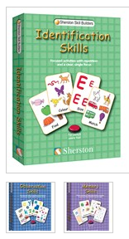
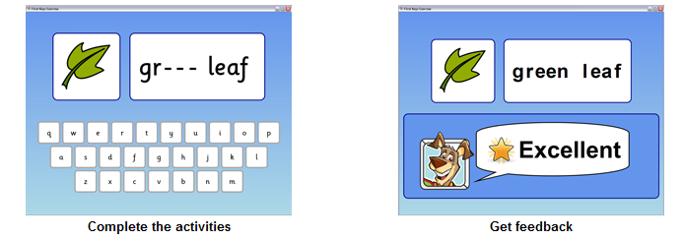
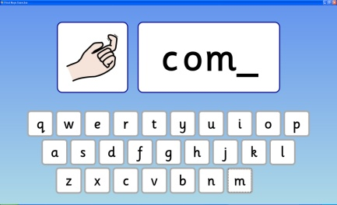
Early Literacy
ChooseIT Readymades: Literacy
Tizzy’s Toybox
Identification Skills
Vowel Sounds
First Keys 3

Slide 18
Matching : Sequencing : Sorting
Identification Skills
Communicate: By Choice
Tizzy’s Toybox

Slide 19
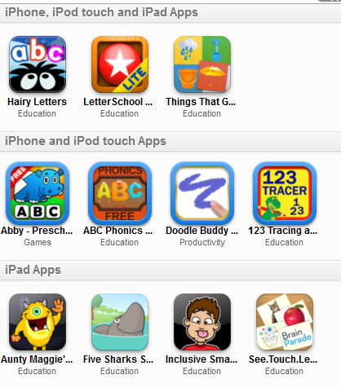
Apps

Slide 20
Hardware
Inclusive One-Touch
Inclusive LearnPad™ Tablet

Slide 21
Tilt and Touch
Inclusive Tilt and Touch LCD
Inclusive Tilt and Touch Plasma

Slide 22
Peripherals
BIGtrack
Big Grips Frame for iPads
Franklin Literacy Word Bank

Slide 23
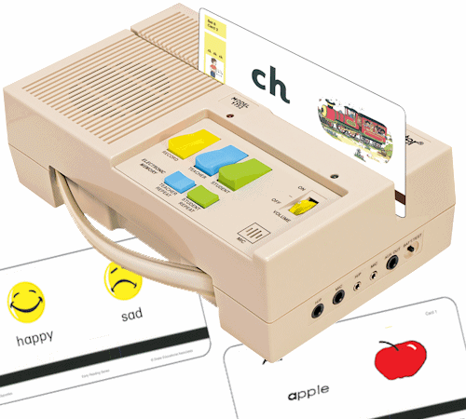
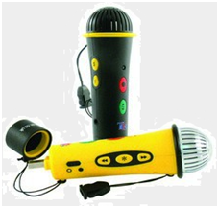
Languagemaster
Storyphones
Easimic

Slide 24
Keyboards
Clevy Keyboard
It-Keys (wireless)
Jumbo XL Keyboard
Early Learning Keyboard

Slide 25
Useful websites
www.inclusive.co.uk
www.dyslexic.com
www.thedyslexiashop.co.uk
www.bdatech.org
www.bdadyslexia.org.uk
www.bdastore.org.uk
www.dyslexiaaction.org.uk

Slide 26
This presentation was produced by
Judith Stansfield, author of
Dyslexia: Early Identification
with illustrations by Diane Giblin. ISBN 978-1-872653-55-6
It may be purchased from www.bdastore.org.uk
The presentation may be copied for educational purposes, but not sold on for profit.
www.jcstansfield.wordpress.com

