Slide 1
Art Inset 21st July 2022
Warm ups
Sketchbooks
Own sketchbook and planning
Whole School art and dt overview
Progression of skills document
Evaluation bubbles
Assessment questions

Slide 2
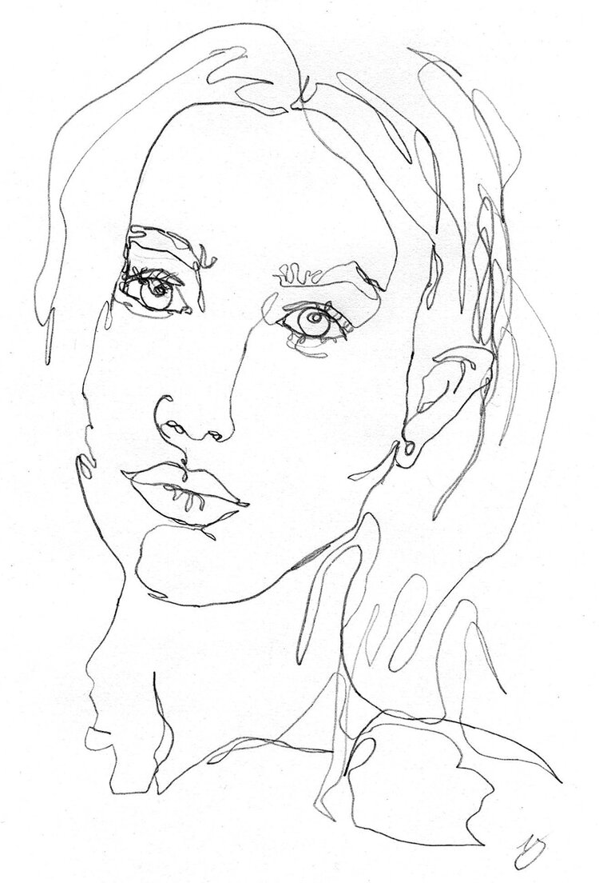
One-line drawing
https://www.accessart.org.uk/continuous-line-drawing-exercise/
There is no need to time yourself (unless you would like to) and you can stop the video at 2 minutes.
I would like you to find a small object that you can draw. Place the item in front of you so you can clearly see it. If you can, use a black pen to complete your drawing and remember to not take your pen off the page.
I look forward to seeing your amazing artwork.
Extension
If you would like to challenge yourself, you can draw a family member’s face, or your own face looking into a mirror.

Slide 5
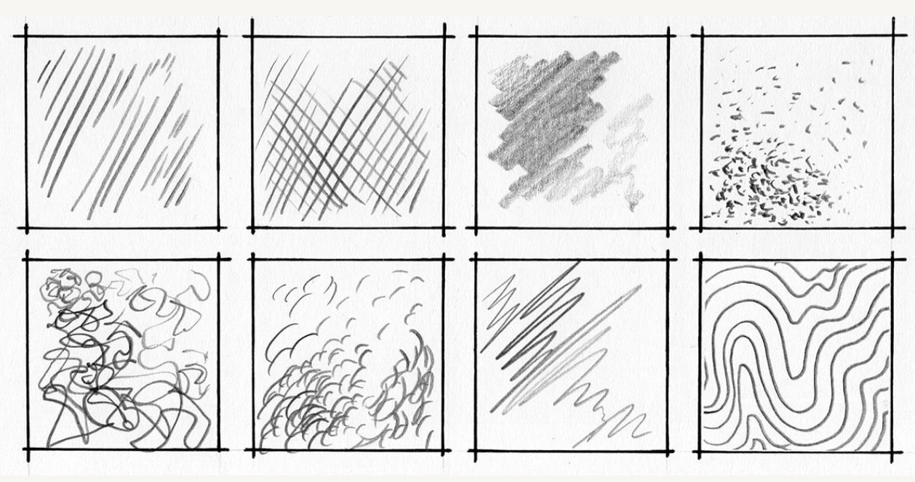

Slide 6
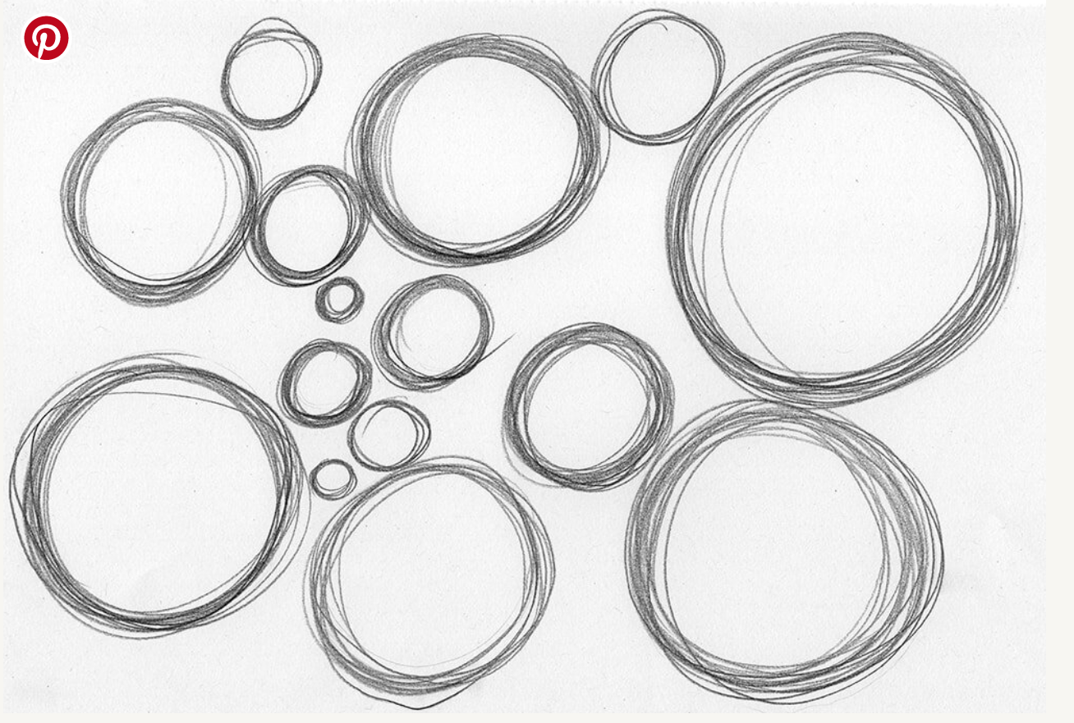
Shape of the day
This exercise staple can be done quite well while you’re doing something else more interesting. I tend to practice it while watching telly or chatting with my friends.
There is not much explanation needed, truly. All you do is to pick a shape, be it lines, circles, ellipses, rectangles, what have you and draw it, repeatedly, in the two minutes you have.

Slide 7
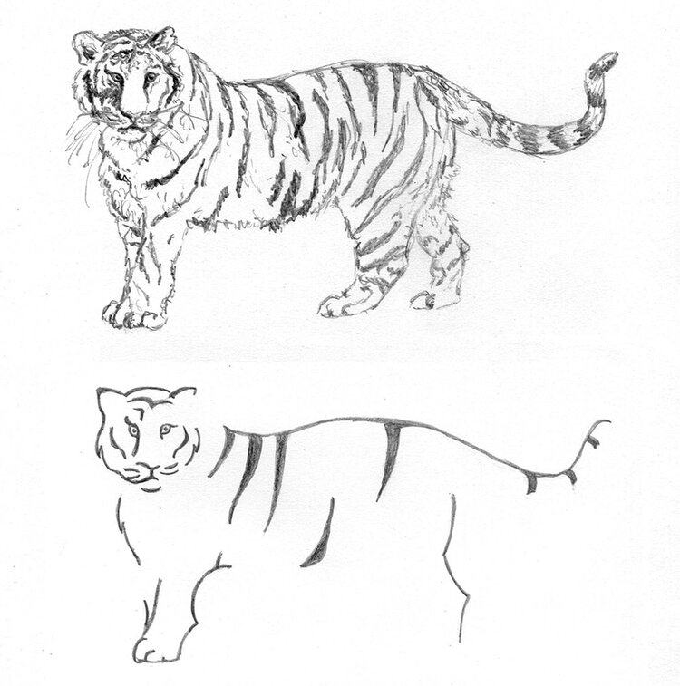
Minimalist drawing
Being able to recognise the most important, distinguishing features of a subject has been around since the dawn of art, quite literally.
It used to be an absolutely crucial skill, in fact, as conveying a meaning through a drawing used to be limited not only by skill but also by the materials available.
Indeed, cave drawings were exactly that, a minimalist rendering of these people’s everyday lives, showing themselves as well as animals and objects, with limited lines and colours.

Slide 8
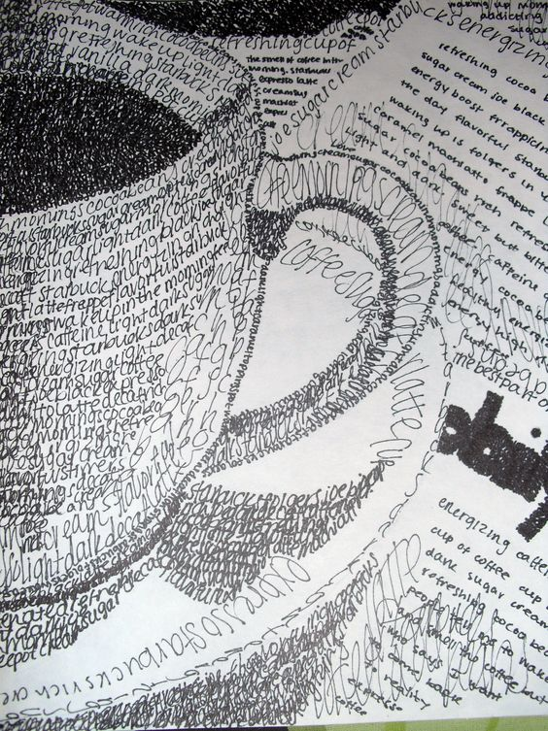

Slide 9
2 3
5 6
7 8 9

Slide 10
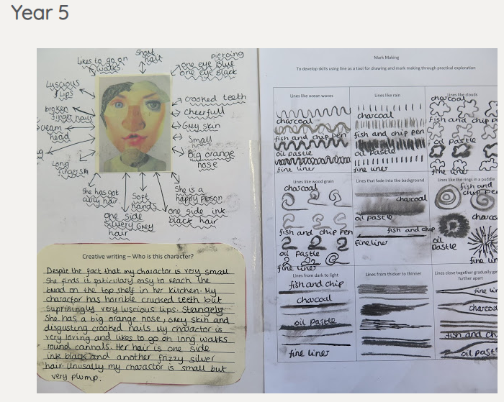
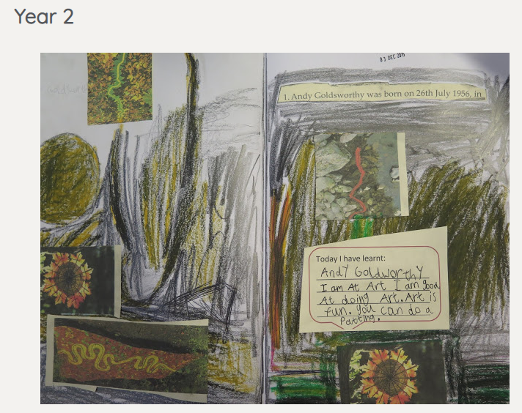
Explore ideas by …
1. Learning about other artist (Knowledge)
Start with a picture from a famous artist/craft person/architect and ask children to respond to it.
Learn more about that artist.
Write down what you think.
What you can see.
How it makes you feel.
What does it remind you of?

Slide 12
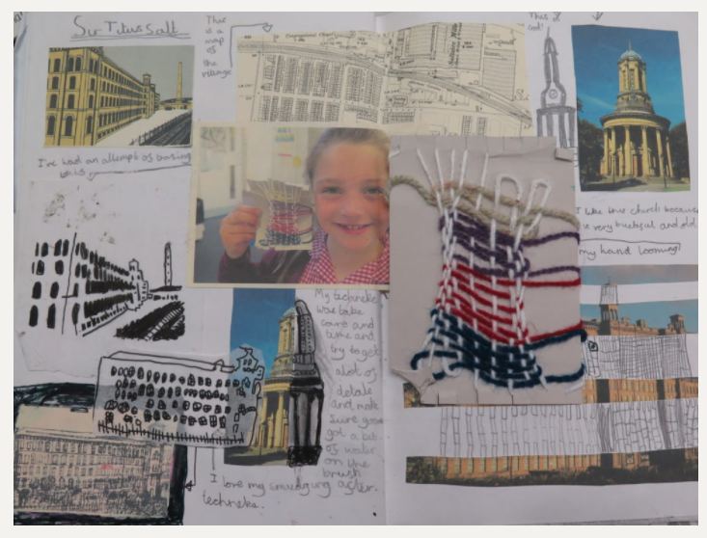
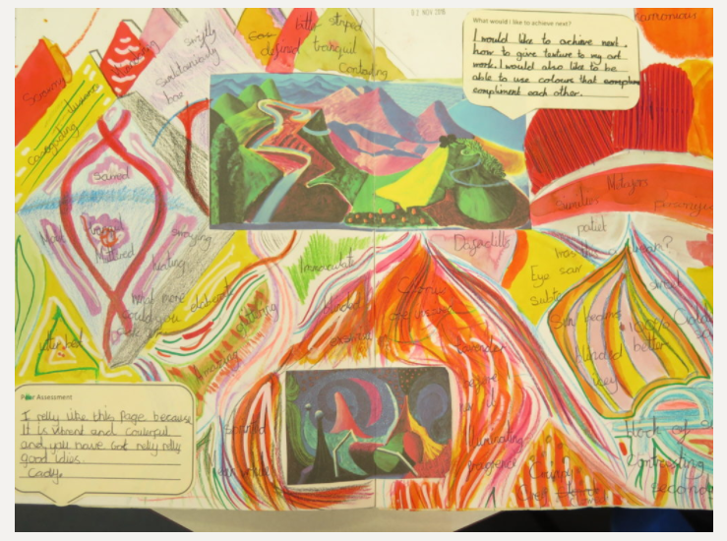
Explore ideas by …
2. Experimenting with my ideas (Ideas for art)
Have a go at drawing/painting/
Collaging/sewing etc in the style of that artist.
Have a go at warm up exercises to experiment with different mediums/shapes etc.
It is important to give children choice in their artistic journey if you want to create independent artist. For example always offer them more than one material to make marks with.

Slide 13
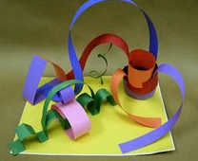
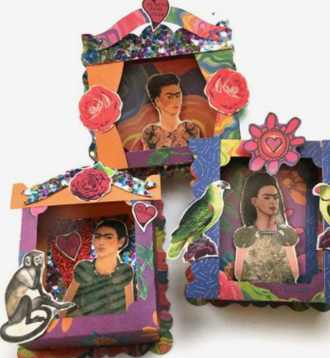
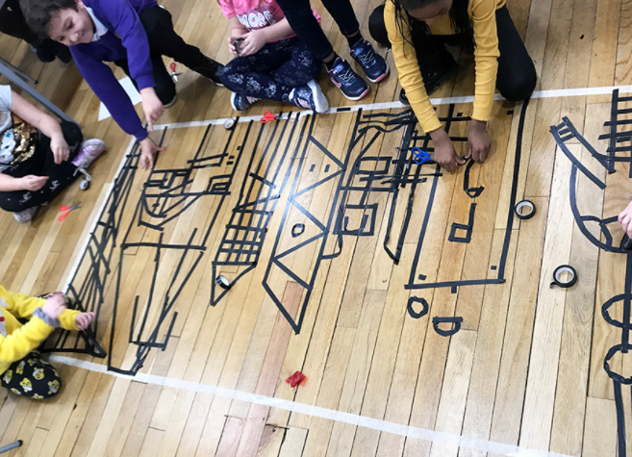
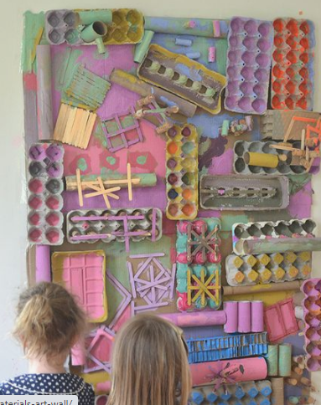
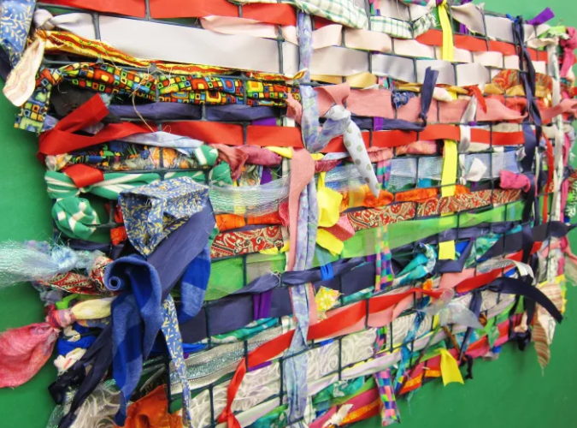
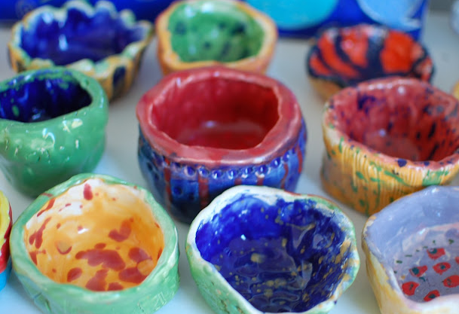
Explore ideas by …
3. Making art.
Put all their ideas together into a final piece.

Slide 14
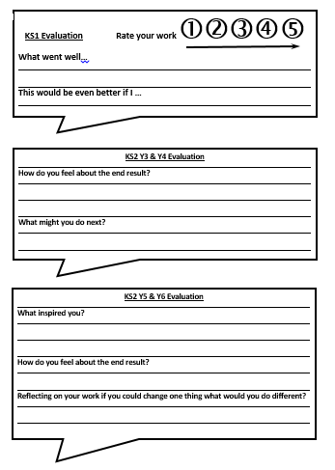
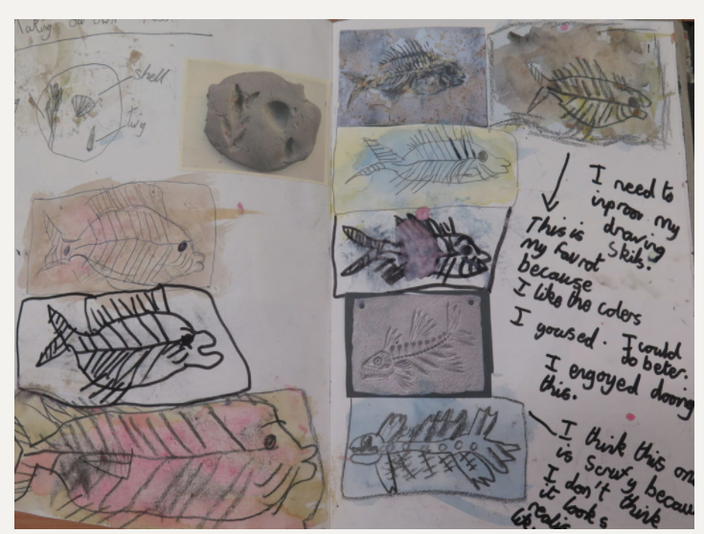
Explore ideas by …
4. Evaluating art
Ask children to evaluate their work.
Evaluate twice, once on the 3rd week using art evaluation bubbles and then evaluate at the end of the process.
Review their own practice.
Older children can share critical dialogue with others and evaluate each others work.
Work should not be rubbed out or thrown away. Children can just make annotations and visual corrections.

Slide 15
Sketchbook
Advice and Guidance

Slide 16
ALL ART work should be completed in sketchbooks and if it isn’t, then it needs to be stuck in or photographed and stuck in.
Teachers – you need to have a sketch book too, there are loads in the art cupboard…please help yourself – good for modelling to the children, your visualizer is your friend!
Demonstrate that you are enjoying art, talk out loud about what you are doing in your sketch book, say “I can do this, what can you do?” Take away the “white fright” of the page for the children.

Slide 17
Sketchbooks should give children the opportunity to explore, create and reflect on their work.
Sketchbooks shouldn’t be perfect – they should be full of ideas, good bits, bad bits etc.
Don’t expect too much in one lesson, work for shorter bursts and build in time for talk/discussion and reflection.

Slide 18
IN EVERY LESSON there should be a plenary where the children write a short reflection in their sketchbook about what they learnt or a reflection of what they have done.

Slide 19
On the next few slides, there are examples of sketchbooks from a Primary school called Gomersal.
They have an experienced art teacher, a dedicated art studio and each student receives half a day of art each week!
Think of them as the GOLD STANDARD of sketchbooks!
Ofsted have worked with Gomersal and have used them as a kind of “benchmark” of what is expected in sketch books.
PLEASE DO NOT WORRY!
I know that our sketch books do not look like this at the moment but please just have these in mind when you next work with your children and their sketchbooks.

Slide 21
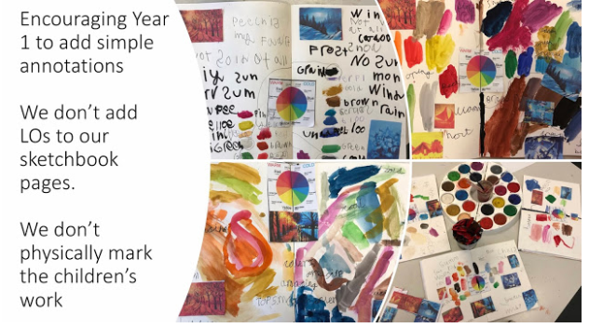

Slide 23
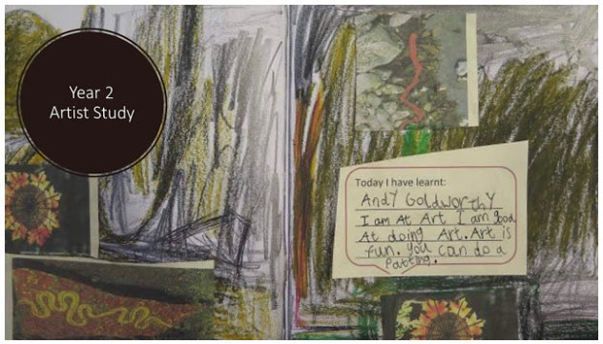

Slide 24
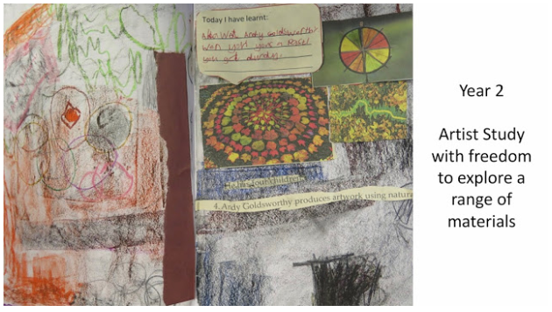

Slide 25
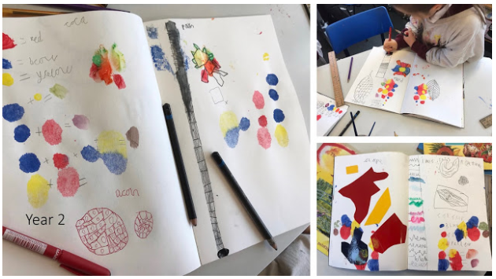

Slide 26
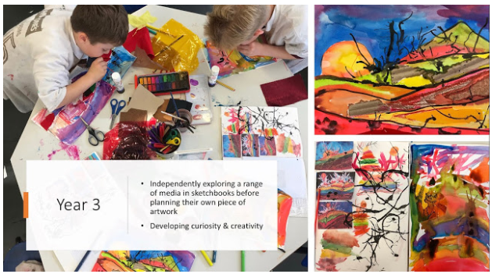

Slide 28
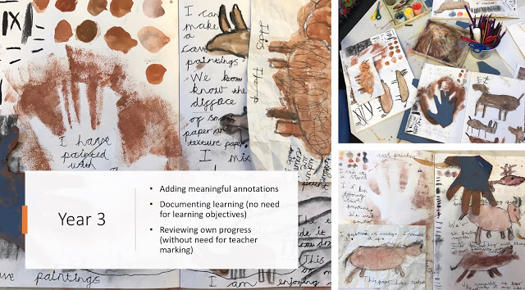

Slide 33
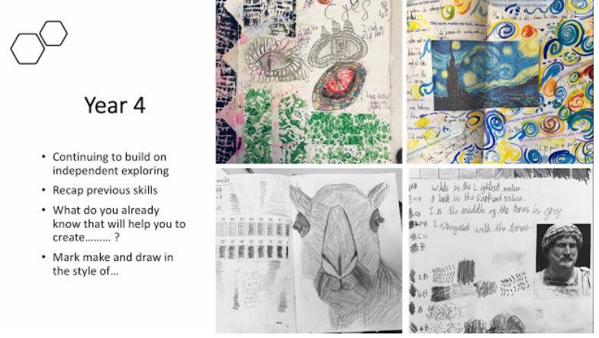

Slide 34
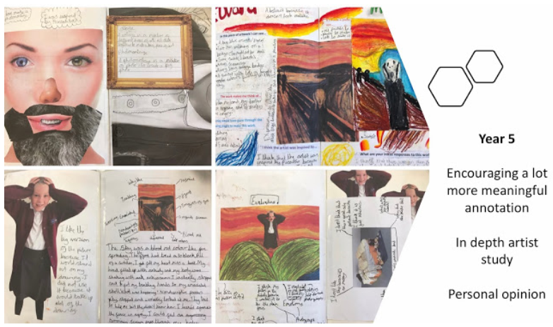

Slide 35
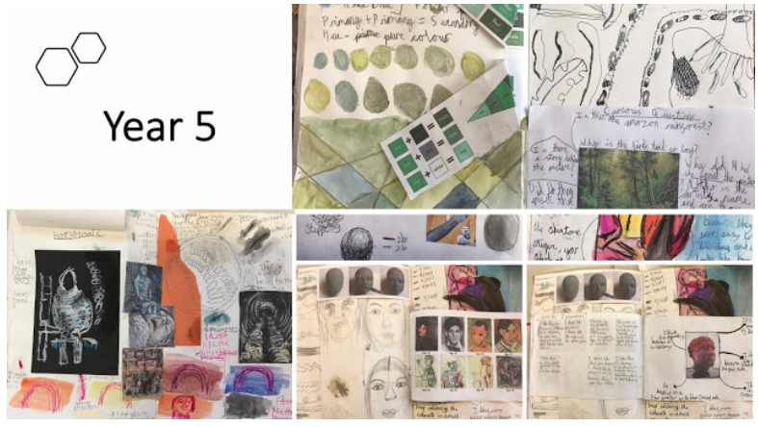

Slide 36
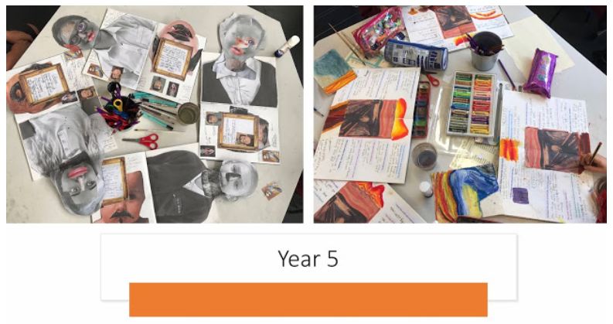

Slide 37
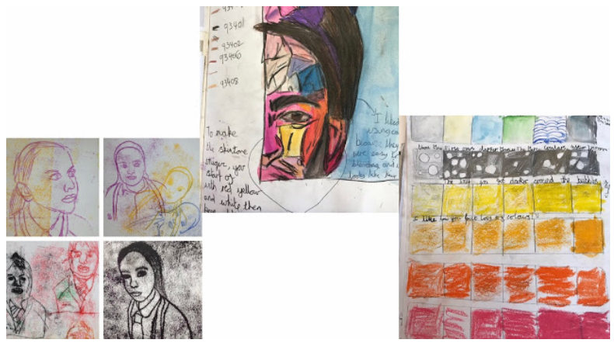

Slide 38
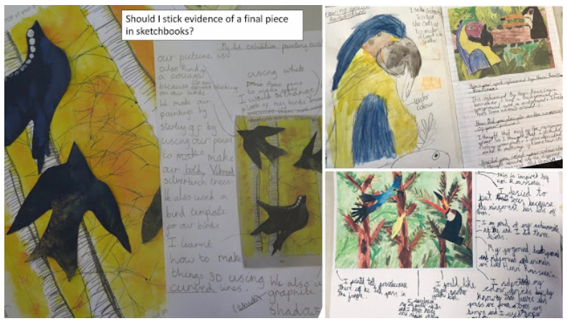

Slide 39
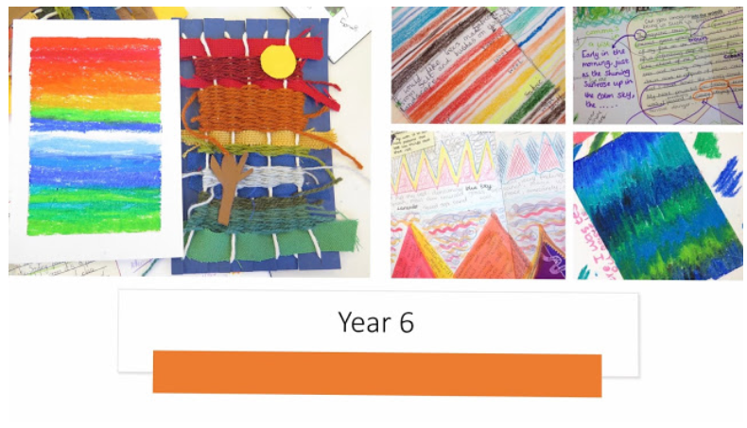

Slide 40
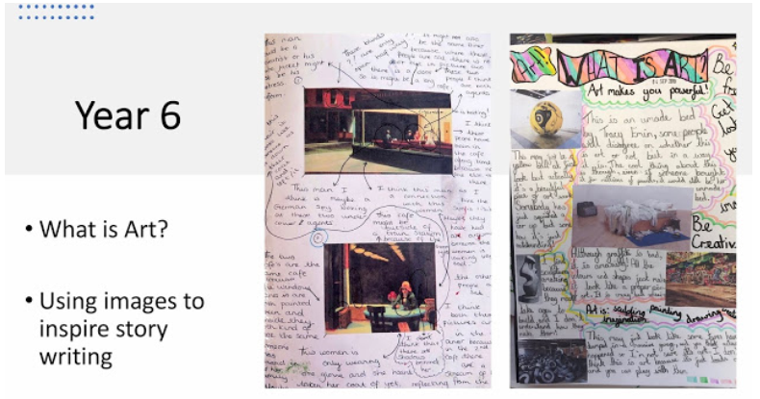

Slide 43
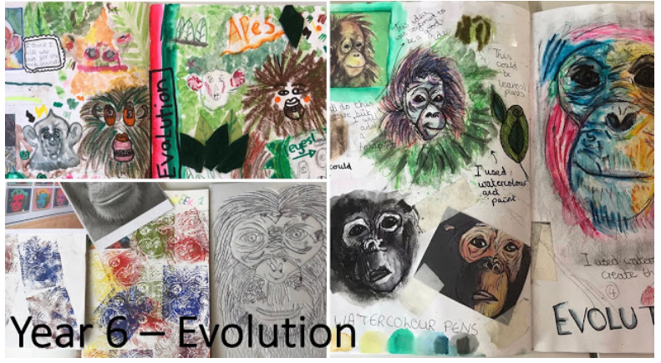

Slide 44
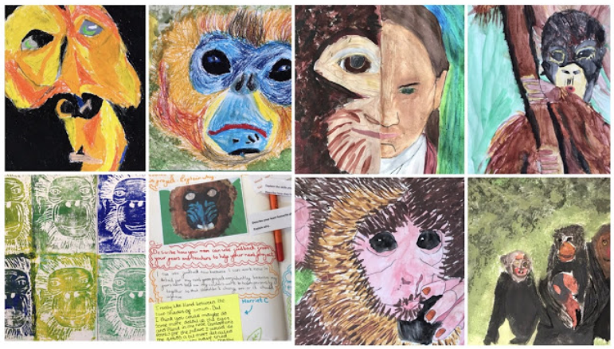

Slide 45
So, to summarise…
ALL ART should be completed in sketchbooks and if it isn’t, then it needs to be stuck in or photographed and stuck in.
Sketchbooks should give children the opportunity to explore, create and reflect on their work.
IN EVERY LESSON there should be a plenary where the children write a short reflection in their sketch book about what they learnt or a reflection of what they have done.

Slide 46
Our turn:
In our year groups, use your sketchbook to start your journey for next year.
Look at your first unit of work.
Look at the progression skills and make a note in
your sketchbook writing it as a short title.
Discuss who the artist is that you will look at and research using the chromebooks. Make notes and some small sketches to go along side this.
Think about what materials children will use.
What will the end results look like? Make notes in your sketchbook, ready for when you get to this stage.

Slide 47
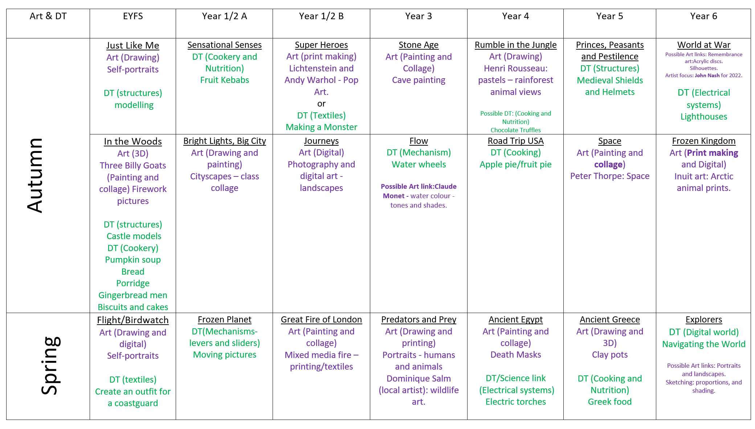

Slide 48
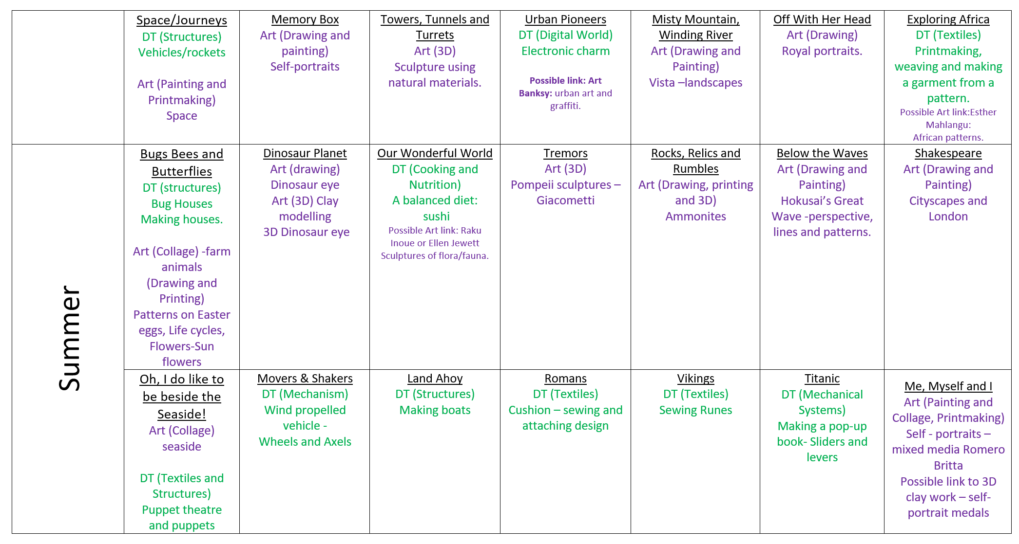

Slide 49
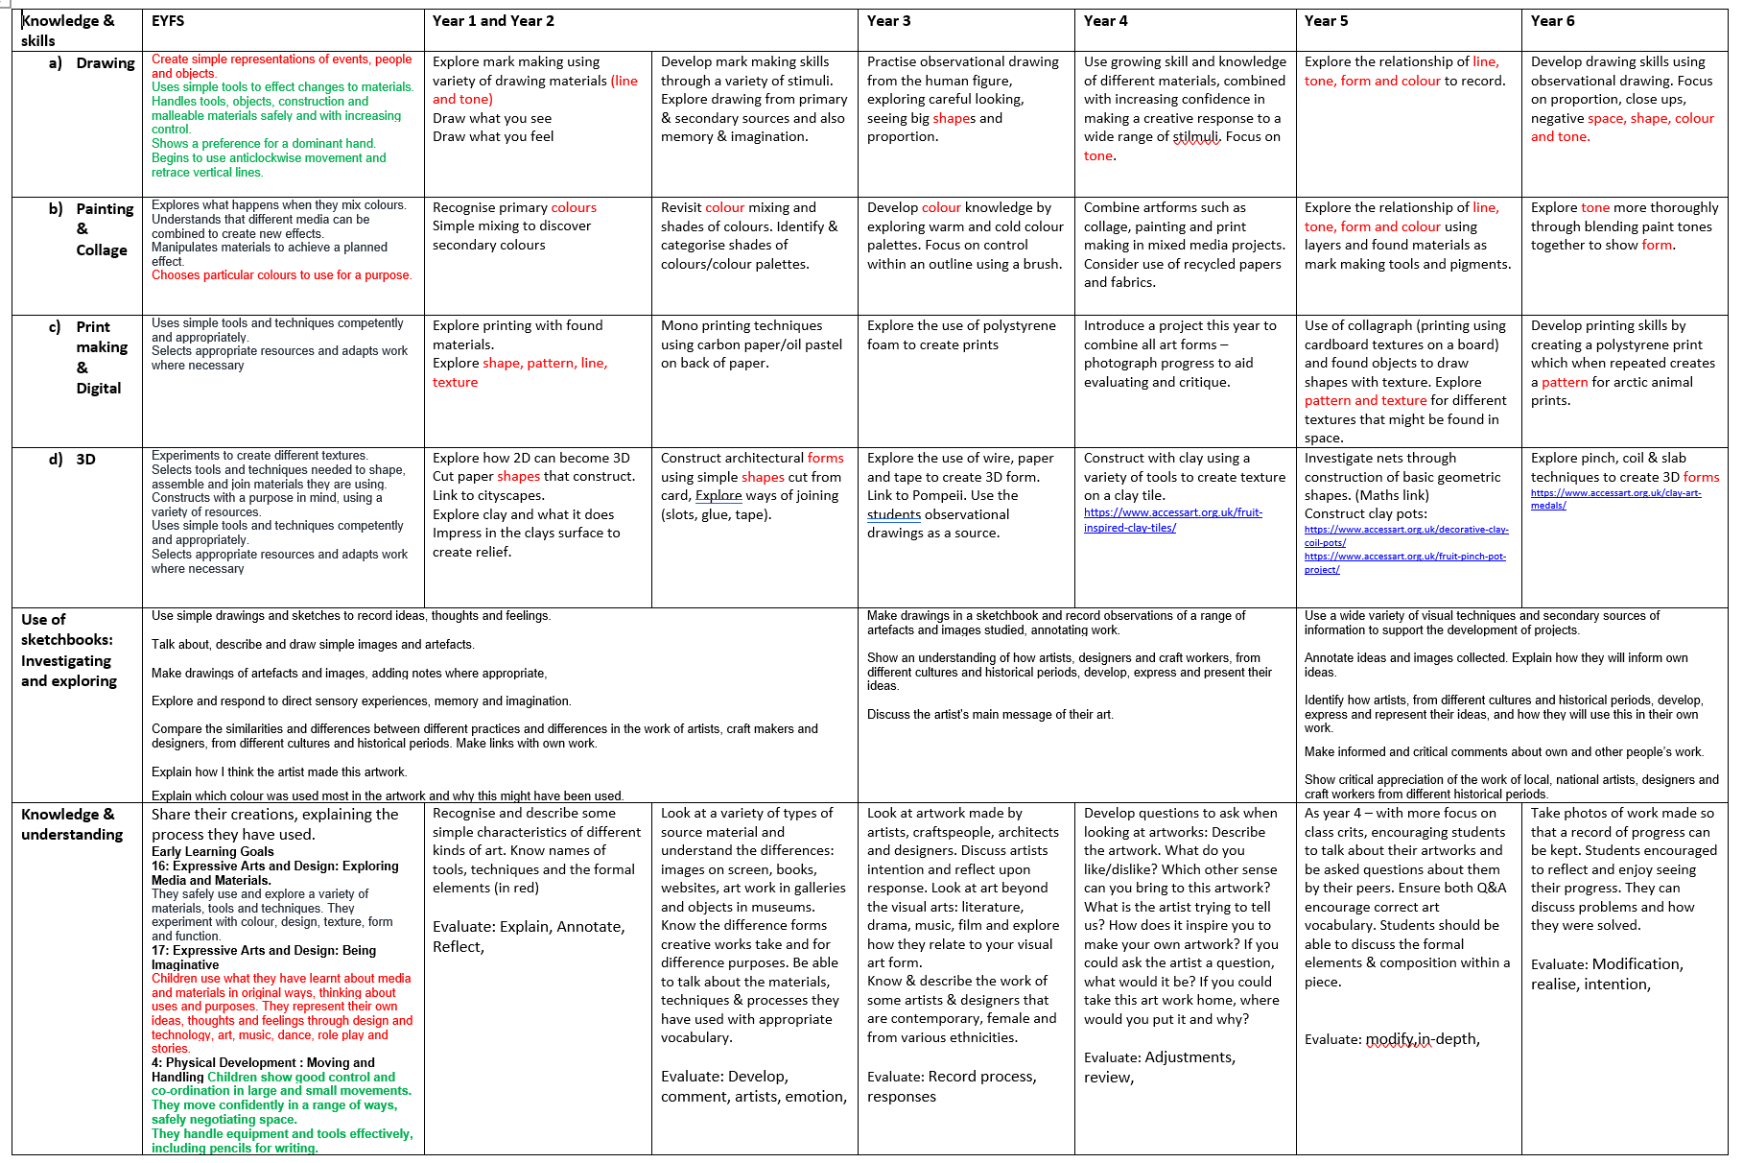

Slide 50
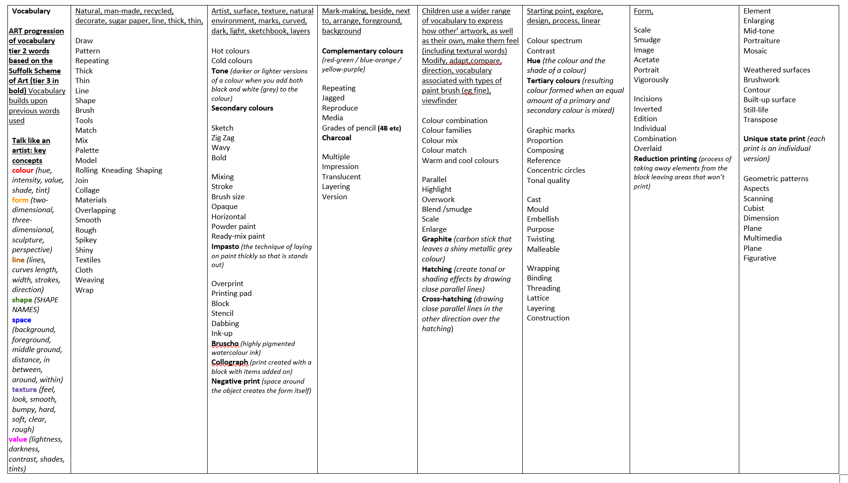

Slide 52
Discussion Questions Year 1 and 2
Assessment is a holistic practice, which takes place during every art lesson through conversations with pupils
Tell me about what you are making
What might you do next?
Tell me about what you made.
Which materials might you use?
What have you discovered?
What would you like to explore more of?
Remember ‘Creativity is a fragile process that is hard to measure and assess and should always be nurtured and supported’.
Discussion Questions Year 3 and 4
Assessment is a holistic practice, which takes place during every art lesson through conversations with pupils
Tell me about that you are making and what inspired you.
What might you do next? Tell me about the materials and techniques you are using.
What have you discovered?
How do you feel about the end result?
Tell me about things you really liked or enjoyed.
What would you like to explore more of?
What kinds of problems did you encounter and how did you get round them?
Remember ‘Creativity is a fragile process that is hard to measure and assess and should always be nurtured and supported’.
Discussion Questions Year 5 and 6
Assessment is a holistic practice, which takes place during every art lesson through conversations with pupils
Tell me about that you are making and what inspired you.
What might you do next? Tell me about the materials and techniques you are using.
What have you discovered?
How do you feel about the end result?
Tell me about things you really liked or enjoyed.
What would you like to explore more of?
What kinds of problems did you encounter and how did you get round them?
What is the potential of what you have done? What would you do next?
Remember ‘Creativity is a fragile process that is hard to measure and assess and should always be nurtured and supported’.

