Slide 1


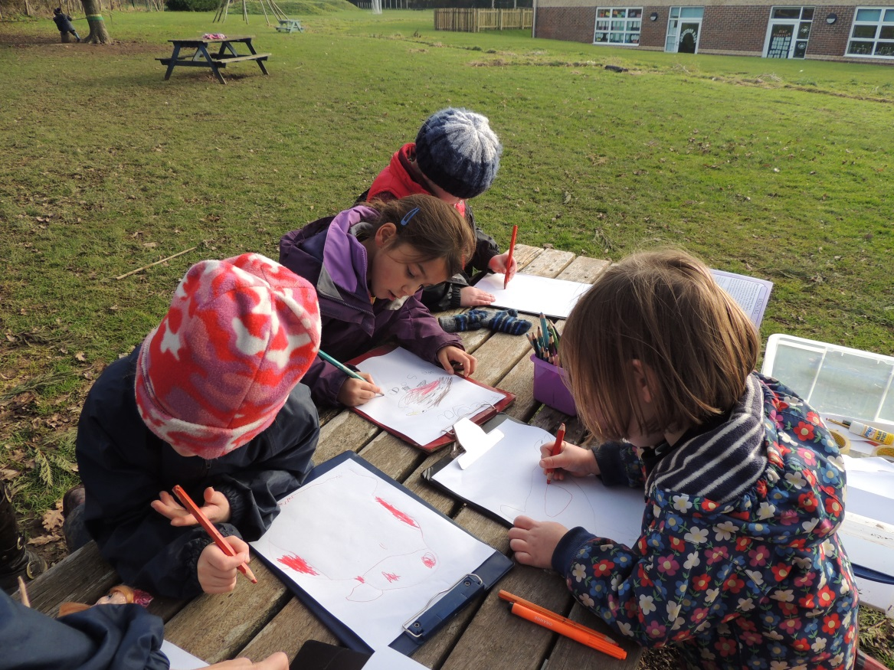
New Assessment Information for Parents

Slide 2
In this session we will be looking at……
Why have levels been removed?
The future of primary assessment.
How are we working with our locality of schools?
What does good quality assessment look like?
How are we tracking pupils progress during these changes?

Slide 3
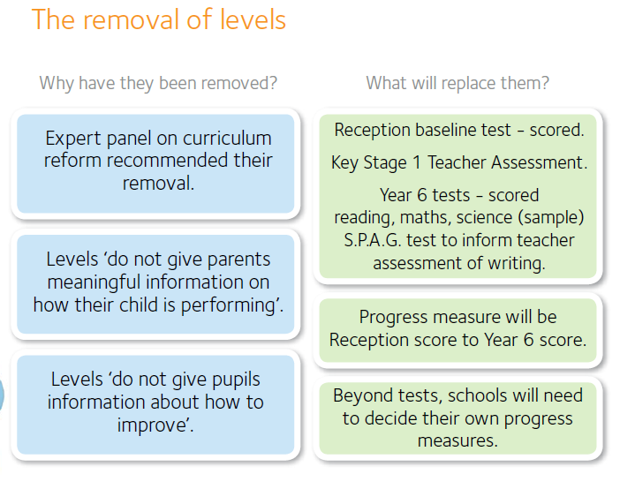
Why have levels been removed?

Slide 4
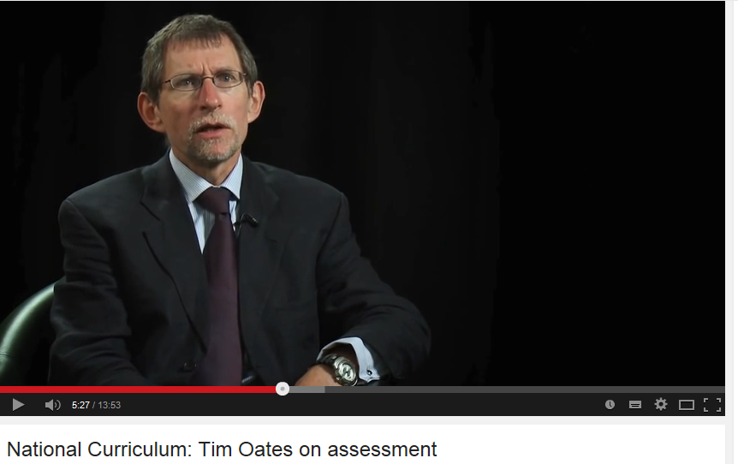
Tim Oates

Slide 5
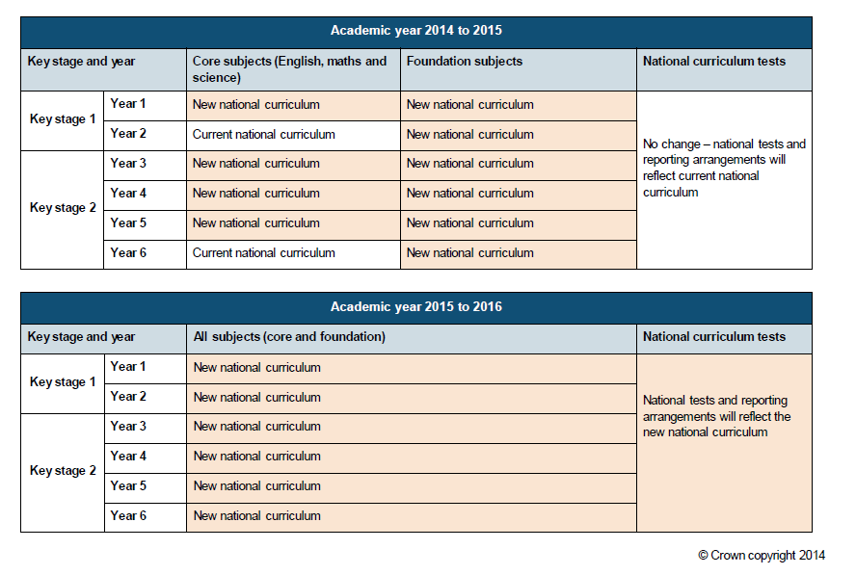
The future of Primary Assessment..

Slide 6
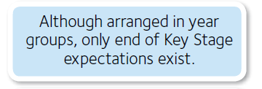
What are schools expected to report to parents?
Ofsted do not have any predetermined view as to what specific assessment system a school should use. Inspectors’ main interest will be whether the approach adopted by a school is effective. They will be looking to see that it provides accurate information showing the progress pupils are making. The information should be meaningful for pupils, parents and governors.

Slide 7
How are we working with our Locality Schools?
Weald Locality Agreed aims and Principles for Assessment

Slide 8
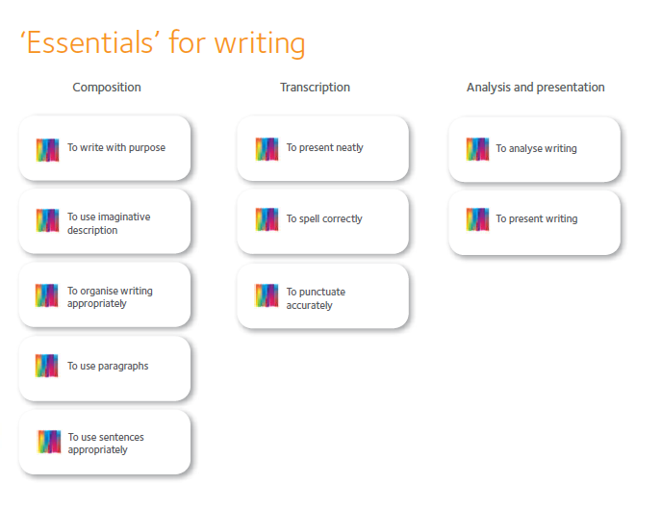
Essentially the skills remain the same throughout the curriculum it’s about the depth of understanding and confidence in independent application of these skills in an increasing range of contexts.

Slide 9
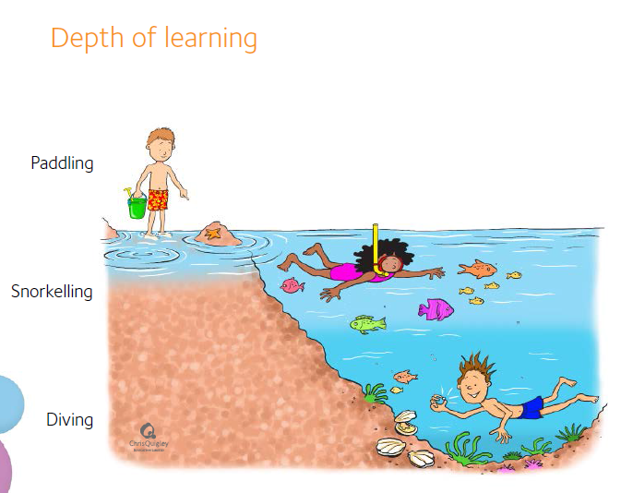

Slide 10
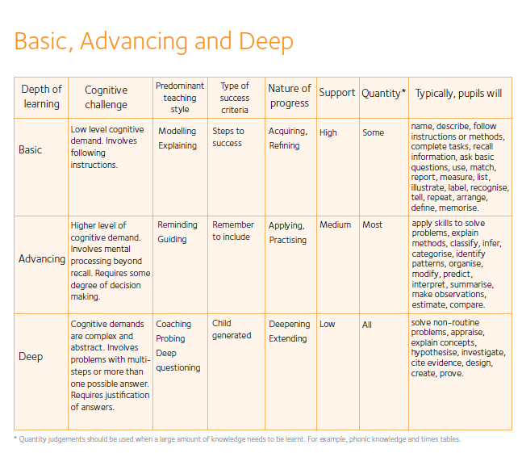

Slide 11
Good Quality Assessment
Rich open-ended tasks
No ceilings
Investigation, problem-solving, choice
Group work, dialogue
Integral to teaching and learning
The principles of good assessment have not changed. Stick with what you believe in.

Slide 12
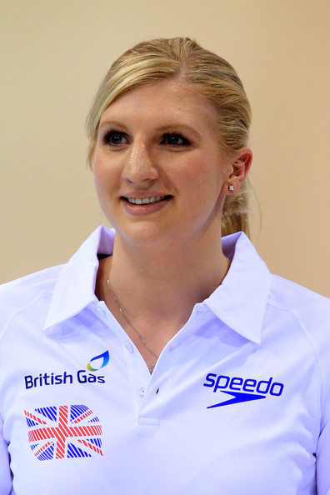
I can swim 50m….. So can Rebecca Adlington!

Slide 13
How are we currently tracking pupil progress whilst these changes are implemented?

